Slide 1
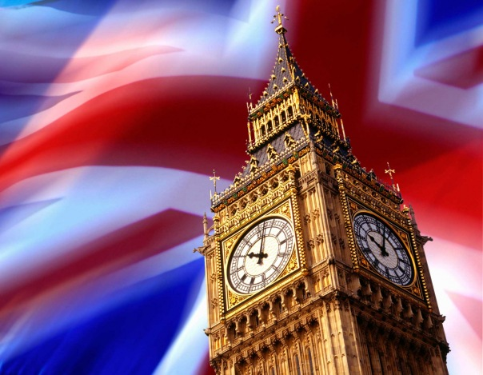
Викторина - Хорошо ли ты знаешь Великобританию?
Презентацию составила
Берг Наталья Валерьевна
учитель
английского языка
МОУ СОШ № 21 г. Раменское

Slide 2
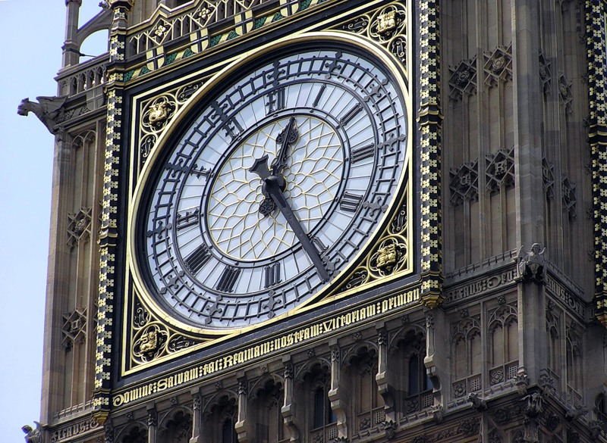
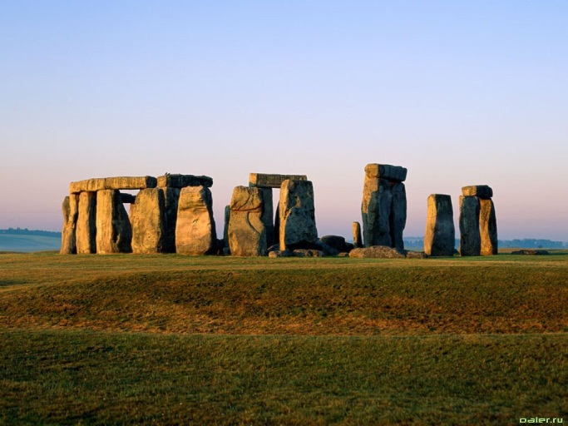
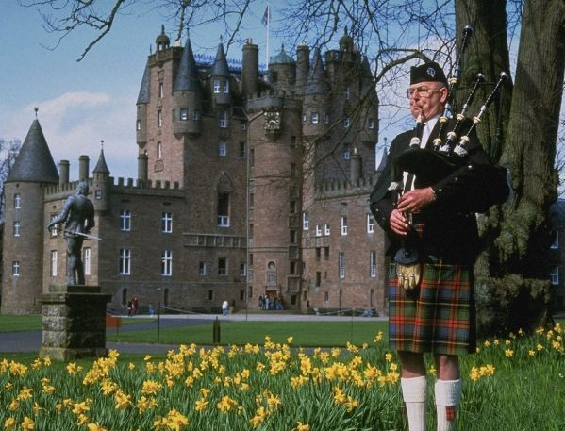
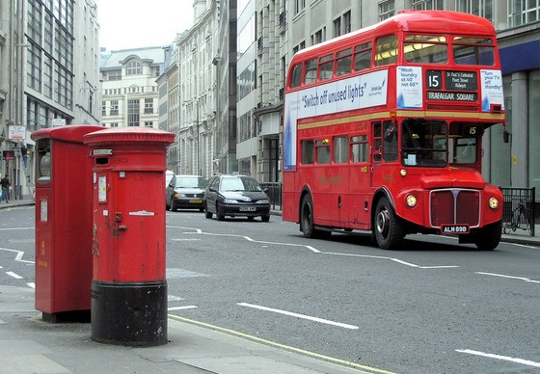
Quiz
Do You Know Great Britain Well?

Slide 3
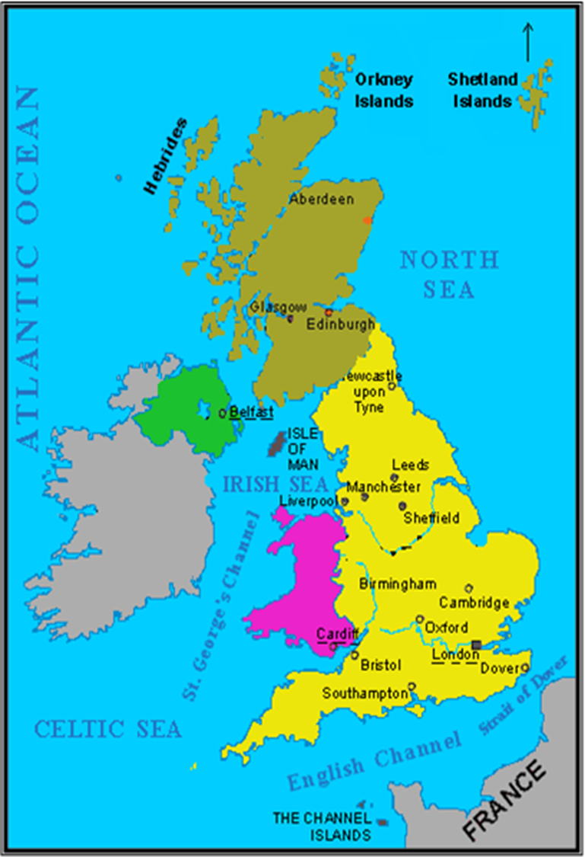
This wonderful country has many different names: Great Britain, the UK, England or just Britain.
What is
the official name of the country?

Slide 4
The United Kingdom of Great Britain and Northern Ireland (the UK)

Slide 5
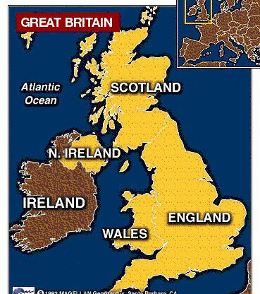
Name four parts of the UK
England
Scotland
Wales
Northern Ireland

Slide 6
What are the main colours of the Union Flag?

Slide 7
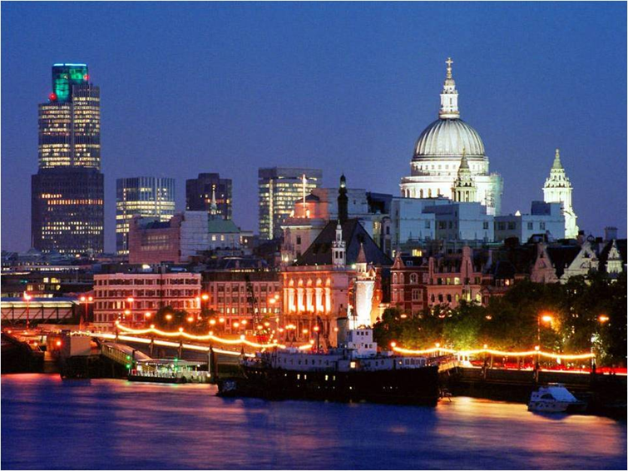
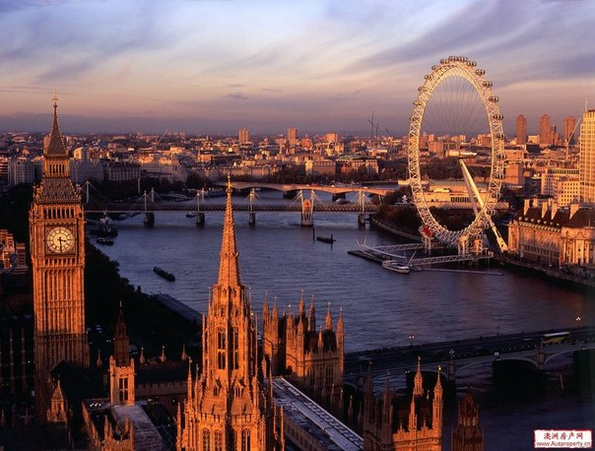
What is the capital of England?
LONDON is the capital of England.

Slide 8
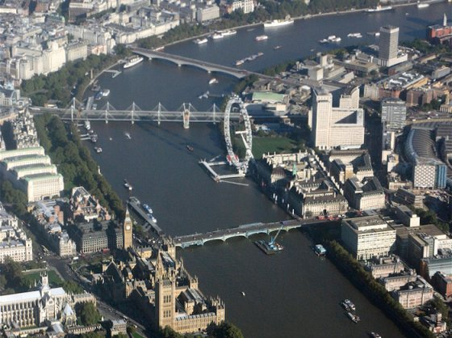
What river is London situated on?

Slide 9
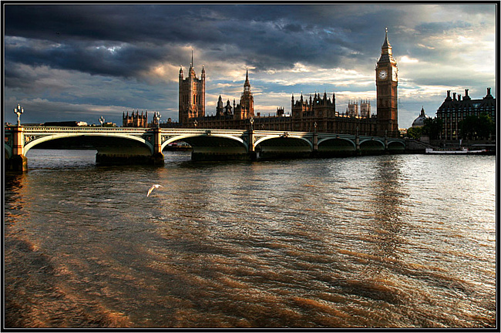
London, the capital of Britain, is situated on the river Thames…

Slide 10
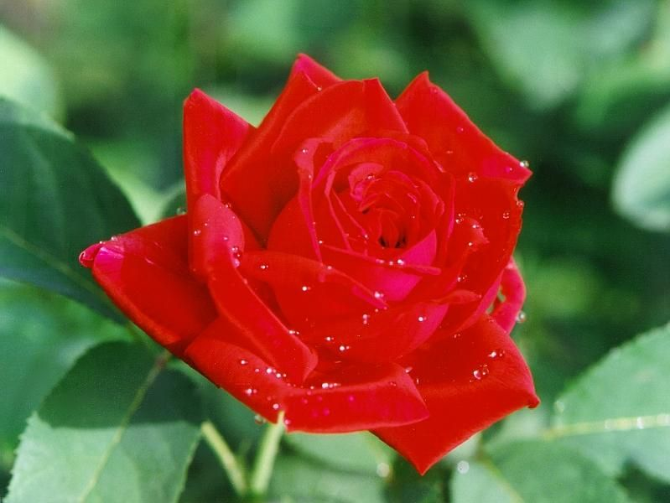
What is the symbol of England?

Slide 11
What is the name of the famous clock in London?

Slide 12
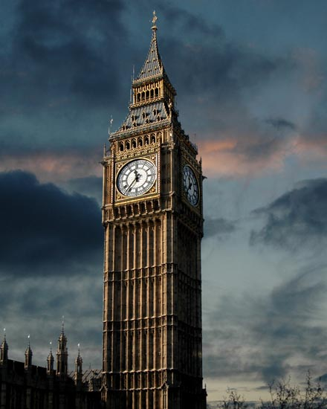
Big Ben

Slide 13
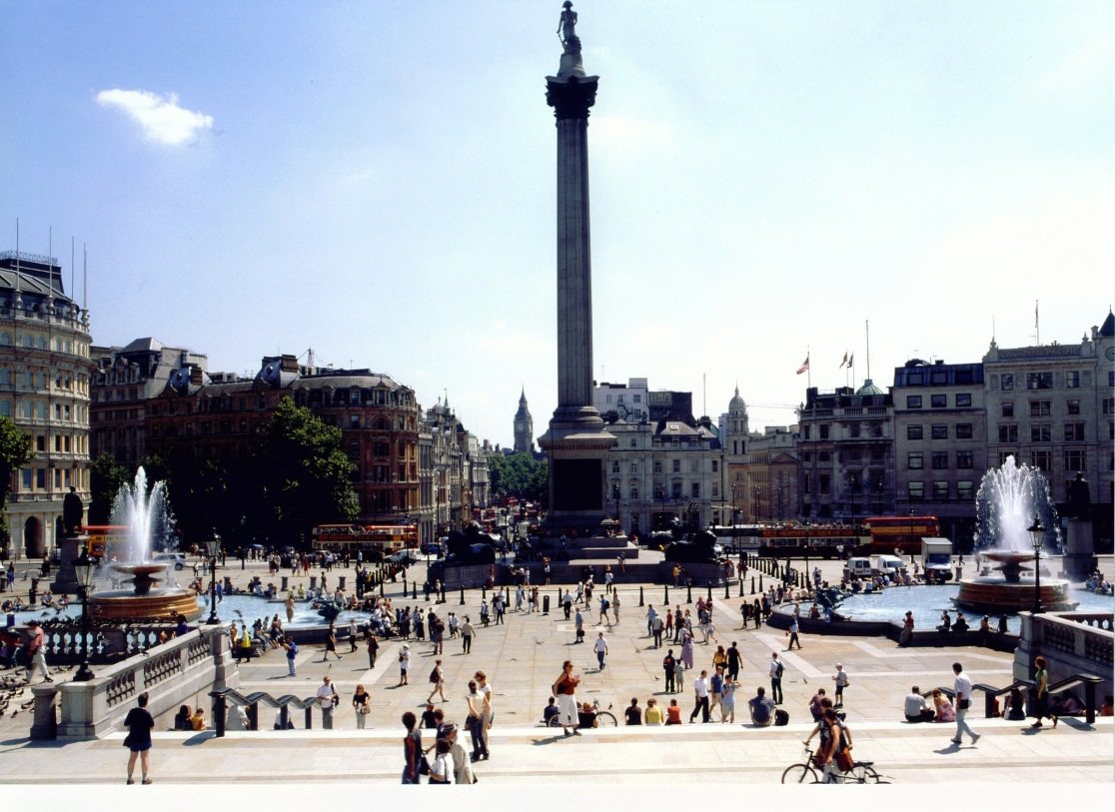
What is the main square in London?
Trafalgar square!

Slide 14
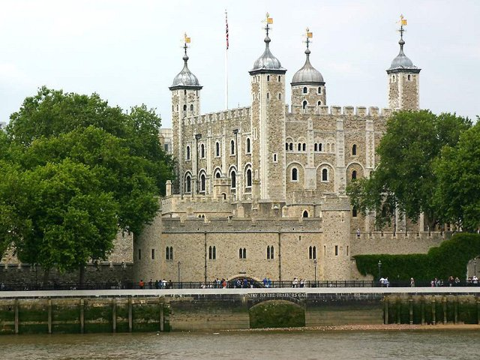
Where can you see ravens in London?
In the Tower

Slide 15
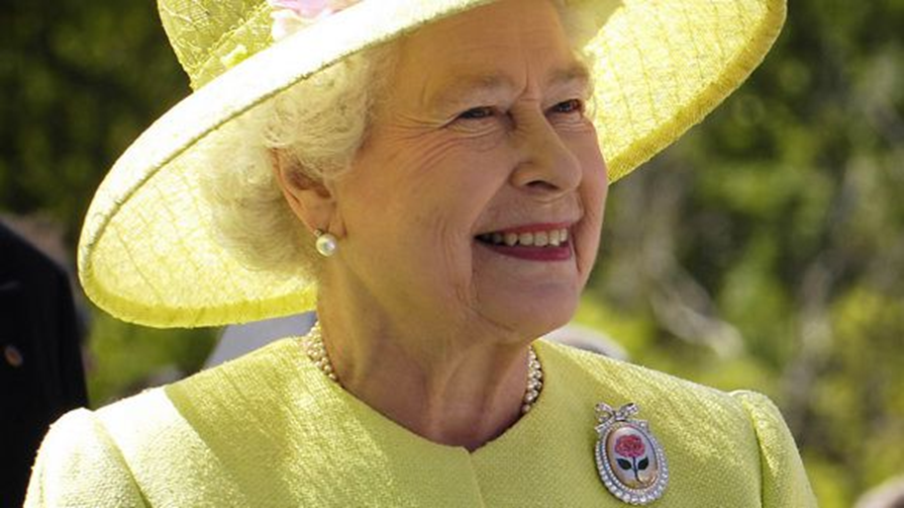
Who is the Head of State in Great Britain?
The Queen Elizabeth

Slide 16
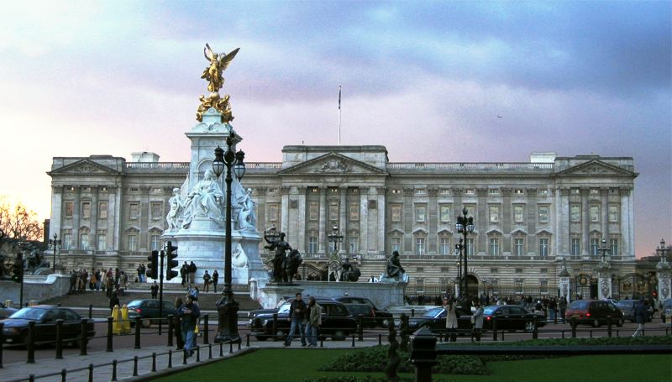
Where does the Queen live?
Buckingham Palace is the official residence and the London home of the Queen!

Slide 17
Name the place where the Parliament works.
The Houses of Parliament are the place where Parliament works!

Slide 18
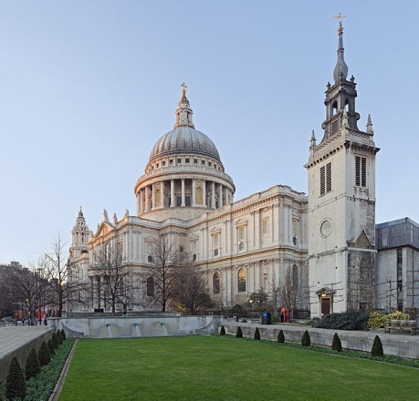
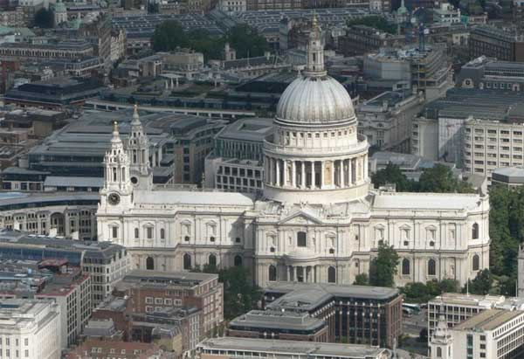
What is St. Paul’s Cathedral? a) Church b) Tower c) Bridge

Slide 19
Who lived in Sherwood Forest?
Robin Hood did.

Slide 20
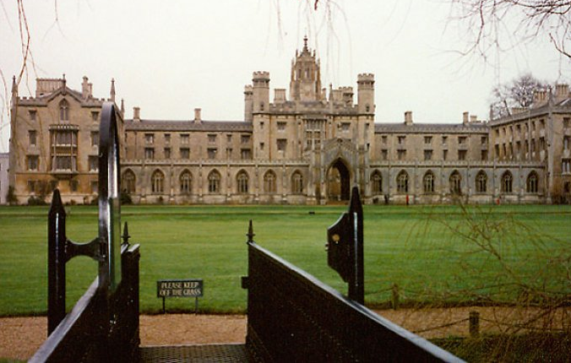
What are the largest and the oldest universities in Britain?
Oxford university
cAMBRIDGE university

Slide 21
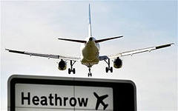
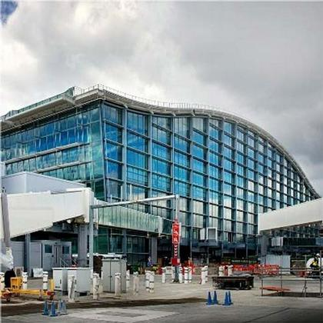
What is the famous airport in London?
Heathrow Airport

Slide 22
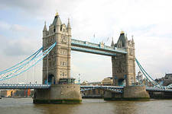
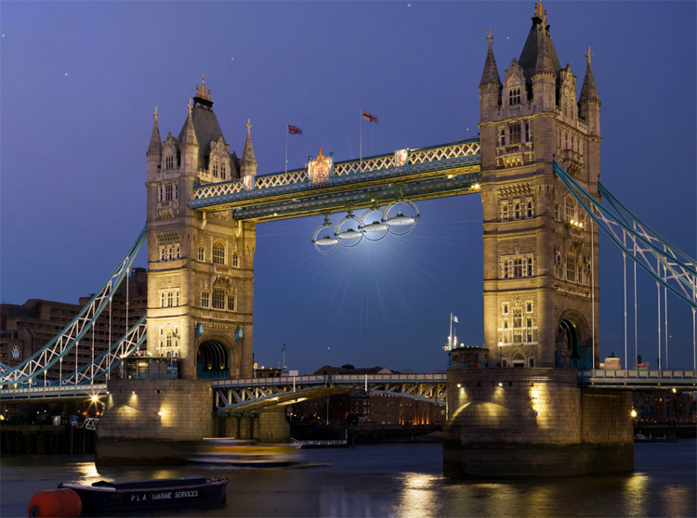
What is the most famous bridge of London?
The Tower Bridge

Slide 23
What is the favourite hot drink in Britain?

Slide 24
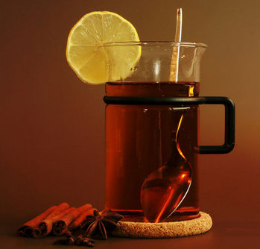
What is the difference between English and Russian tea?

Slide 25
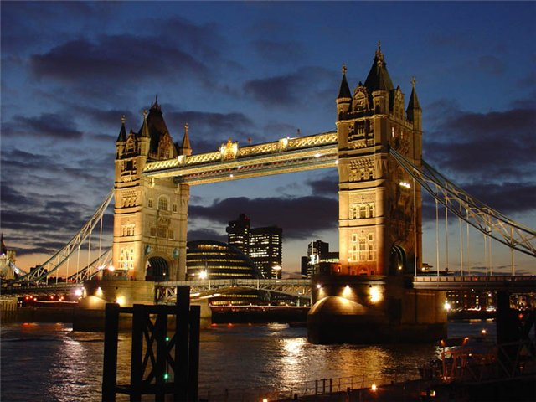
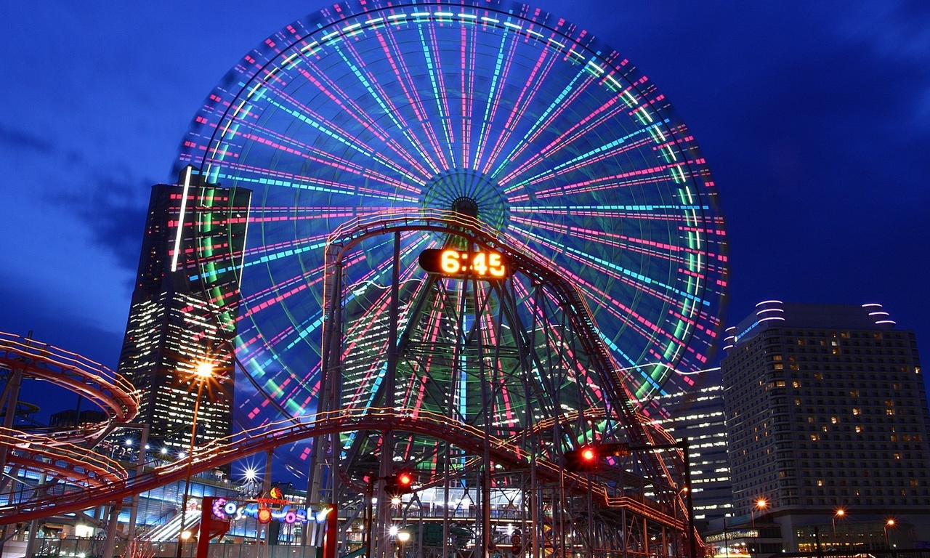
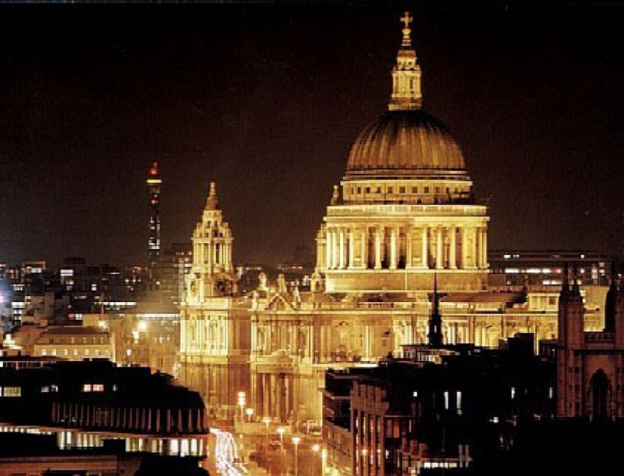
Well done!!!
Goodbye!!!

Slide 26
Sources
Http://obozrevatel.com
Http://dinternal.com.ua
http://formen.hilat-hina.info/?idnt=host&categs=%D1%8D%D0%B4%D0%B8%D0%BD%D0%B1%D1%83%D1%80%D0%B3
Http://900igr.net
Http://dmitryvolkov.ucoz.ru
http://sochi-hottours.ru
http://news.intv.ua
http://music.2krota.com
http://tour.pavlin-travel.ru
http://letotravel.com
http://bigpuzzle.ru
http://elviraz.ucoz.ru
http://butorrent.com
http://ducktour.ru
http://consumer-club.com.ua
http://trikky.ru
http://kiwikids.beon.ru
http://europansion.ru
http://sonora-ltd.ya.ru
http://kurortbest.com
http://altapress.ru
http://1gsa.ru
http://schools-wikipedia.org
http://terra-nostra.ru
http://tury.ru
http://pochemuha.ru
http://about-britain.ru/goroda-velikobritanii/oksford.shtml
http://kudapostupat.by/article/item/id/244
http://air-tours.ru/news/khudshij_mezhdunarodnyj_aehroport_mira/2009-10-24-872
http://vkontakte.euromag.ru/great_britain/8139.html
http://www.dreams-travel.kiev.ua/site/country.php?lang=RU&id_country=31&spec=on&id_spec=10532
http://www.drive2.ru/users/alex2121/blog/288230376151782140/
http://7news.in.ua/tech/health/250999/
http://mport.bigmir.net/tonus/cocktail/1502720
http://recepti.kz/interesno/page/17/
http://pgall.com/displayimage.php?album=6&pid=1166

