Slide 1
ENVIRONMENTAL
PROTECTION

Slide 2
VOCABULARY
environment-окружающая среда chlorofluorocarbons- хлорофторуглеводы
protection-защита to release-выбрасывать
surroundings-окружение refrigerator-холодильник
development-развитие conditioner-кондиционер
crowded-переполненный to increase-возрастать
nuclear-ядерный skin-кожа
pollution-загрязнение cancer-рак
noise-шум to weaken-ослаблять
destruction-разрушение immune-иммунная
alarming-тревожный danger-опасность
acid rain-кислотный дождь to fill-заполнять
to suffer from-страдать от waste-отходы
depletion-истощение chemical-химический
ozone-озон fertilizer-удобрение
layer-слой pesticide-пестицид
to protect-защищать to die-умирать
ultraviolet-ультрафиолетовый following-следующий
ray-луч brink-край(обрыва, пропасти)
to damage-портить, наносить ущерб extinction-вымирание

Slide 3
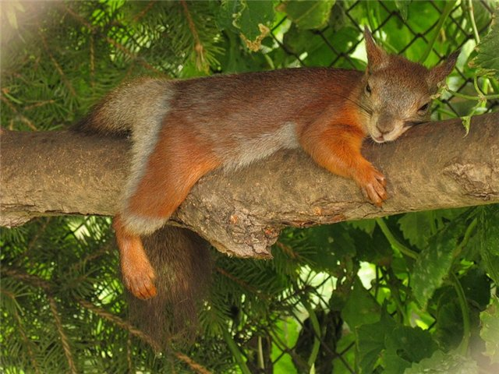
Translate the words and
say what part of
speech they are:
To pollute, pollution, environment, poisonous, ecological, radiation, greatly, universal, protection, harm, harmful, nature, natural, biology, biologist, protect, science, scientific, care, careless.

Slide 4
Say what ecological
problems are of people’s great concern nowadays. You may use the following words:

Slide 5
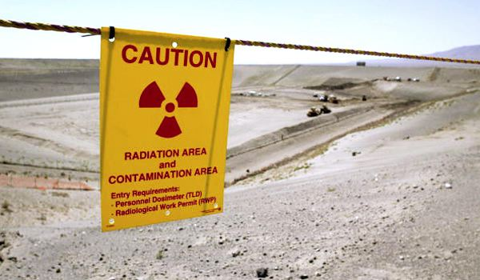
NUCLEAR POLLUTION… very dangerous!!!!!

Slide 6
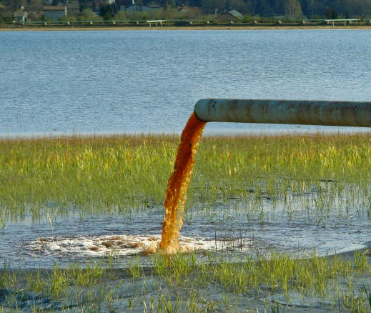
WATER POLLUTION: ugly rivers of dirty water, to pollute water with factory waste, polluted fish, dead rivers, to be concerned about the purity of water, waste of chemical plants.

Slide 7
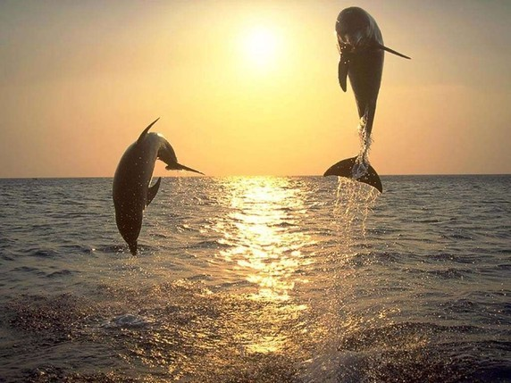
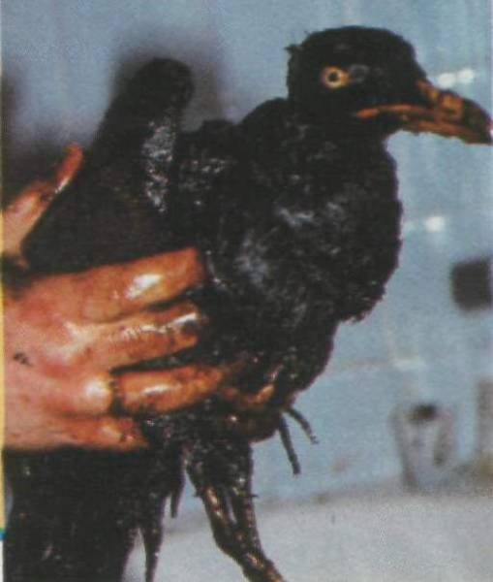
Water must be clear….
What is ecological problem caused by?

Slide 8
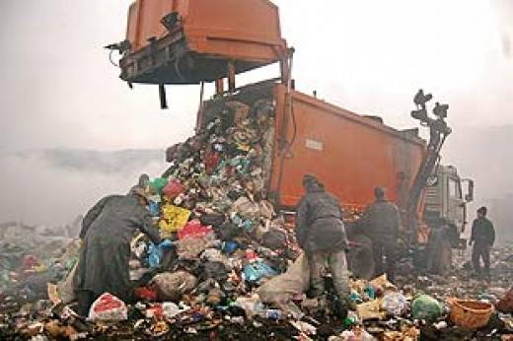
LAND POLLUTION: dead land, lifeless arenas, to turn the land to a desert, forests are cut and burn in fire.

Slide 9
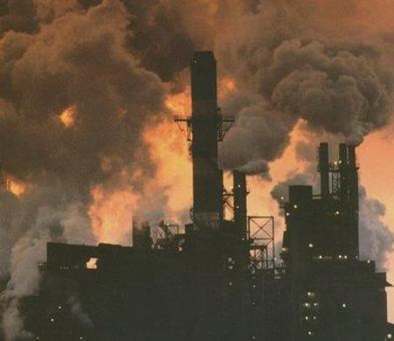
AIR POLLUTION: fume from the chimneys, the release of harmful substances into the air, to be covered with soot and dirt, smog over the city, hard to breathe, unhealthy environment, smoke clouds

Slide 10
Complete the sentences, using the verb to cause, to be caused by ……..
1. Air pollution ………….
2. Soot and dirt in industrial cities………
3. Smoke clouds ……….
4. Polluted fish in rivers………..
5. Water pollution……….
6. Cutting of the vast forest……..
7. A great number of cars……….
8. Noise pollution………..

Slide 11
Match:
1)litter a)garbage on the ground or in the street
2)fence b)a special can for garbage
3)jail c)everything that a person can see
4)garbage can d)a walk that separates two places
5)view e)sickness
6)fine f)to manage or to stop
7)litterbug g)a number of people pay as punishment
8)disease h)money people as punishment
9)control i)a place people stay as punishment
10)group j)a person who throws litter

Slide 12
Pollution is spoiling the air you breathe!
Pollution is handing like a brown cloud over New York today. Dirt and smoke are pouring from cars and factories. Pollution is spoiling the air we breathe ,and it’s harming our health.
New York has a big problem these days. The city has dirty air. The air smell bad , and it look ugly. Pollution is a health problem, too, because it’s hurting people’s lungs.
This man thinks that pollution is dangerous. He doesn’t like the air, so he isn’t breathing it. He’s smelling a flower, and it smells good, but he doesn’t know it. He’s touching the flower with his mask, and the flower feels soft, but he doesn’t know it. He’s listening for birds, but he doesn’t hear any. He's looking for beauty, but he doesn’t see any. He believes that pollution is coming between us and the beauty of nature. He is trying to show his ideas with the gas mask. He wants people to work together now and to make the air cleaner soon.

Slide 13
Answer the questions.
1.What is handing like a brown cloud over New York today?
2.Where are the dirt and smoke coming from?
3.What is pollution doing to our air and to our health?
4.What problem does New York have?
5.How does the air smell and look?
6.Why is pollution a health problem?
7.Why is the man wearing a gas mask?
8.Why doesn’t he like the air?
9.What does he think about pollution?
10.What is he trying to do?

Slide 14
Using the scheme below describe the ecological situation. Try to answer the following questions.
What makes ecological situation the most serious problem nowadays?
Why do we consider man’s interference in nature careless?
What measures should be taken to solve the problem of environmental protection?

Slide 15
Ecological situation.
Man’s interference In nature
Planet-wide problems
Environmental protection
Creating a system of ecological security
Cutting of the Vast forests
Greenhouse
effect
Poisoning of the world’s air, land, water
Acid rains
Environmental protection agencies
Global warming
Industrial by-products
Ozone depletion
Massive deforestation
International organization Greenpeace
Chemical fertilizers and pesticides
Upsetting of oxygen balance
Radioactive substances

Slide 16
Vocabulary
Careless interference - беззаботное вмешательство
The greenhouse affect - парниковый эффект
To upset the oxygen balance - нарушать кислородный баланс
Chemical fertilizers - химические удобрения
Deforestation - обезлесение

Slide 17
Translate the sentences from English into Russian in writing, using dictionaries.
Acid rains affect both plant animal life.
Environmental problems, relatively short have already been an object of a number of international discussions.
As the pollution of large cities continues to grow.
Since acid rains are a major threat to forests, possibilities of preventing them are being worked out.

Slide 18
Translate into English.
Кислотные дожди воздействуют как на животных, так и на растения.
Она возникла ( to appear ) в начале 70-х годов.
Сегодня в нее входят ( to number ) почти 2 млн человек из 15 стран.
Воздушное загрязнение вызывается ( to calls) дымом заводских труб.

Slide 19
The earth is our home and we must protect it…

