Slide 1
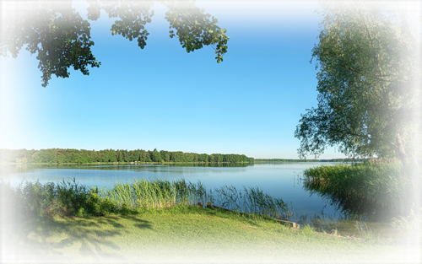
Hometown
Выполнила: Ученица 8 класса Башкирова Вероника

Slide 2
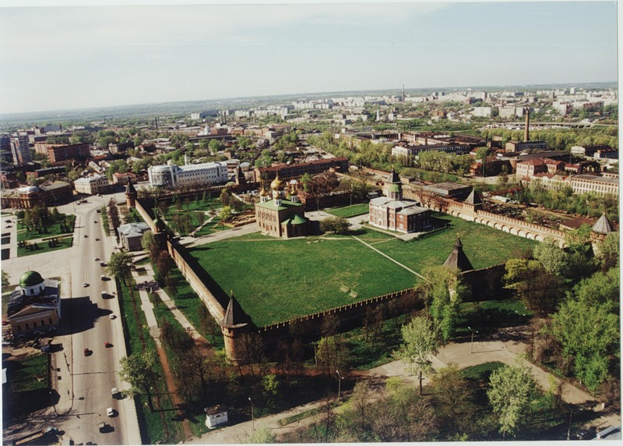
My hometown is Tula.

Slide 3
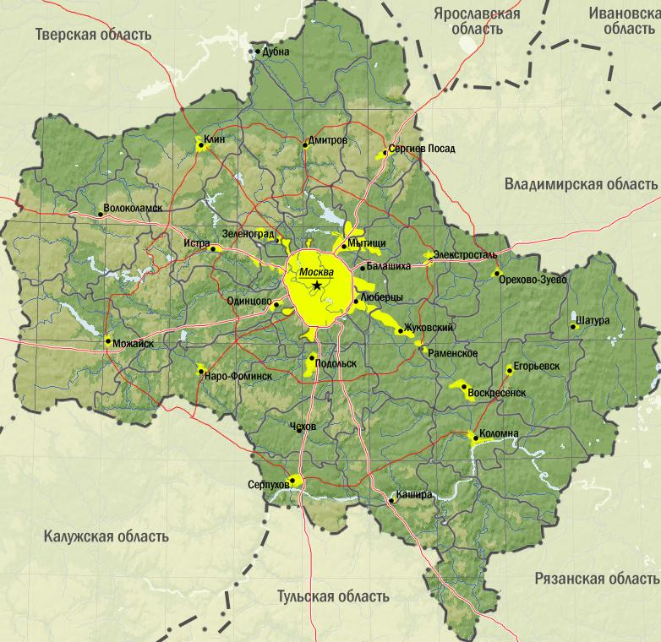
Tula is situated in the southeast of Moscow.

Slide 4
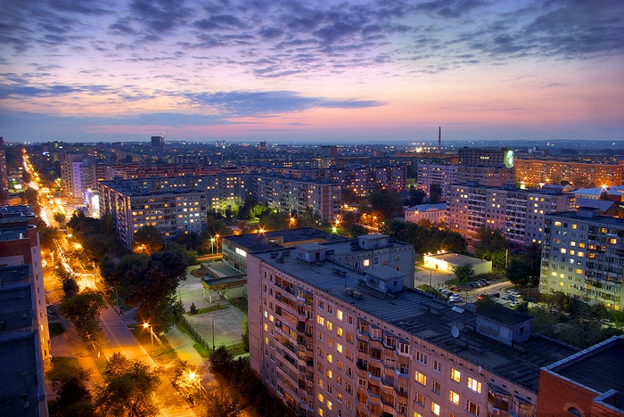
Though Tula is not as large as Moscow it has got many good aspects of a modern city.

Slide 5
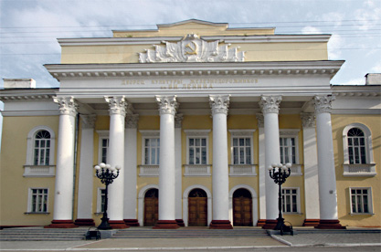
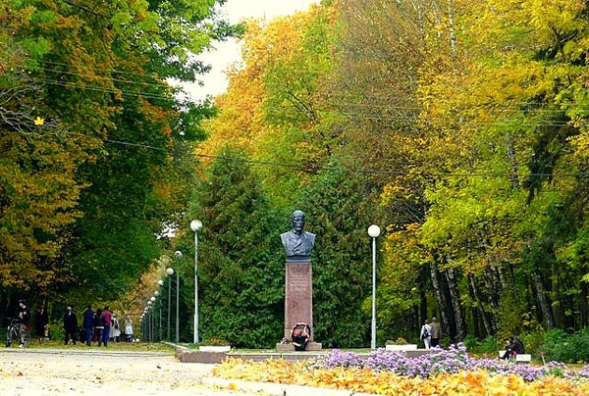
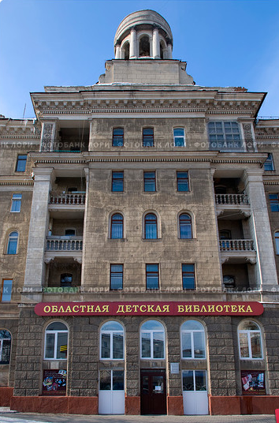
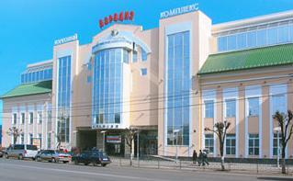
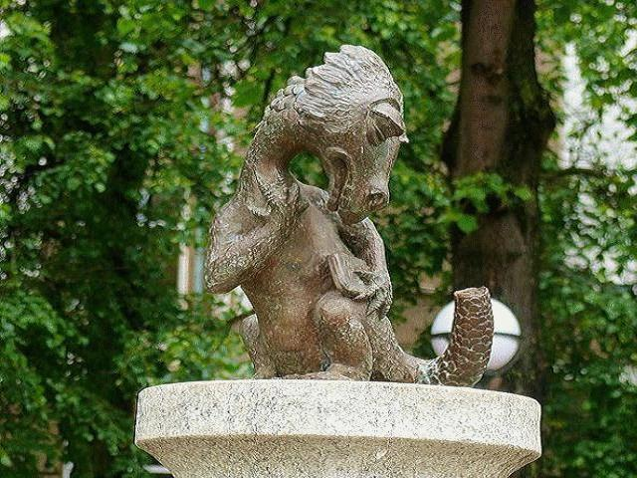
club
park
library
We’ve got
and much more
shop
grove monument

Slide 6
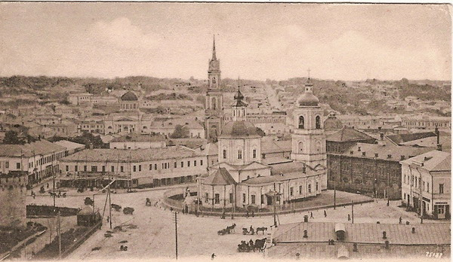
I love my hometown

Slide 7
It is a great city

