Slide 1
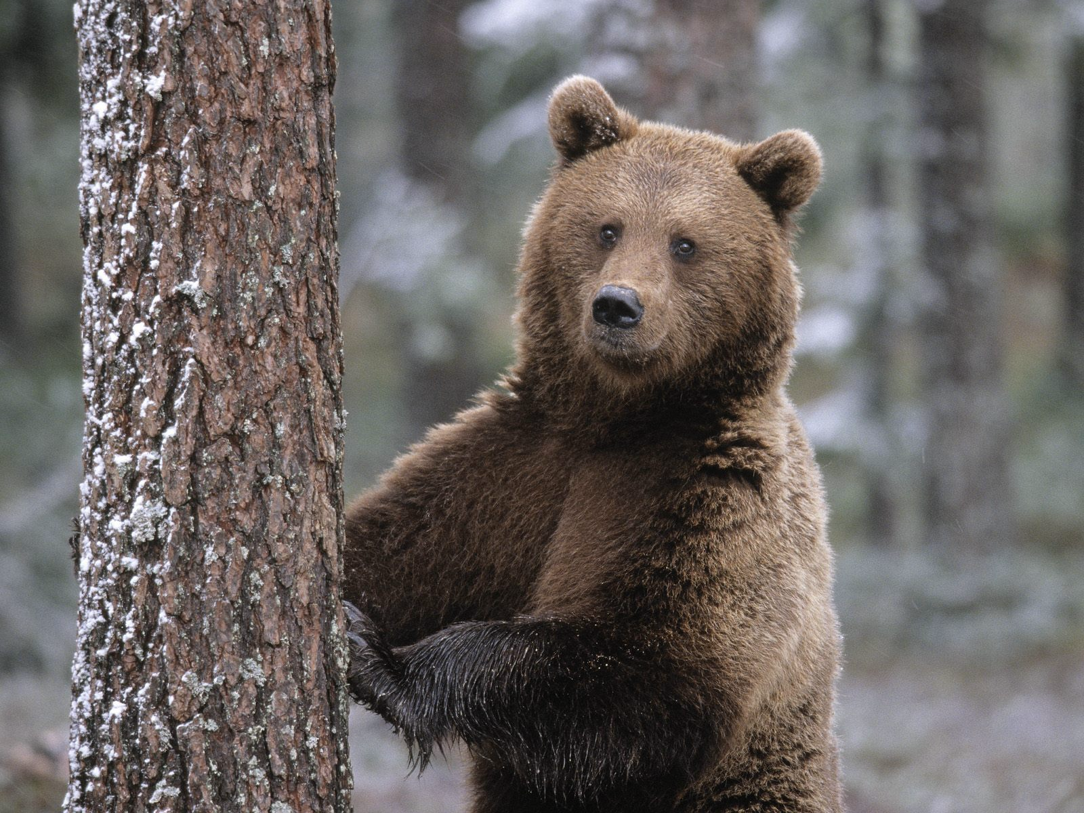
Brown bear
Dashkov Danil, 3a

Slide 2
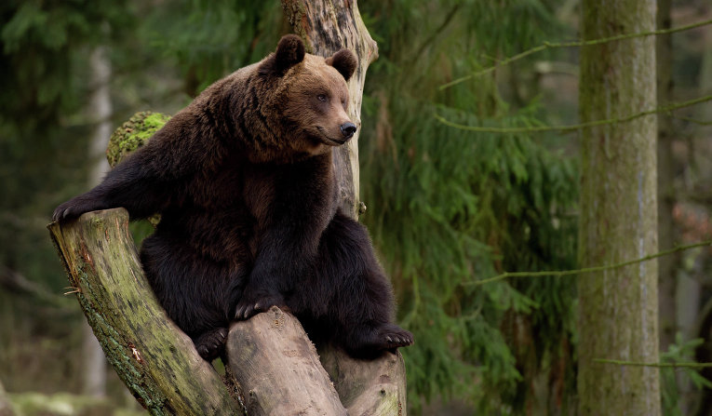
Brown bear
The brown bear likes to make its home in a tree

Slide 3
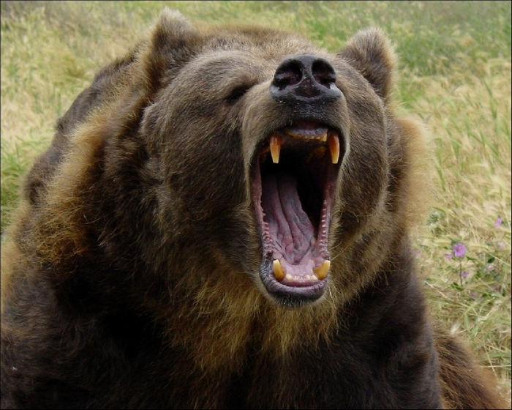
Brown bear
The bear lives in the forest
It is a big animal
It is very strong

Slide 4
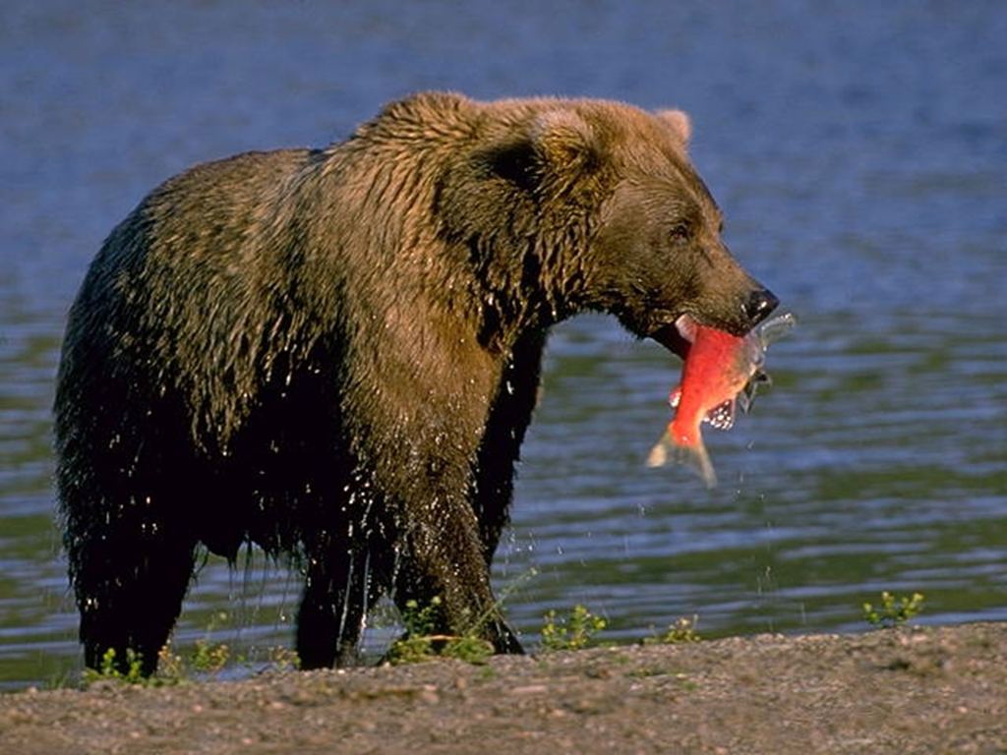
Brown bear
It likes to eat forest berries, honey, fish, small birds and animals too.

Slide 5
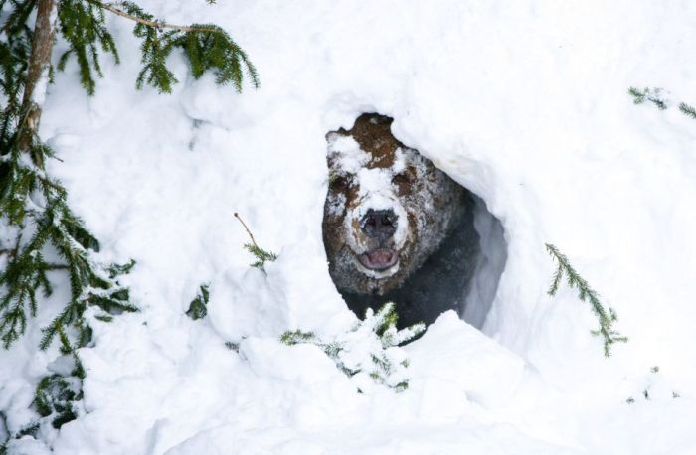
Brown bear
In winter the brown bear can`t see any food in the forest
So it goes to sleep
When it gets warm, the bear gets up and walks about the forest
It is very hungry and angry

Slide 6
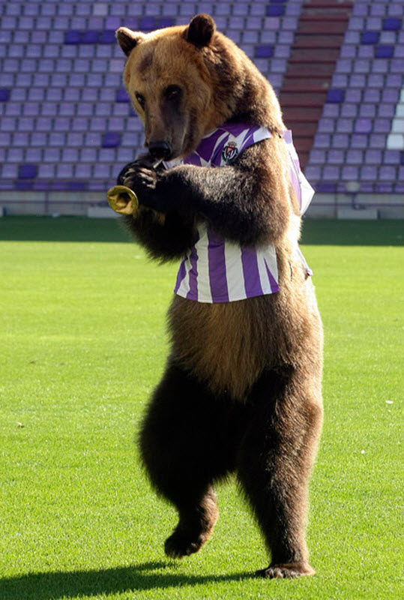
Brown bear
The brown bear
is very smart.
People can teach
it to dance, to ride
a bike and to play
hockey.

Slide 7
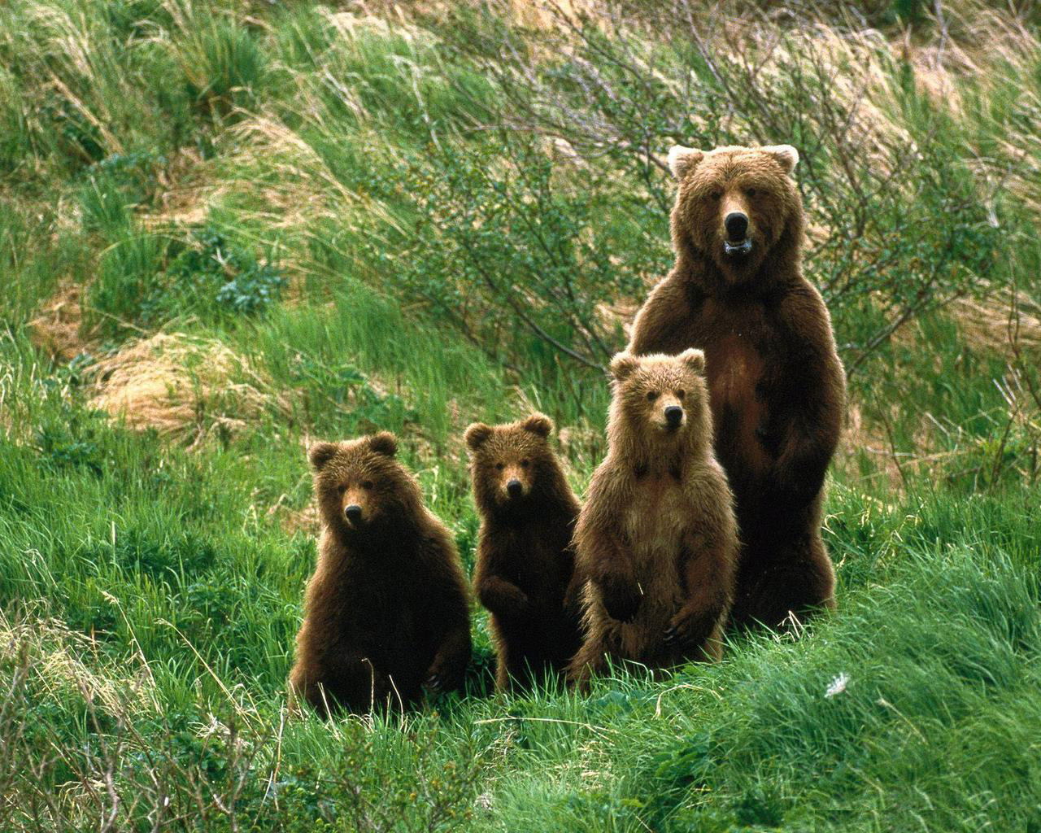
Thank you for your attention!

