Slide 1
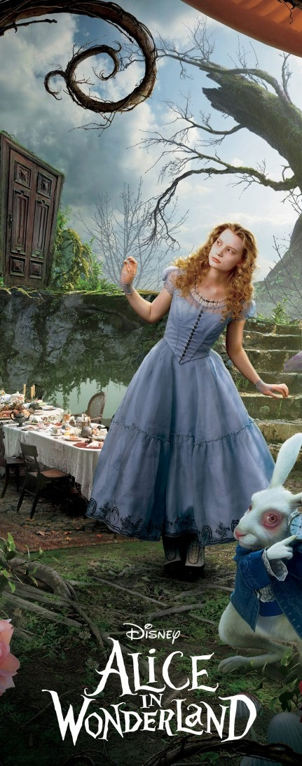
Alice in Wonderland

Slide 2
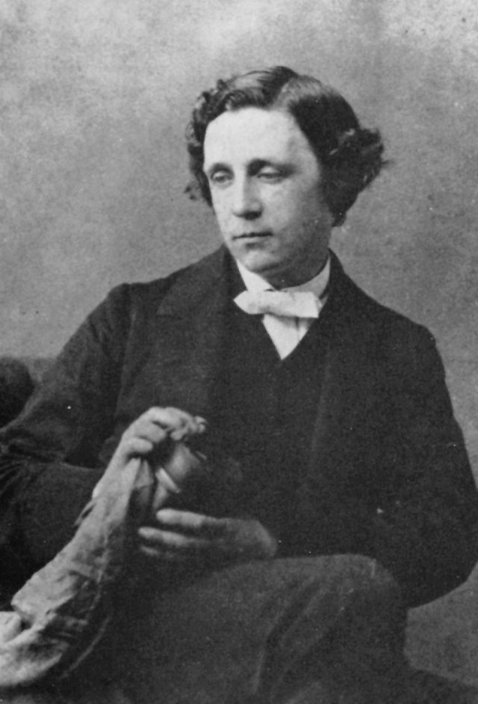
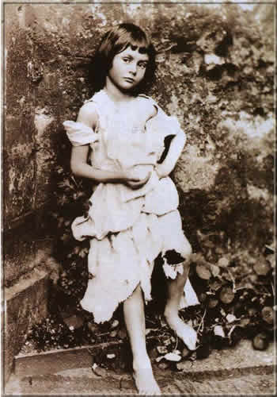
Charles Lutwidge Dodgson and Alice Liddell
Charles Lutwidge Dodgson ( 27 January 1832 – 14 January 1898), better known by the pseudonym Lewis Carroll was an English author, mathematician, logician, Anglican deacon and photographer. His most famous writings are Alice's Adventures in Wonderland and its sequel Through the Looking-Glass, as well as the poems "The Hunting of the Snark" and "Jabberwocky", all examples of the genre of literary nonsense.
When he was 23 he took on several different posts at Christ Church College in Oxford, where he eventually came to know the dean Henry George Liddell and his family, including seven year old Alice.
Finding a great interest in photography as well as writing, Dodgson became enamored with the little Liddell girls, especially Alice. They are the subjects of some of his most famous photographs, and little Alice went on to become the heroine of his most famous story Alice’s Adventures in Wonderland, initially entitled Alice Underground.

Slide 3
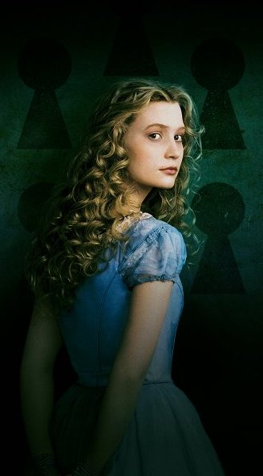
Alice
Sitting on the riverbank with her sister, Alice notices a talking, clothed White Rabbit with a pocket watch run past. She follows it down a rabbit hole, when suddenly she falls a long way to a curious hall with many locked doors of all sizes and there begins her adventure into a world both like and unlike her own in which she meets fantastical creatures, strange rules, and even stranger characters.

Slide 4
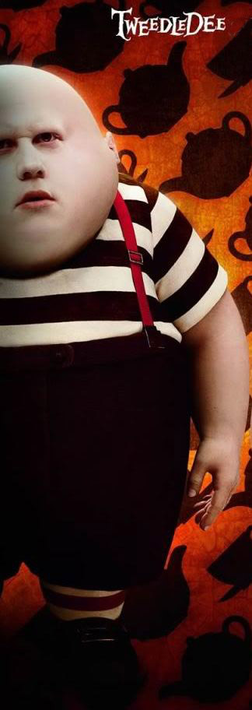
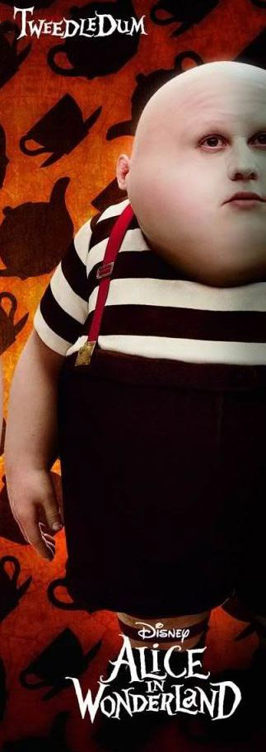
Tweedledee and tweedledum
Tweedledum and Tweedledee
Agreed to have a battle;
For Tweedledum said Tweedledee
Had spoiled his nice new rattle.
Just then flew down a monstrous crow,
As black as a tar-barrel;
Which frightened both the heroes so,
They quite forgot their quarrel.

Slide 5
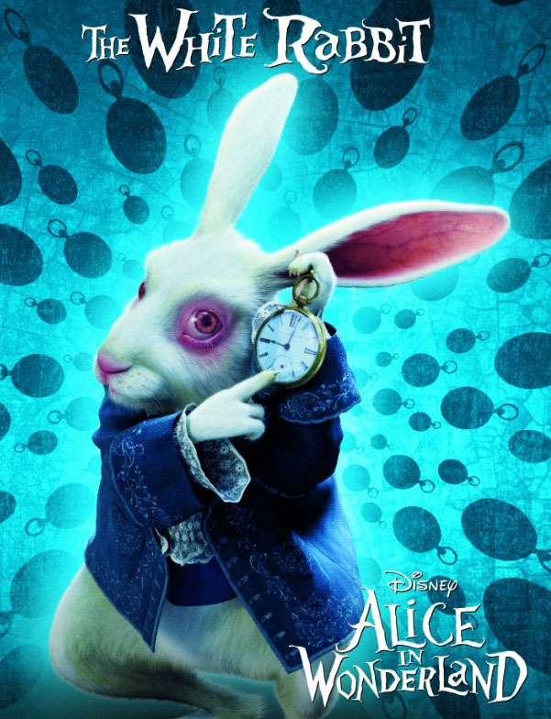
The white rabbit
He appears at the very beginning of the book, in chapter one, wearing a waist-coat, and muttering "Oh dear! Oh dear! I shall be too late!" Alice follows him down the rabbit hole into Wonderland. Alice encounters him again when he mistakes her for his housemaid Mary Ann and she becomes trapped in his house after growing too large. The Rabbit shows up again in the last few chapters, as a herald-like servant of the King andQueen of Hearts.

Slide 6
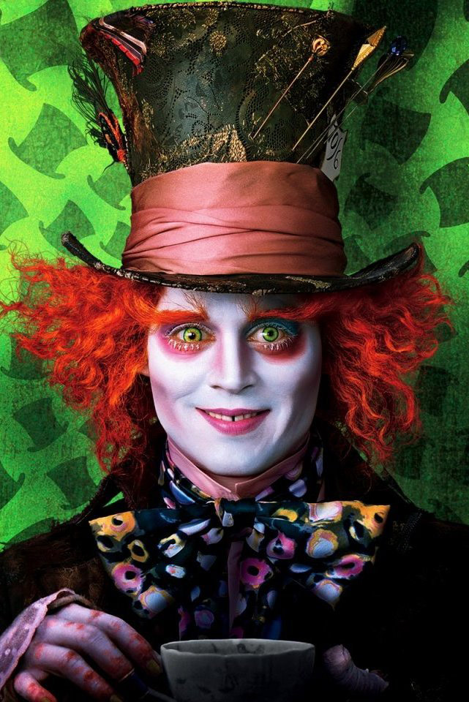
The hatter
He is a fictional character in Lewis Carroll's Alice's Adventures in Wonderland and the story's sequel Through the Looking-Glass. He is often referred to as the Mad Hatter, though this term was never used by Carroll. The phrase "mad as a hatter" pre-dates Carroll's works and the characters the Hatter and the March Hare are initially referred to as "both mad" by the Cheshire Cat, with both first appearing in Alice's Adventures in Wonderland, in the seventh chapter titled "A Mad Tea-Party".

Slide 7
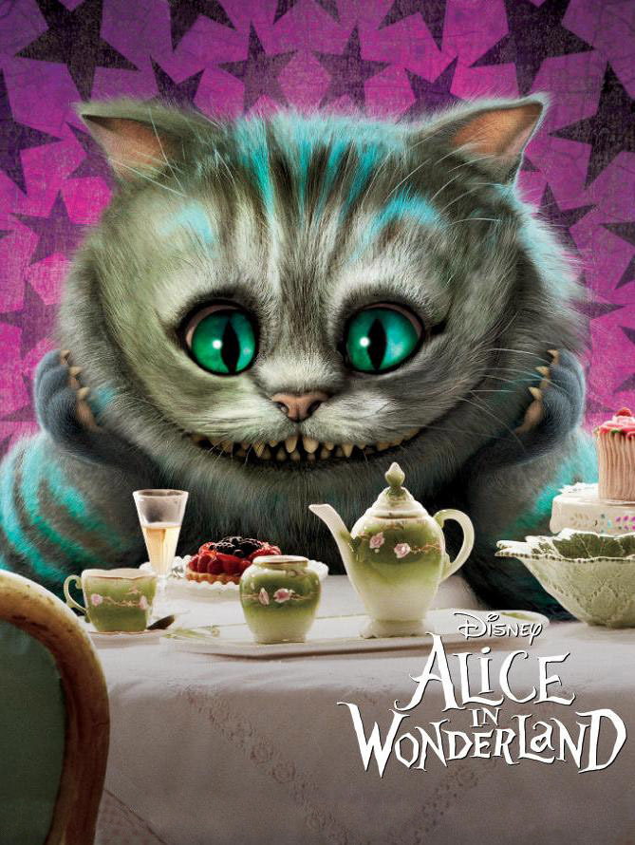
The Cheshire cat
He is a dapper tabby with the ability to appear and disappear. He is all calm, casual sensuality with a seductive grin that masks his cowardice.

Slide 8
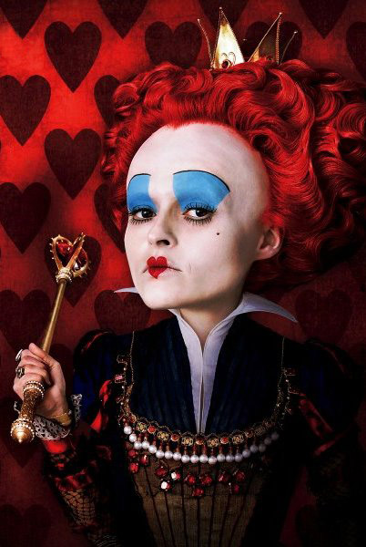
The red queen
The Queen of Hearts is the main villain of "Alice in Wonderland". She is a mean, nasty, short-tempered tyrant that rules Wonderland with an iron fist.

Slide 9
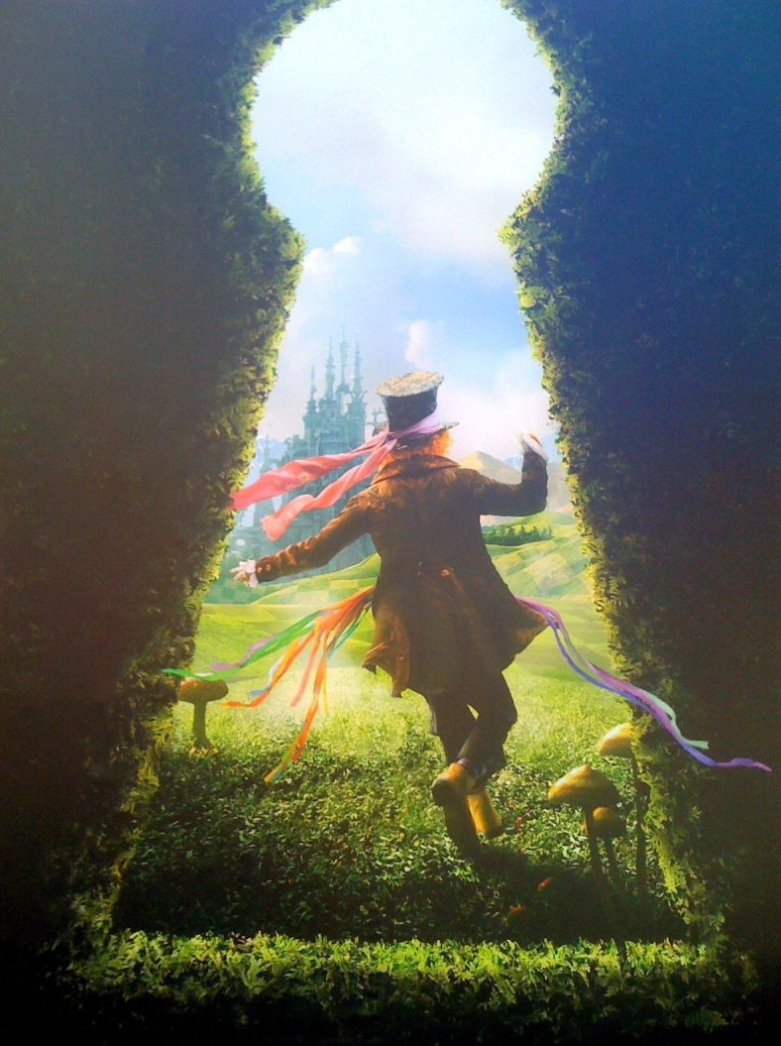
The end

