Slide 1
The presentation is made by student of the 6th «A» form, school №797 Vinokurov Vladislav.
Moscow 2012

Slide 2
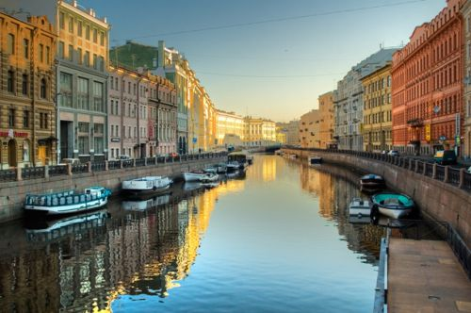

Slide 3
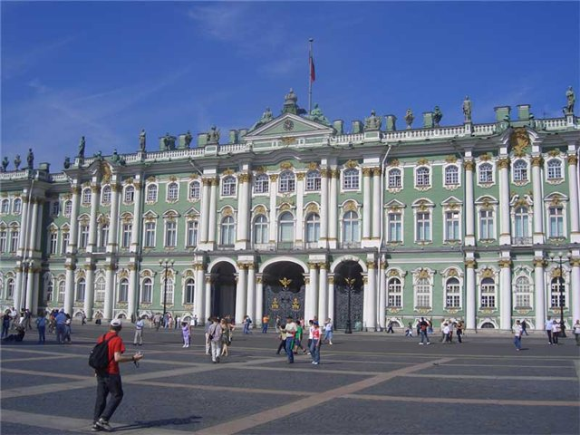
My trip I spent in the St. Petersburg.
I was in the Hermitage. State Hermitage in St. Petersburg is the largest in Russia and one of the world's largest art and cultural museums, Federal State budgetary institution.

Slide 4
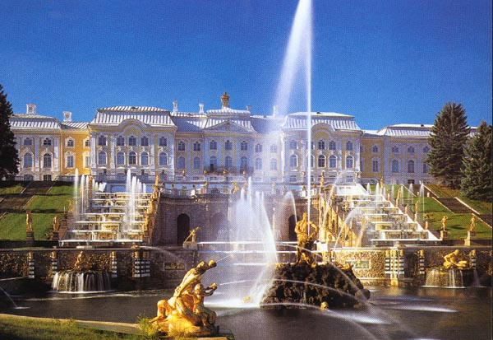
I was in the Peterhof. Peterhof was founded in 1710 as the Imperial country residence, the status of the city - in 1762. The city is a monument of world architecture and the palace and park art XVIII-XIX centuries Museum "Peterhof".

Slide 5
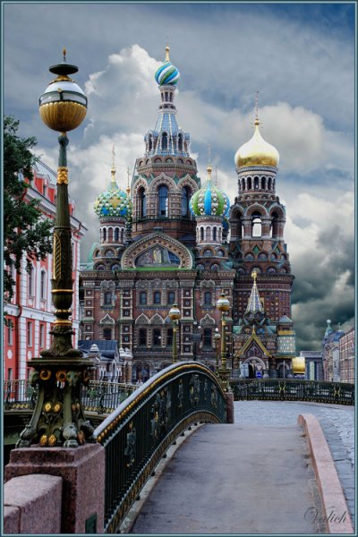
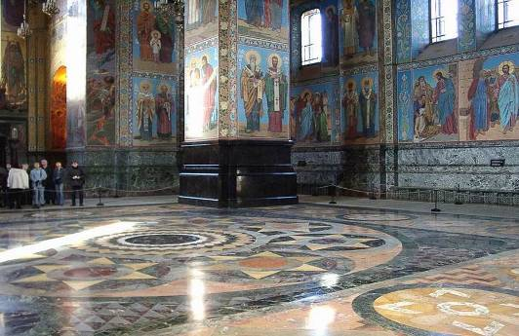
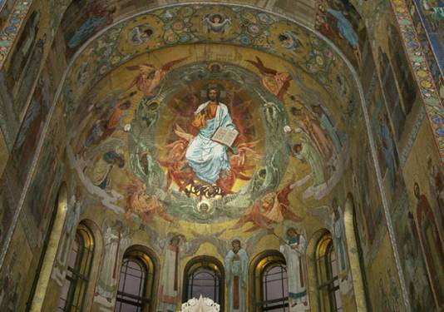
I was in the Savior on Spilled Blood.
Church of the Savior on the Blood of Christ, Church of the Savior on the Spilled Blood in St. Petersburg - Orthodox odnoprestolny Memorial Church of the Resurrection of Christ, erected in memory of the fact that this place March 1, 1881 in an attack was mortally wounded by the Emperor Alexander II (expression on the blood indicates blood king). The temple was built as a monument to Tsar-Martyr of the money raised throughout Russia.

Slide 6
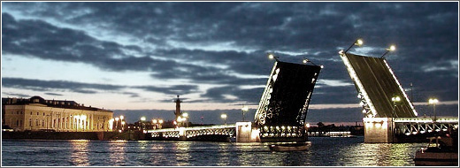
Alexander Nevsky Established: 1959 - 1965 The bridge is 629 m Width: 35 m Strategically building a bridge was needed to solve the traffic problems of Malaya Okhta. Structure built by the architects of the Leningrad branch of the Academy of Building and Architecture of the USSR. In 2000 - 2001 years. reconstruction of the bridge project engineer AA Zhurdina under the direction of Vladimir Pavlov. Today, the Alexander Nevsky Bridge fits well with the architectural ensemble of the city

Slide 7
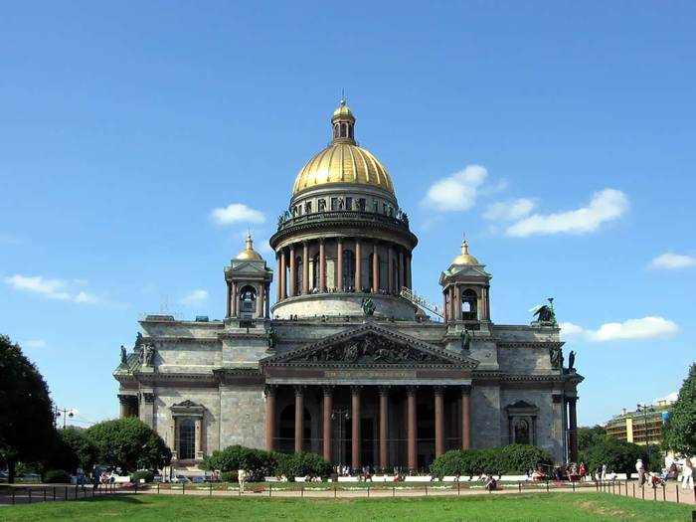
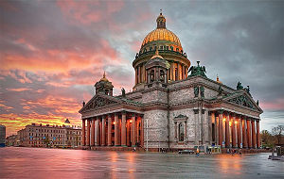
I was in the St. Isaac's Cathedral.
It was built in 1818-1858 years by the architect Auguste Montferrand, oversaw the construction of Emperor Nicholas I, the chairman of the commission building was Carl Opperman.

Slide 8
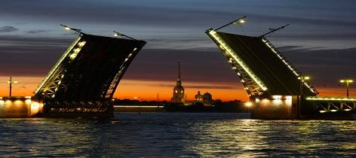
My trip was very good.

Slide 9
Information resourses
www.imageafter.com/
www.morguefile.com
www.everystockphoto.com/
www.flickr.com/creativecommons/
www.videoresursy.ru
www.sxc.hu
www.fotolia.com

Slide 10
THANK YOU FOR ATTENTION

