Slide 1
Romeo and Juliet
William Shakespeare

Slide 2
There is no sadder story in the world, than the story of Romeo and Juliet!..
W.Shakespeare
1594 – 1595

Slide 3
Some places

Slide 4
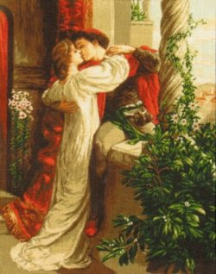
Romeo and Juliet is a tragedy written by William Shakespeare about two young lovers whose deaths finally unite their feuding families. It was among Shakespeare's most popular archetypal stories of young, teenage lovers.

Slide 5
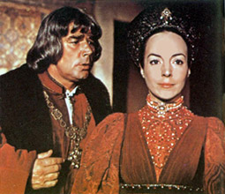
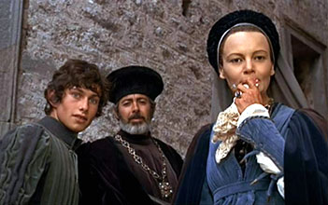
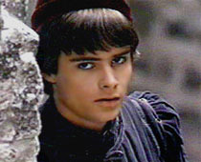
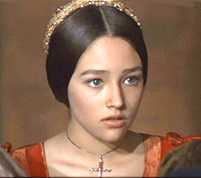
Between them war
Montague
Capulet

Slide 6
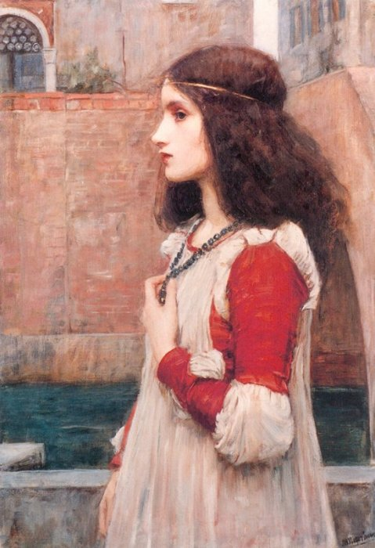
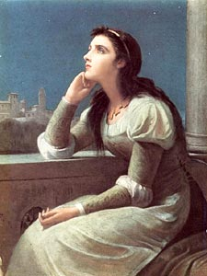
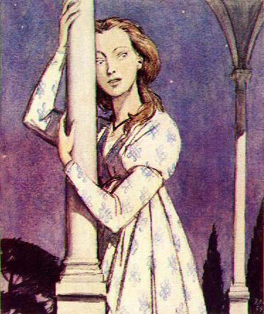
Juliet

Slide 7
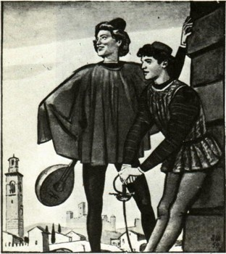
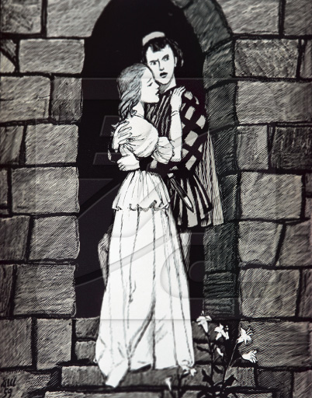
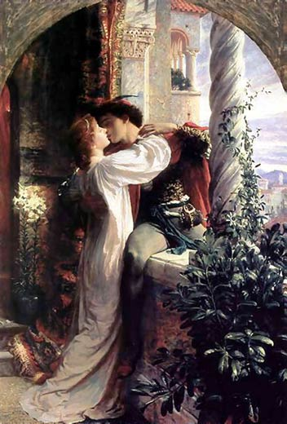
Romeo

Slide 8
