Slide 1
Dreams,
dreams,
Dreams…
Made by
Anna Efimova,
Valentin FiTSner,
Anna Tsarkova
Syzran
2010

Slide 2
Dreams and their meanings in our life.
Dreams are the phenomena, which people can’t guess*. Dreams have aroused our curiosity since ancient times. Egyptian priests claimed to be able to interpret dreams and they believed that dreams could foretell the future. Aristotle regarded dreams as an early warning system about the state of our health. But only Sigmund Freud became a person, who changed the way we think about sleeping and dreams forever.
*guess - разгадывать

Slide 3
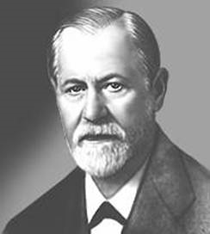
“The Dream Book” by Sigmund Freud
“The dream book” of Freud is one of the most interesting and unusual among all books. Sigmund Freud is the popular psychologist of the twentieth century and the father of psychoanalysis, based on interpretation of associations and dreams. Freud researched and analyzed his own dreams for a long time. And soon he discovered what each symbol really meant. We have done our “The dream book” based on experiments by Freud. We tried to collect the most exciting and important facts and interpretations in it. Using this book you can learn a lot of new things about yourself. It helps you to prevent or foretell events in your life.

Slide 4
Meanings of dreams

Slide 5
Dreams about Food
If you see in dream sweets it means that you are deceived* by a very sly person.
If you eat sweets – you’ll get a very good friend.
*deceive - обманывать

Slide 6
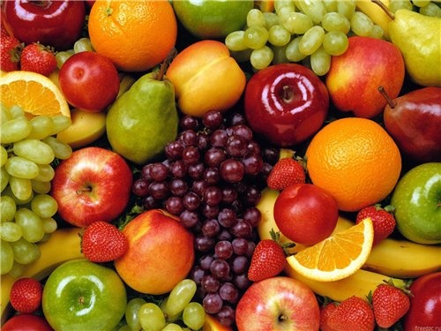
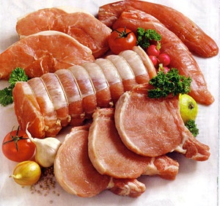
If you see vegetables and fruit in your dream it means that you’ll be very lucky in future.
If you see meat in your dream – you’ll get a lot of troubles.
If you eat meat – you’ll be ill in future.

Slide 7
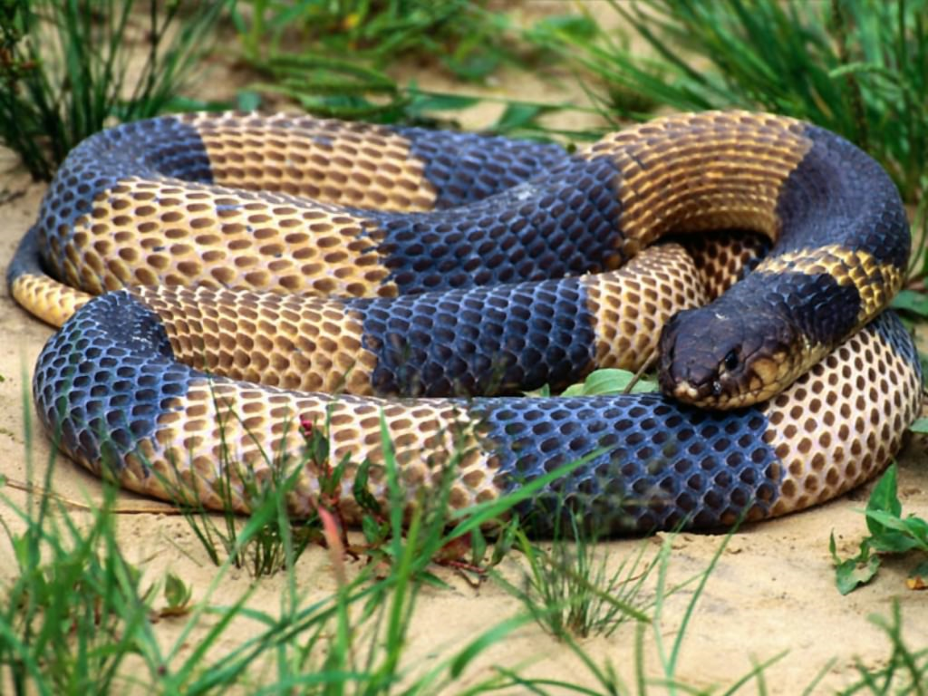
Dreams about Animals
If you see a snake in your dream. Don’t worry. It is very good. Your friend becomes your protector*.
*protector – защитник, покровитель

Slide 8
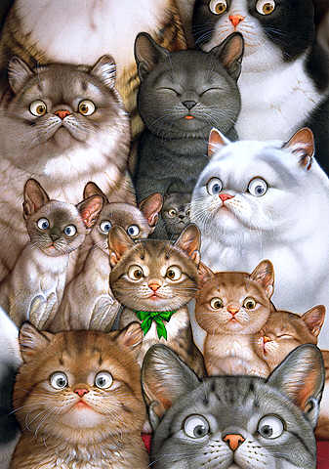
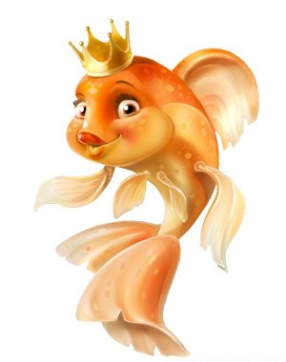
If you see a lot of cats in dream it means that you have bad friends. They are deceivers and very selfish.
If you see gold fish in dream it means that you’ll get exciting adventures.
If young woman see gold fish – she’ll get married in nearest future.

Slide 9
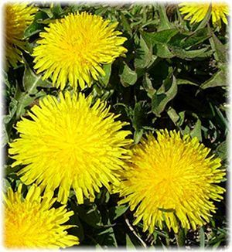
Dreams about flowers
If you see dandelions* in dream it means that you’ll get pleasant news.
If you see carnations** in dream – you should wait for good achievements and success.
*dandelion – одуванчик; ** carnation - гвоздика

Slide 10
If you see roses in dream – you’ll get happiness, joy.
If roses are yellow it means treachery* and fright.
If roses are white it means that you’ll be happy in marriage.
*treachery - измена

Slide 11
Dreams about seasons
If you saw dream about winter it means that you’ll be ill in future, also it can means that you’ll be successful on job.
If you saw dream about spring it means that you’ll get luck and success in life and wonderful future.

Slide 12
If you see dream about summer it means that you’ll get good news, which can change your life
If you see dream about autumn it means that you’ll get acquainted with new people.

Slide 13
We hope that our “The dream book” helps you in understanding of your dreams . We wish you good dreams with pleasant meaning.
The End

Slide 14
Thank you for watching

