Slide 1
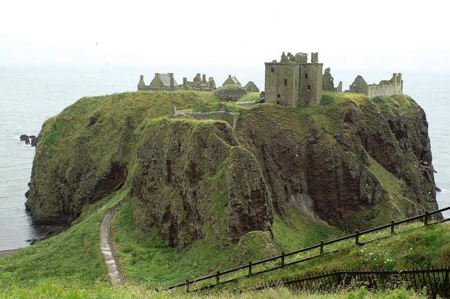
Presentation of a theme “Prominent places of England “
The student of a 9-B class executed
The school of Terny
Fesenko Zhanna

Slide 2
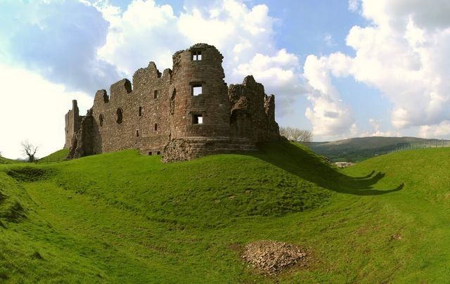
Plan
The Palace of Westminster or the Houses of Parliament
Big Ben
Westminster Abbey
Buckinqham Palace
Tower Bridge
The Tower of London
St. Paul”s Cathedral
British museum
Madam Tussaud’s Museum
Trafalgar Square
Hyde Park
Stonehenge
Lock of Bodiam
“City on ships”
University of Liverpool

Slide 3
The British Parliament sits in the Building which is called the Palace of Westminster. It’s also called the Houses of Parliament because there are two Houses: the House of Lords and the House of Commons.

Slide 4
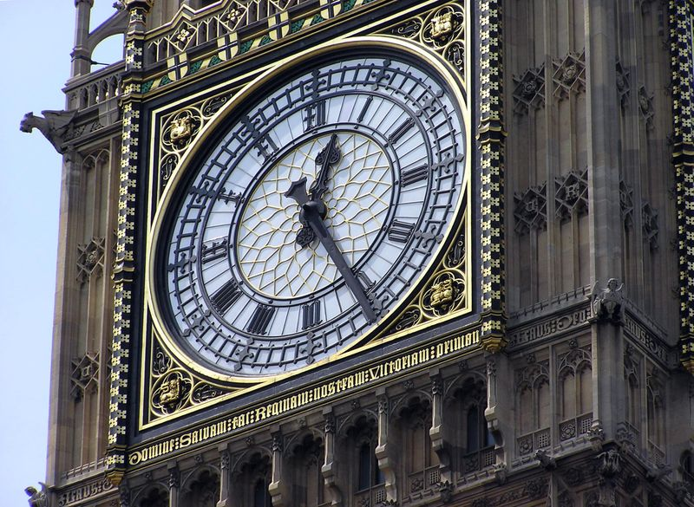
Big Ben
On the Houses of Parlament one can see the famous Tower Clock Big Ben. The symbol of London . Big Ben is the real bell which strikes every quarter of an hour.

Slide 5
Westminster Abbey
It’s one of the most famous sights in London, where kings, queens and many famous people are buried.

Slide 6
Buckingham Palace
It’s the Queen’s official London residence.
Tourists always go to see the ceremony of changing the Guard there.

Slide 7
Tower Bridge-is one of the main symbol of London and all Great Britain.
This bridge is located, in the historical center of city not far away from London Tower located on the north of river Thames, and was named on the honor of it.

Slide 8
Tower of London
It is one of the oldest building of the city.
Many centuries ago it was a fortress, a royal palace and then a prison.
Now it is a museum of arms

Slide 9
St. Paul”s Cathedral
It is a biggest English Church.
St. Paul Cathedral - the Anglican Cathedral named after an apostle Paul and is built in the highest point of London

Slide 10
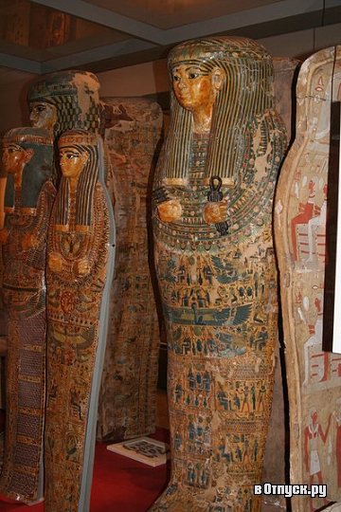
British Museum is the largest and richest museum in the world. It was founded in 1753. In this museum in Egyptian Galleries contain human and mummies.

Slide 11
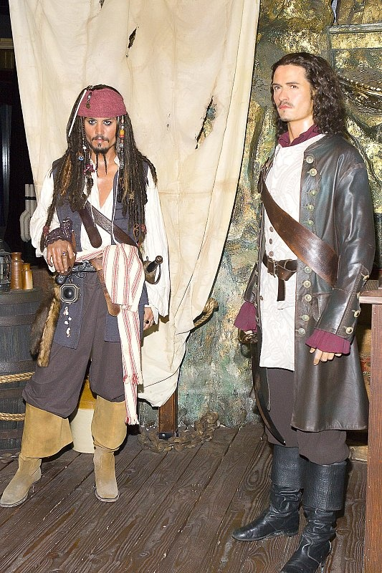
Madam Tussaud’s Museum is an exhibition of hundreds of life-size wax models of famous people of yesterday and today. The collection was started by Madam Tussaud,a French modelers in wax, in the 18 century.

Slide 12
Trafalgar Square is a central square of the city

Slide 13
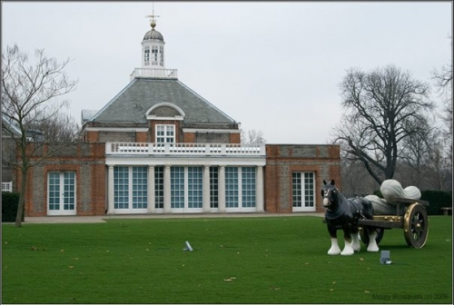
Hyde Park is the most democratic park in the world, because many democratic meetings take place there.

Slide 14
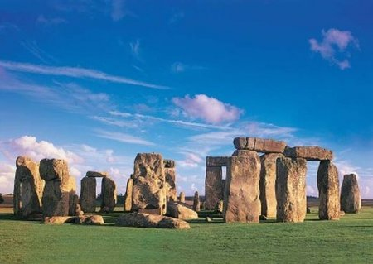
Stonehenge
Is a prehistoric monument, presumably build by Druids members of an order of priests in ancient Britain.

Slide 15
The last real lock is a lock of Bodiam This lock stands near the river Roter in Sassex

Slide 16
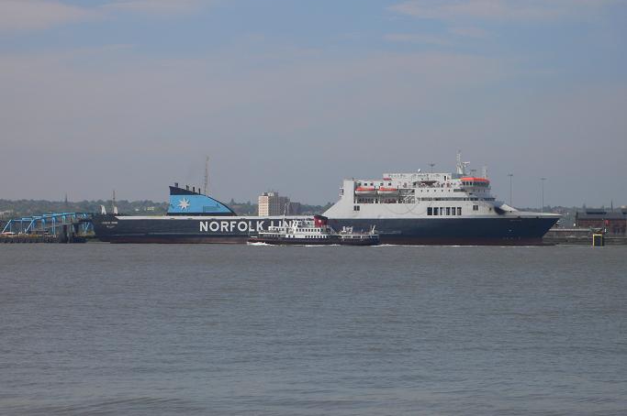
Liverpool, the “city of ships”
It is second greatest port, after London.
The most interesting sight in the Liverpool is the docks.

Slide 17
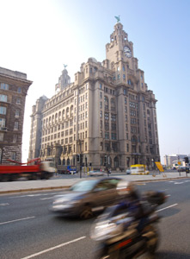
The University of Liverpool established in 1903 is famous for it’s School of Tropical Medicine.

