Slide 1
The Anglo-Saxons and the Vikings
Teacher: Kuznetsov P.S.
School: State Comprehensive School № 113
Form: 6 B

Slide 2
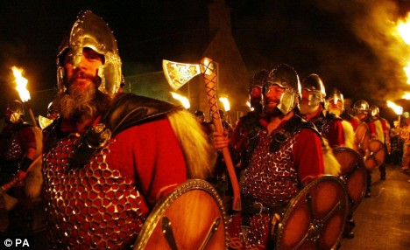
The contents of the work:
1.What do you know about the history of Britain (quiz)
2. The Anglo-Saxons and the Vikings (listen and look at the pictures)
3) The British history from the 5th to 9th century (test)

Slide 3
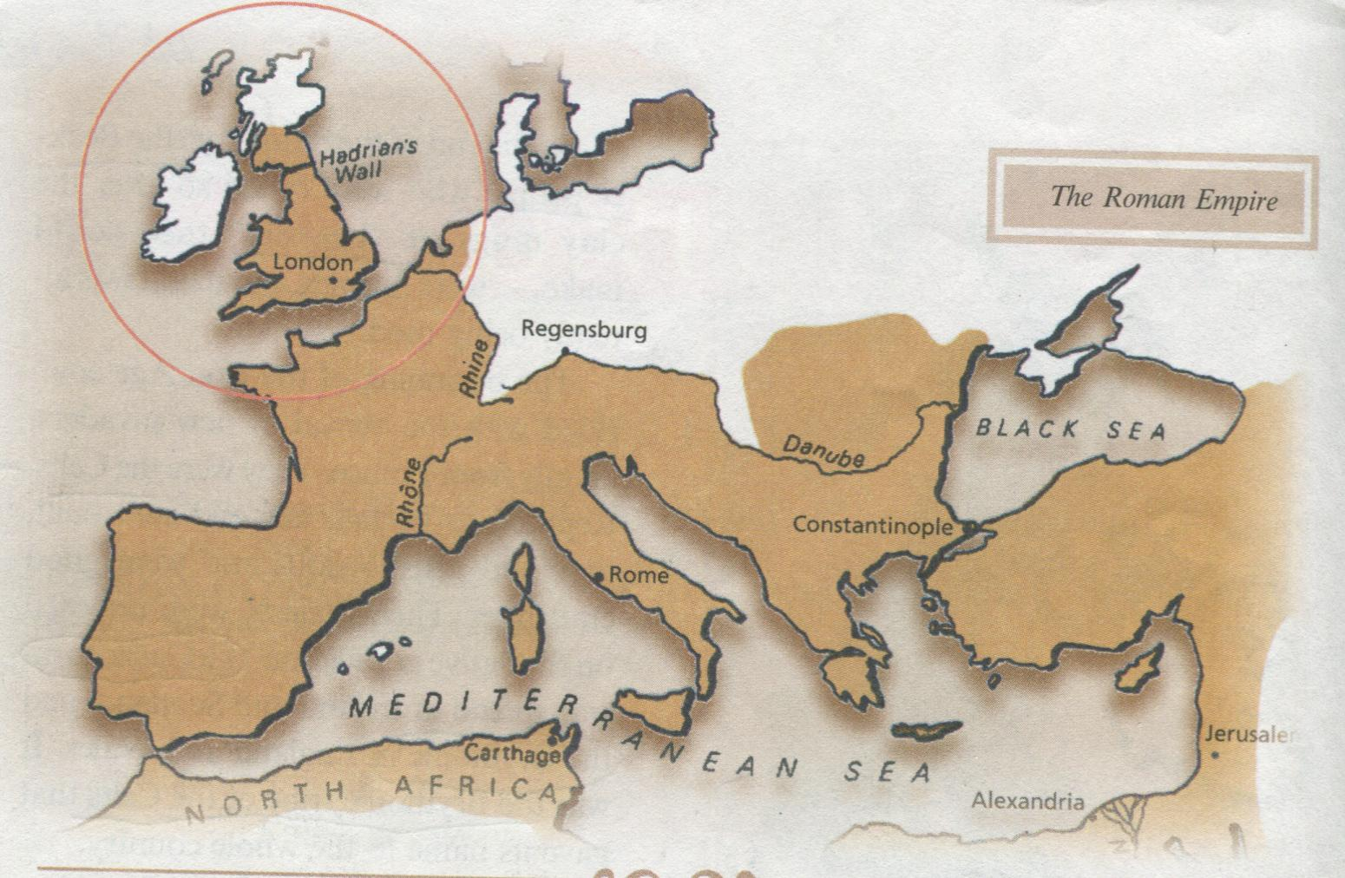
What do we know about the history of Britain?
Quiz

Slide 4
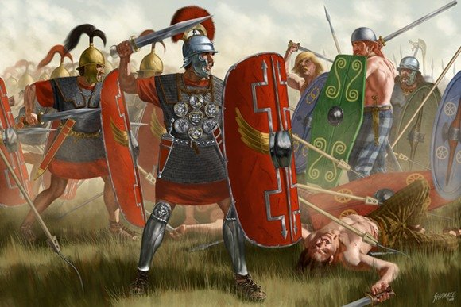
Who were these people?
What did they do in Britain?

Slide 5
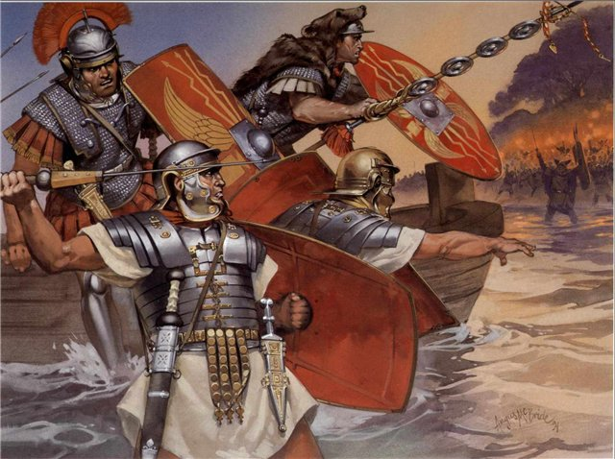
They were the Romans.
They invaded Britain in AD 43 .
They stopped tribal wars, built roads and cities.

Slide 6
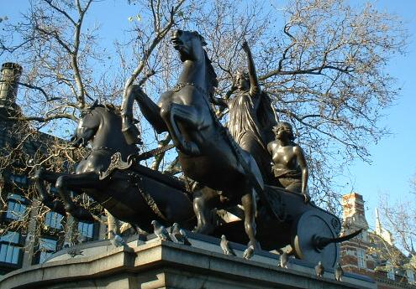
Who was this woman?
What was she famous for?

Slide 7
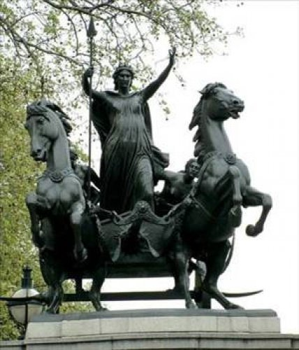
This woman was Queen Boadicea.
The Iceni tribe, led by Boadicea, revolted against the Romans. She and her soldiers were surrounded and had to give in. Queen Boadicea and her daughters didn’t want to be the Romans’ prisoners and took poison.

Slide 8
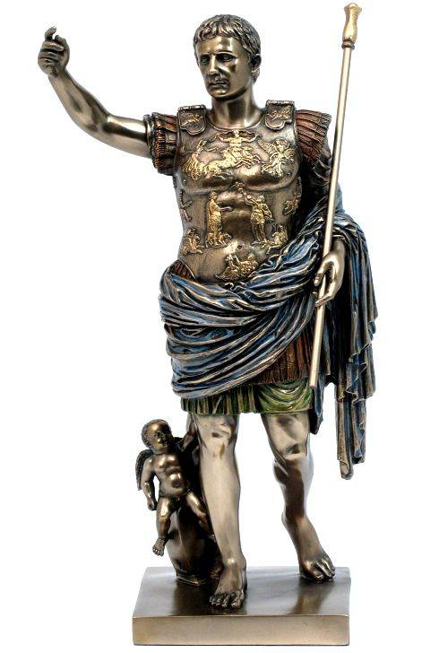
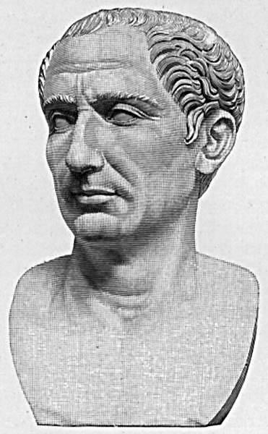
What was this man’s name?
What did he do in Britain?

Slide 9
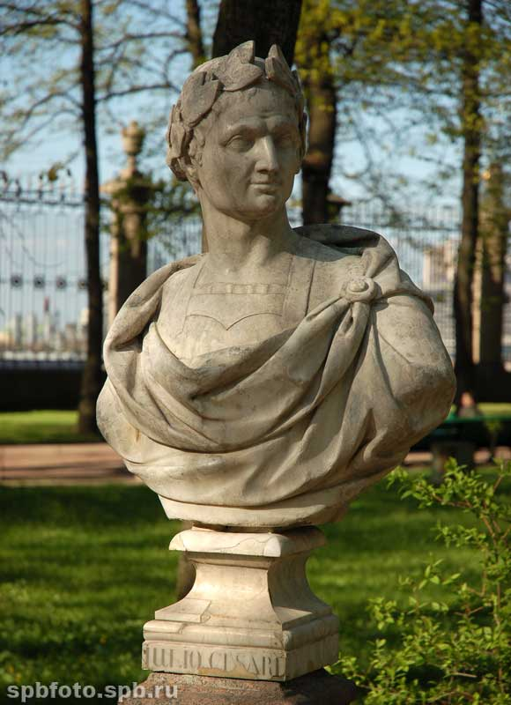
This man was Julius Caesar. He attacked Britain in 55 BC. The Britons fought desperately but soon fled. After the victory Caesar soon left Britain.

Slide 10
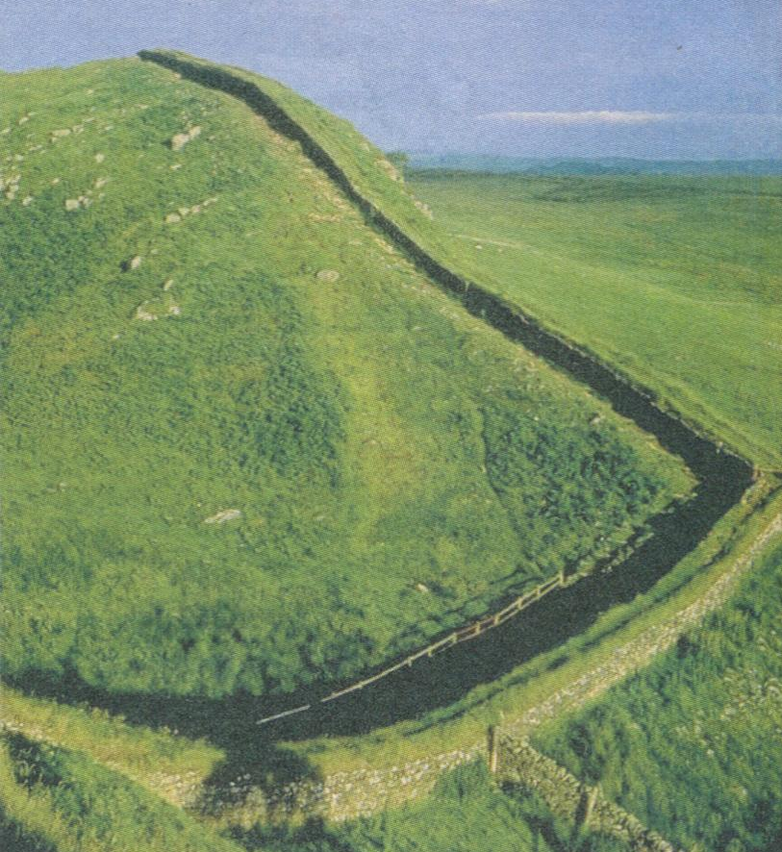
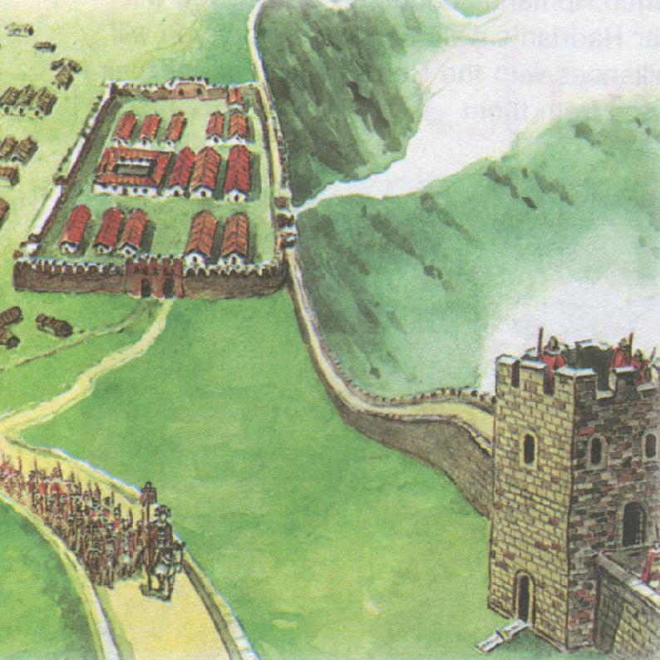
What is it? What was it used for?

Slide 11
This is Hadrian’s wall. It was built by the Emperor Hadrian to protect the Romans from the attacks of Scots and Picts.

Slide 12
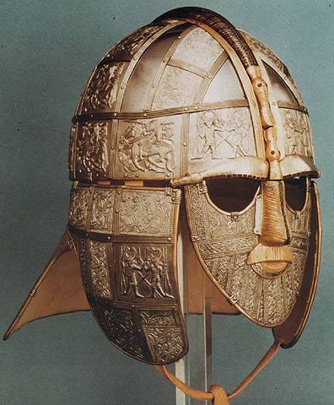
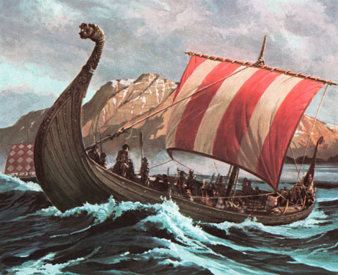
The Anglo-Saxons and the Vikings
Listen and look at the pictures

Slide 13
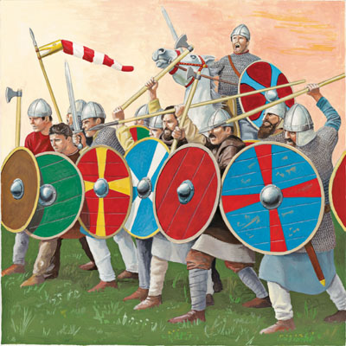
The Anglo-Saxons were making raids against the British in the 5th and 6th century. At last they invaded the central Britain and controlled it.

Slide 14
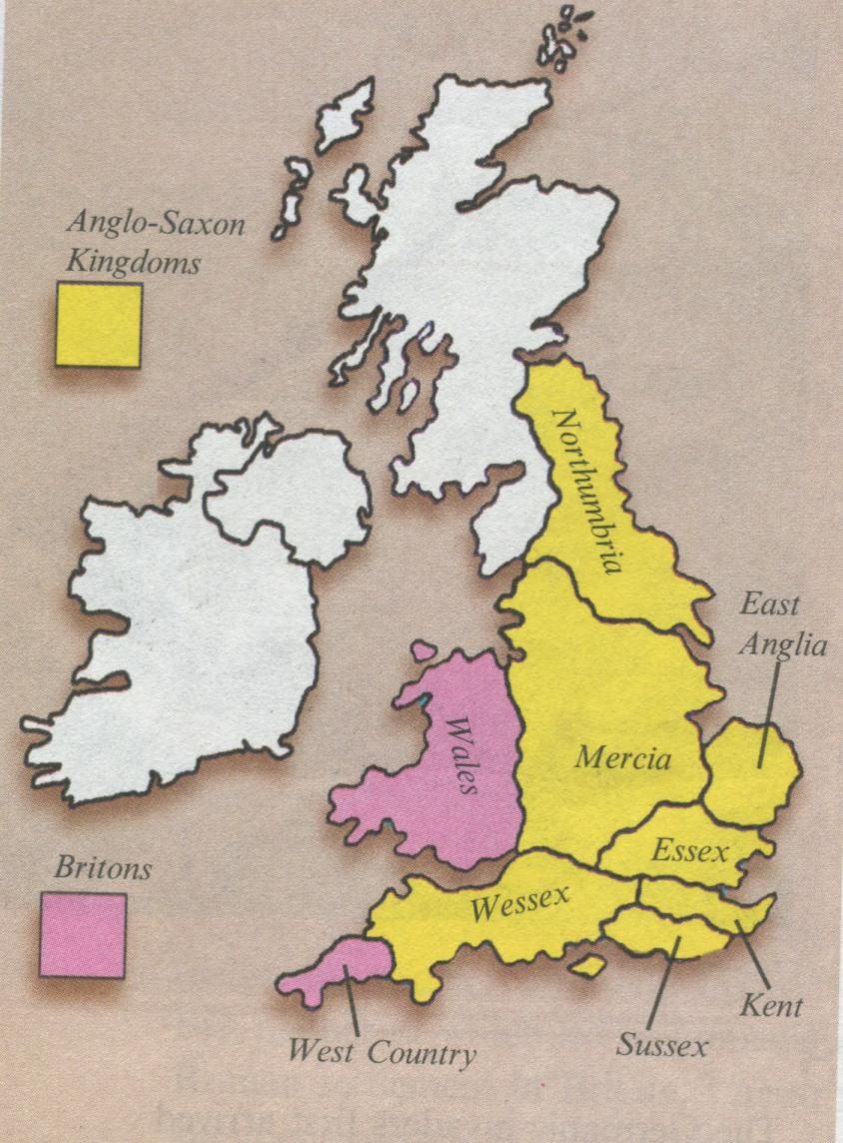
The Anglo-Saxons founded a lot of kingdoms:
Kent
Essex
Wessex
Mercia
Northumbria
Sussex
East Anglia

Slide 15
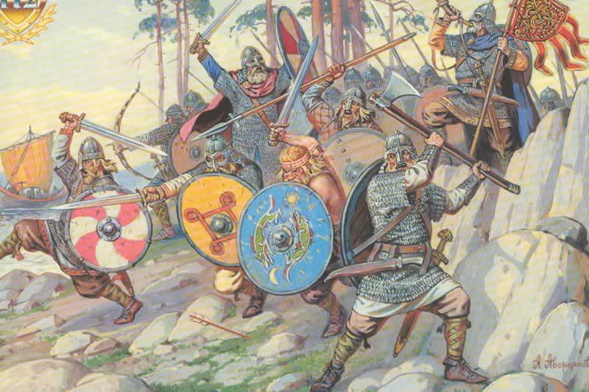
In 789 the Vikings began to attack the British Isles. In 870 only Wessex was left to resist them.

Slide 16
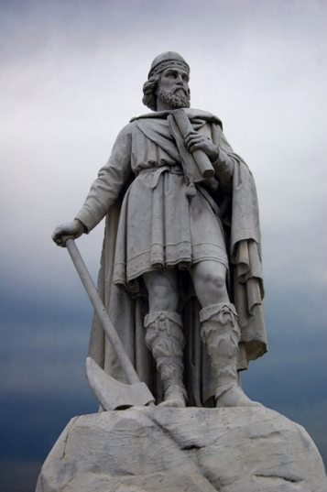
The King of Wessex was Alfred the Great. While he was a king:
Many people went to school for the first time in their lives
He created a big army and built a fleet of warships
He fought hard against the Vikings

Slide 17
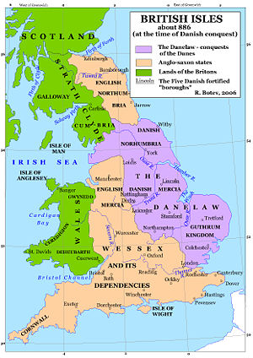
King Alfred and the Vikings made a treaty.
They agreed that the Vikings would live in an area called the Danelaw, where they could follow their traditions and obey their law

Slide 18
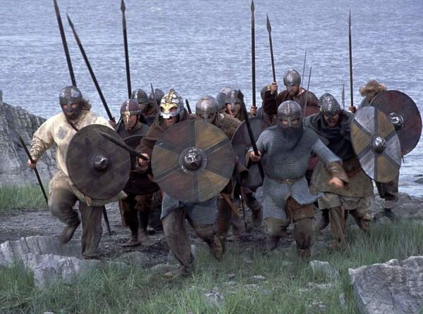
The British history from the 5th to 9th century
Quiz

Slide 19
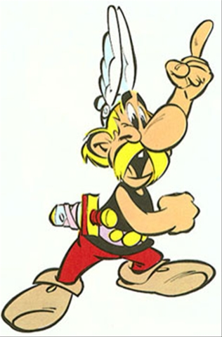
Who invaded Britain in 5th and 6th century?
The Vikings ?
the Anglo-Saxons ?
the Scots ?

Slide 20
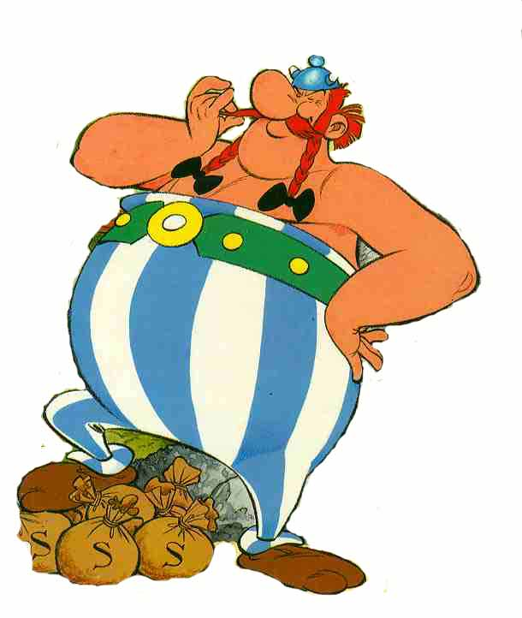
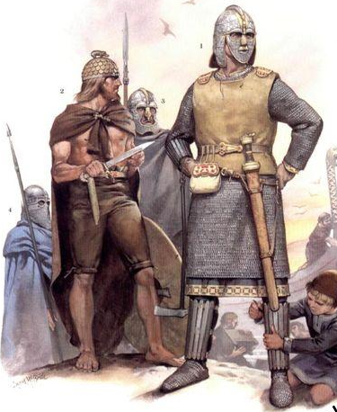
b) The Anglo-Saxons!

Slide 21
How many kingdoms did the Anglo-Saxons found?
Five
Six
Seven

Slide 22
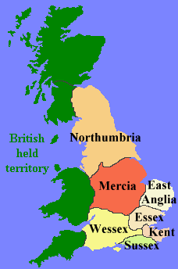
c) Seven!

Slide 23
Who began to attack Britain in 789?
The Vikings?
The Anglo-Saxons?
The Scots?

Slide 24
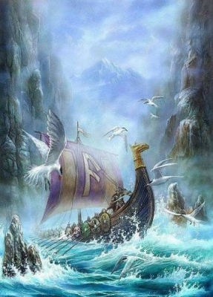
a) The Vikings!

Slide 25
Who was the great king of Wessex?
Boadicea?
Caesar?
Alfred?

Slide 26
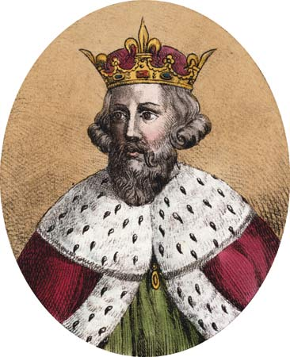
c) Alfred!

Slide 27
What did king Alfred create?
Hadrian’s wall?
An army and a fleet?
Roads?

Slide 28
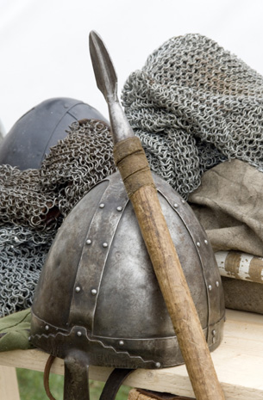
b) An army and a fleet!

Slide 29
How was the Vikings’ area called?
the Danelaw?
b) Sussex?
c) Kent?

Slide 30
a) The Danelaw!

Slide 31
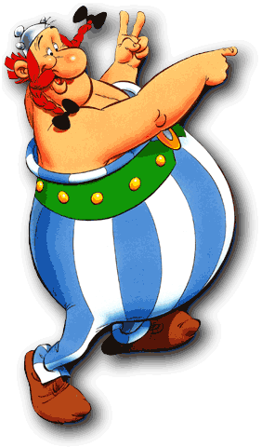
Good luck,
dear pupils!

