Slide 1
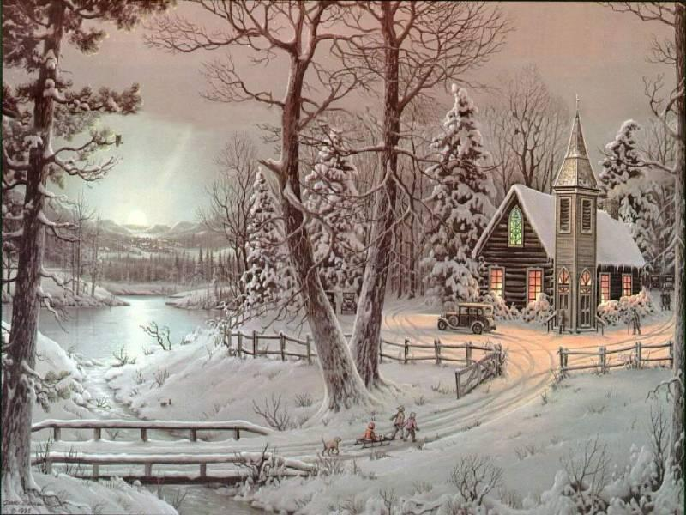
Christmas: customs and traditions

Slide 2

Christmas tongue twisters
Santa's sleigh slides on slick snow.
Tiny Timmy trims the tall tree with tinsel.
Bobby brings bright bells.
Chilly chipper children cheerfully chant.

Slide 3
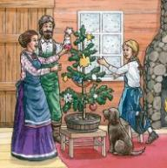
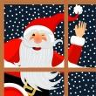
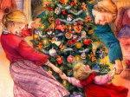
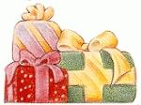
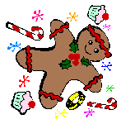
Answer the questions:
What do you know about Christmas?

Slide 4
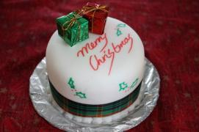
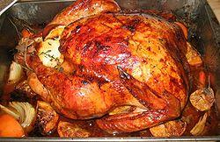
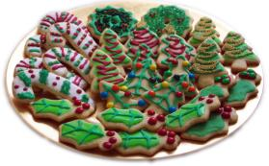
2. What traditional Christmas meals do you know ?

Slide 5
Christmas Associations
Christmas
Symbols
Meal
Presents
People
Plants

Slide 6
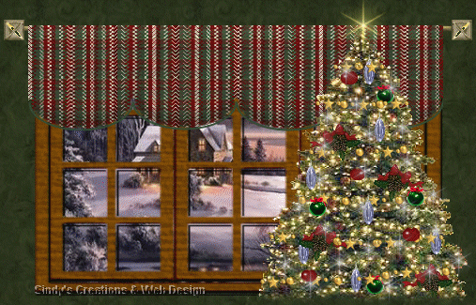

Slide 7
Turkey, pudding, pumpkin pie, vegetables.
Santa Clause, holiday, Christmas tree, birch tree.
Christmas pudding, Easter, ring, horseshoe.
Trousers, stockings, presents, socks.
23rd December, 24th December, 25th December, 26th December.
Christmas Eve, Boxing Day, Thanksgiving Day, Christmas.

Slide 8
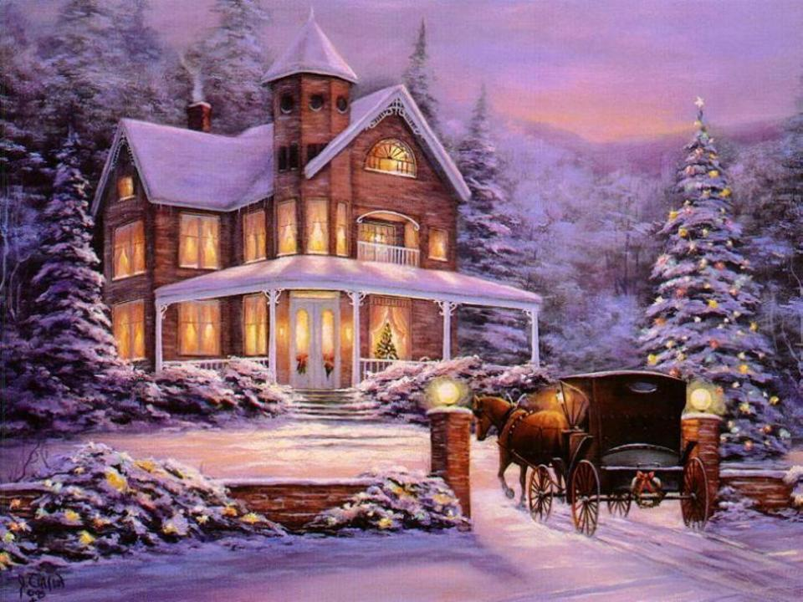


Slide 9
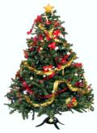
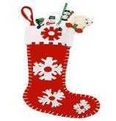
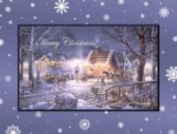

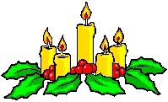

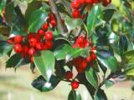
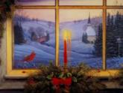

1 | 2 | 3
4 | 5 | 6
7 | 8 | 9

Slide 10
№ | Titles | Number of the picture
1 | Christmas Stockings | 3
2 | Christmas Pudding | 5
3 | Holly | 7
4 | Robin | 9
5 | Christmas tree | 1
6 | Candles and Crackers | 6
7 | Father Christmas (Santa Claus) | 4
8 | Christmas Card | 2
9 | Waits and Carol | 8

Slide 11
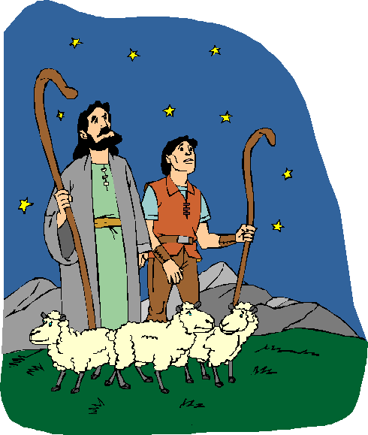
Silent night
Silent night, holy night!
All is calm, all is bright.
Round you Virgin, Mother and child,
Holy Infant so tender and mild,
Sleep in heavenly peace.
Silent night, holy night!
Shepherds quake at the sight.
Glory streams from Heaven afar.
Heavenly hosts sing Alleluia
Christ the Saviour is born,
Christ the Saviour is born.
Silent night, holy night!
Son of God, Love’s pure light.
Radiant beams from Thy holy face,
With the dawn of redeeming grace,
Jesus, Lord, at Thy birth,
Jesus, Lord, at Thy birth.

Slide 12

Colours of Christmas
The colours most closely
associated with the
Christmas season are:
red, white and green.
Some say that this is because of
the red and green plants of
wintertime contrasting with the
white snow.

Slide 13

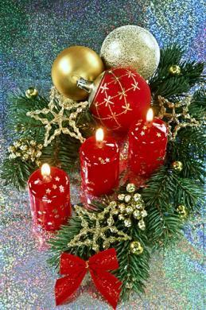
Red
means love and reflects our warmth and
love for each other.
It is also the colour that is considered the
greatest excitement.
As a religious symbol it stands for fire, blood, and charity.

Slide 14
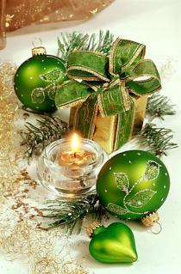
Green
means hope and the eternal
longing for spring and all the
promises of the future.
Green is the symbol of nature,
youth, and the hope of eternal
life.

Slide 15




White
means purity and is represented by the
crystalline form of water and the snowflake.
White is the religious symbol which stands
for light, purity, joy and glory.

Slide 16
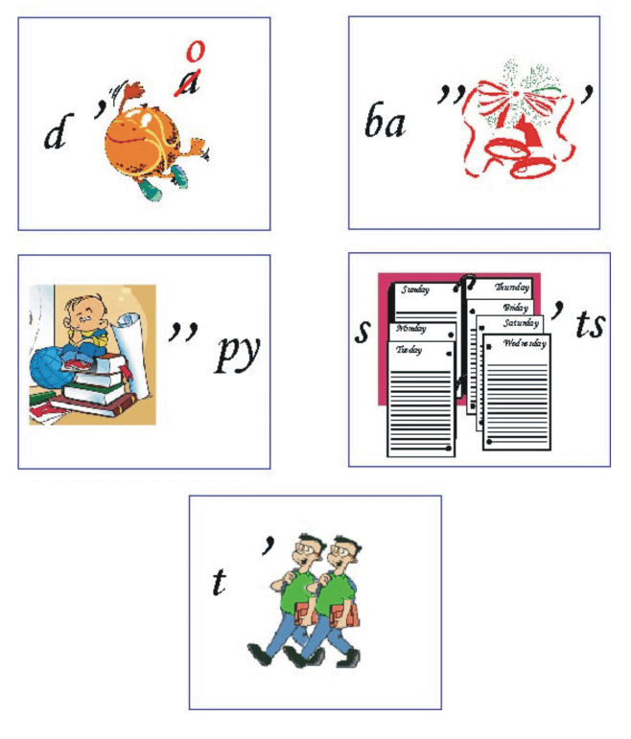

Group 1:
Group 2:
Group 3:
b’ s

Slide 17

Christmas quiz
1. When was Christmas first celebrated?
Around 100 AD
In the 4th Century
1935

Slide 18
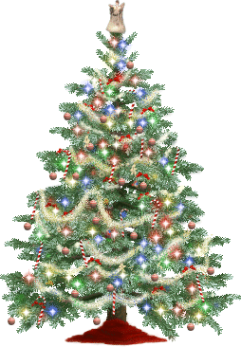
2. Where did the Christmas tree tradition originate?
Germany
Israel
New England

Slide 19

3. Who probably was the first man to illuminate a Christmas tree with candles?
Pope John I
Martin Luther
St.Nicolas

Slide 20
1. What do you like/don’t like to do at Christmas?
2. How do you celebrate Christmas in your family?
3. What gifts do you usually prepare for your friends and relatives?
4. Do you enjoy making greetings cards to their friends and family?
***
In my opinion…
From my point of view…
It seems to me…
There is no doubt…
First of all…..
Because I’m fond of ….
It’s important for me…
Then……

Slide 21
