Slide 1
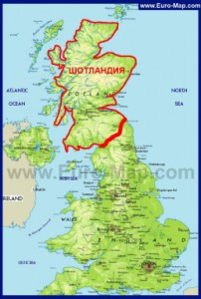
SCOTLAND

Slide 2
SCOTLAND
Scotland is a Kingdom within the United Kingdom of Great Britain and Northern Ireland. Edinburgh is the capital of Scotland. There are five million people in Scotland.

Slide 3
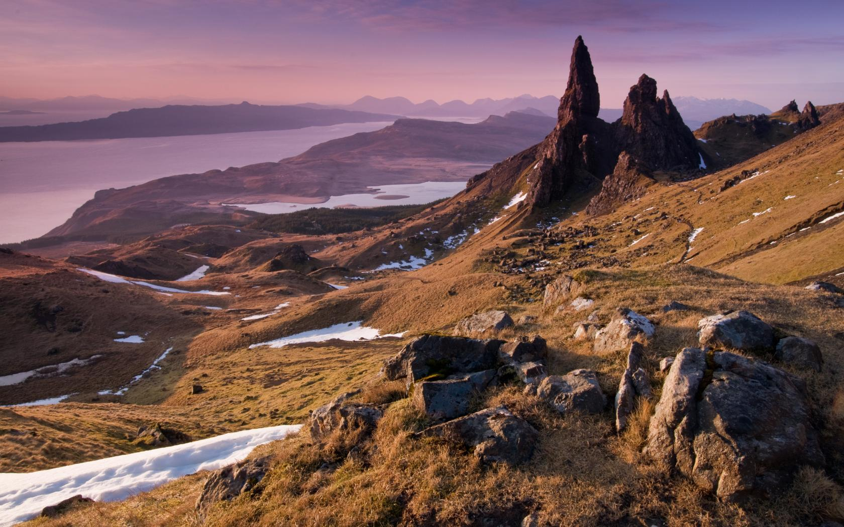
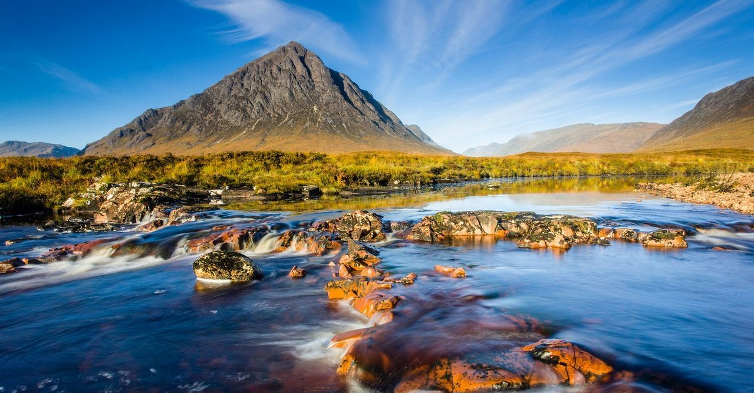
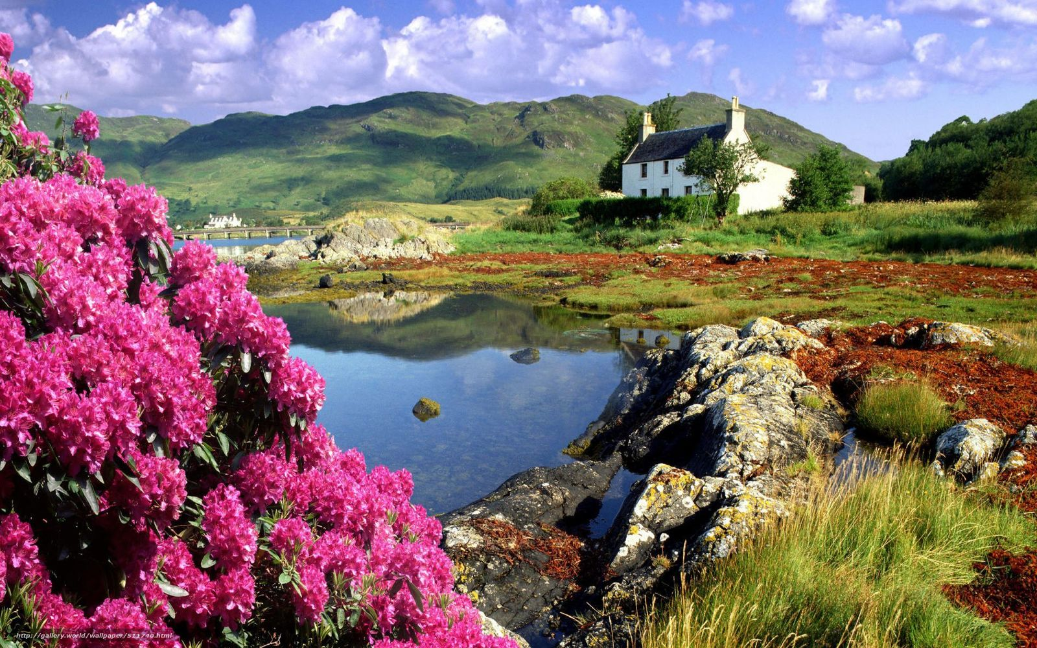
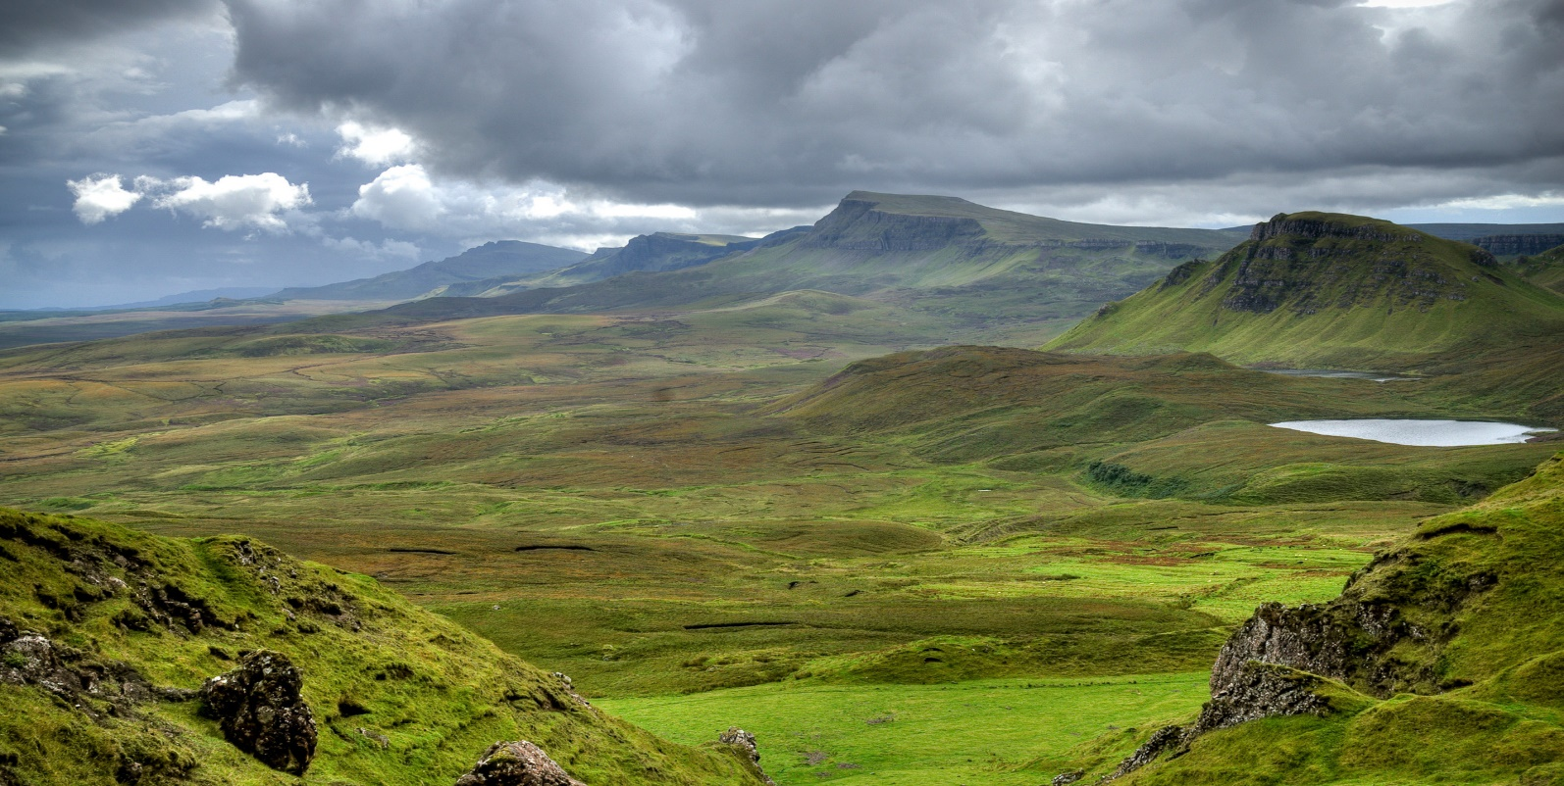

Slide 4
The symbol of Scotland is the Thistle

Slide 5
Cities of Scotland
Aberdeen City, Alloa, Glasgow, Dumfries, Dundee, Inverness, Kilmarnock, Kirkwall, Oban, Perth, Falkirk, Fort William, Edinburgh.

Slide 6
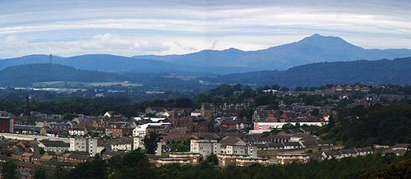
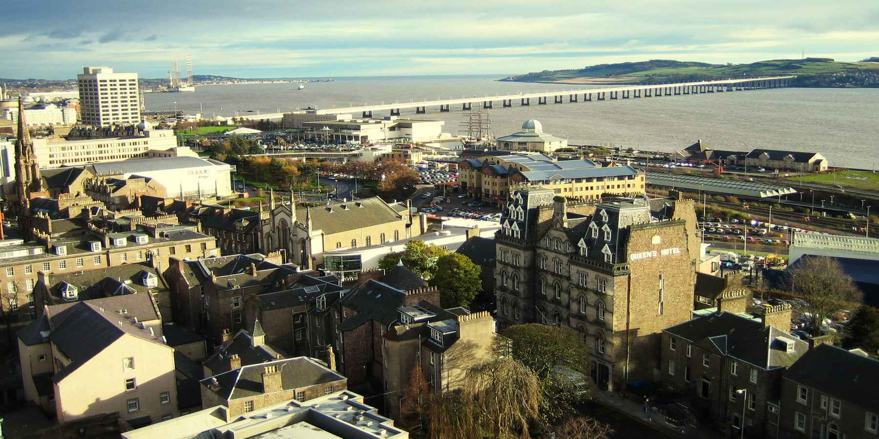
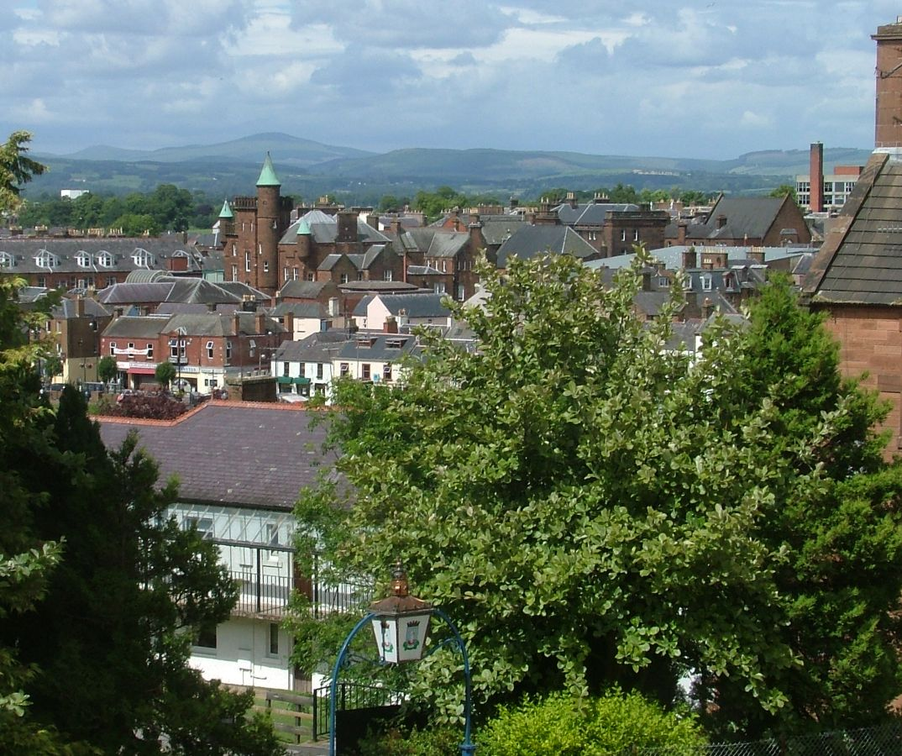
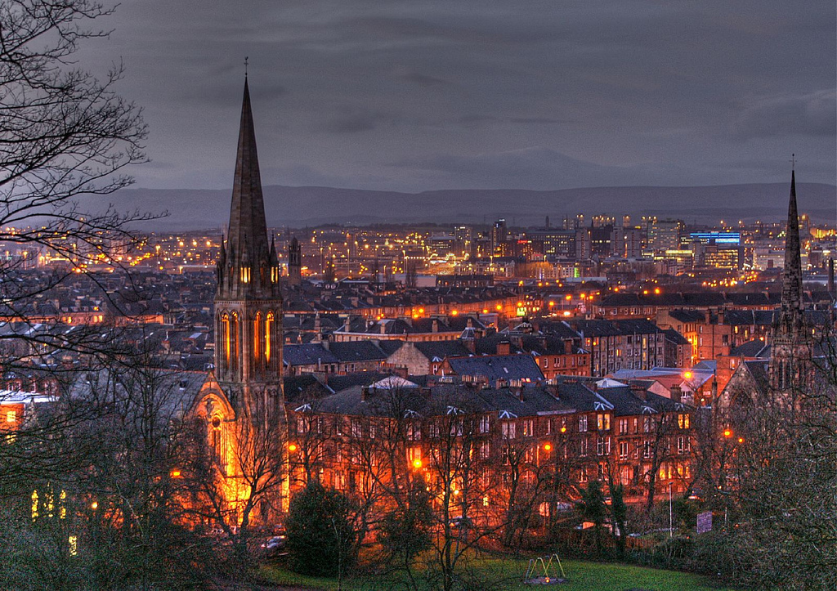

Slide 7
The biggest mountain is Ben Nevis
The name Ben Nevis is descended from the Scottish "Beinn Nibheis". "Beinn" in translation from Celtic means "mountain", the word "Nibheis" is most often translated as "evil“. According to another version the name derives from "beinn nèamh-bhathais", which literally means "mountain, the top of which obscured by clouds“. Its height is 1344 meters.

Slide 8
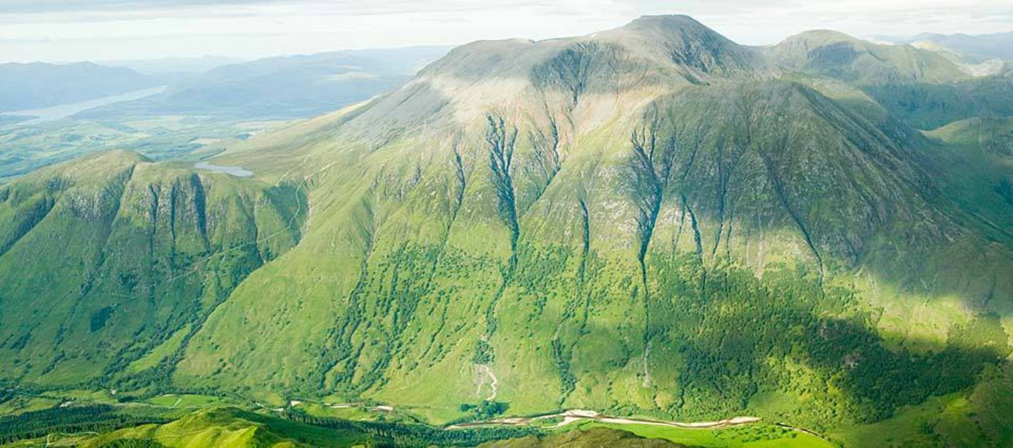

Slide 9
SAINT ANDREW
The Scottish flag is a white cross on a blue background. The cross is the cross of Saint Andrew. Saint Andrew was a disciple of Jesus.

Slide 10
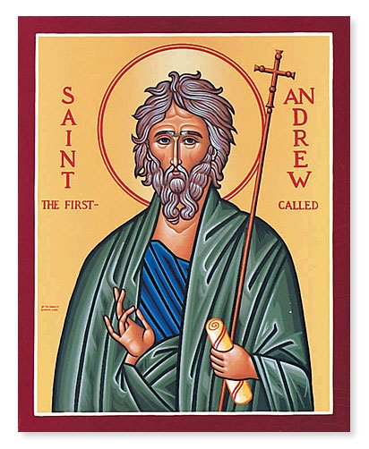

Slide 11
CHURCHES
A long time ago the Scots built many large churches called Abbeys. There are 21 abbeys in Scotland.

Slide 12
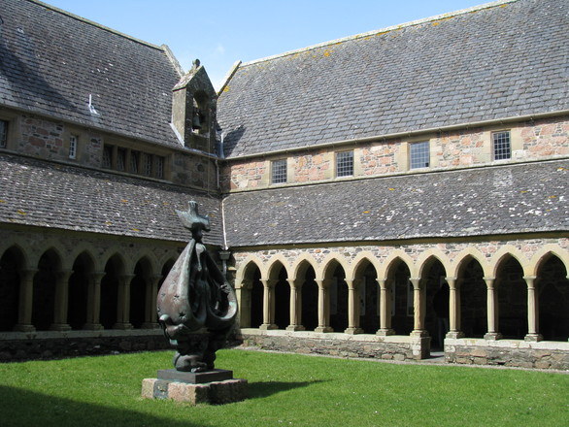
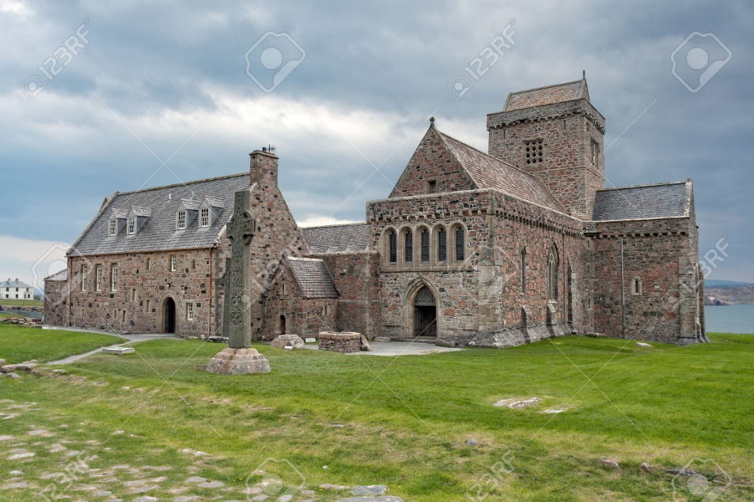
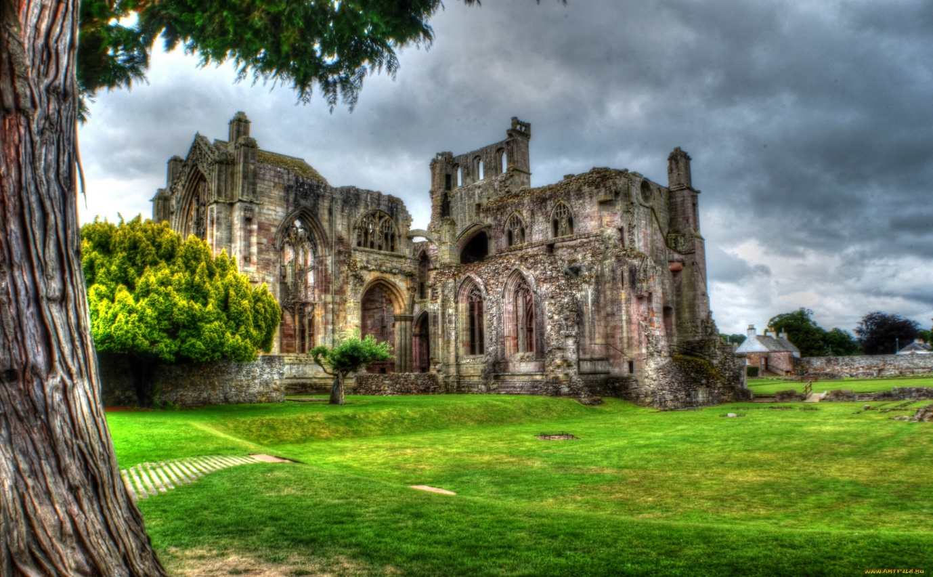
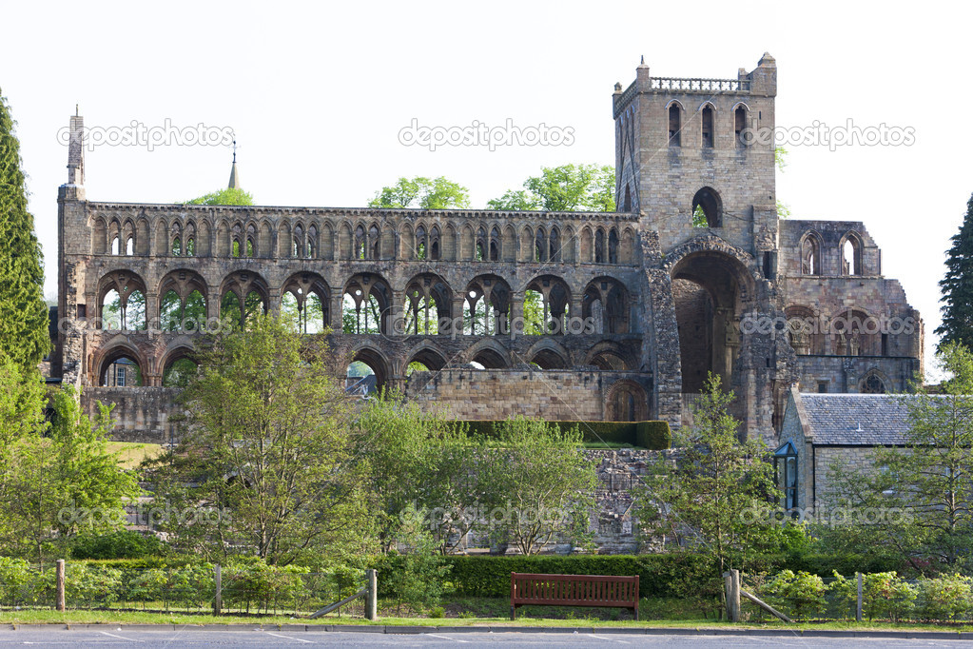

Slide 13
This tree is 5,000 years

Slide 14
The largest number of people with "ginger gene" live in the South-East of Scotland — where they account for about 40 percent of the total world's population.

Slide 15
HISTORICAL PLACE — HADRIAN'S WALL. The history of the fortifications goes back to the distant 122-126 years BC.

Slide 16
VIKINGS

Slide 17
OFFICIAL MYTHICAL ANIMAL — THE UNICORN. It symbolizes the spiritual purity and great wisdom.

Slide 18
INTERESTING FACTS
1.In the country there is a regular flight between the Islands of Westray and Papa Westray. Its length is 2.4 km. The average flight lasts 74 seconds! According to official data it is the shortest in the world.
2.In Scotland there is the famous freshwater lake Loch ness. Worldwide popularity it gained thanks to the legend of the monster named Nessie, who lives in the waters of the lake.
3.The first football match at international level was played between Scotland and England in 1872.
4.The world's first fire Department was established in Edinburgh.
5. Throughout the country there are approximately 750 Islands (more than 130 are uninhabited).

Slide 19
Thanks for watching

