Slide 1
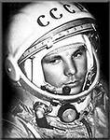
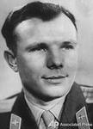
Yuri Gagarin
The Soviet pilot-cosmonaut, Hero of the Soviet Union, cavalier highest distinction a number of states, an honorary citizen of many Russian and foreign cities.

Slide 2
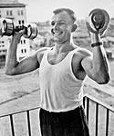
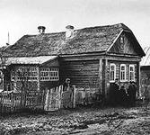
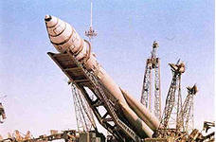
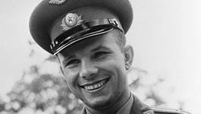
Country: USSR
Major: Pilot-cosmonaut
Military rank:
Expeditions: "East" (12 April 1961) 1st man in space
Time in space: 1 hour and 48 minutes
Date and place of birth: March 9, 1934, the village Klushino, USSR
Date of death: March 27, 1968 (34 years)

Slide 3
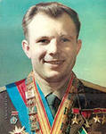
Awards:
The Soviet:
Foreign countries:

Slide 4
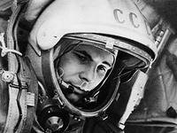
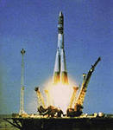
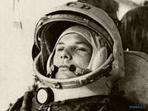
Space flight
Start the "Vostok" was produced April 12, 1961 at 09:07 Moscow time from the Baikonur Cosmodrome, with the pilot-cosmonaut Yuri Gagarin on board Gagarin's call sign was "Cedar".

Slide 5
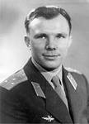
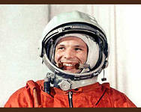
After "at the start," said Gagarin became famous phrase: "Let's go!". Rocket "Vostok" worked without problems
In orbit, Gagarin spent just an experiment: drinking, eating, taking notes with a pencil. "Putting" pencil beside him, he accidentally discovered that he immediately began to float away.

Slide 6
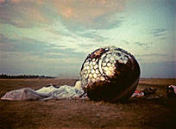
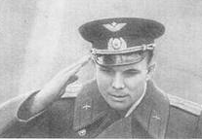
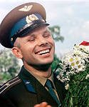
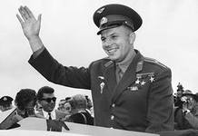
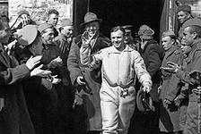
Gagarin meeting
At an altitude of 7 km in accordance with the flight plan Gagarin ejected, after which the capsule and astronaut began to descend by parachute separately.

Slide 7
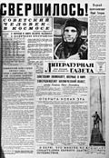
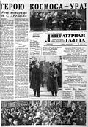
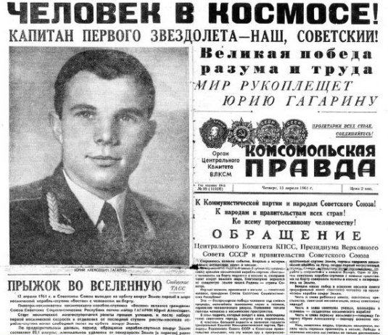
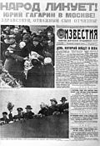
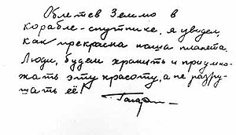
The lighting in the Soviet media

Slide 8
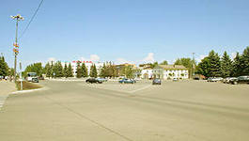
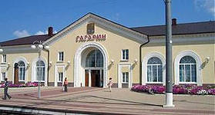
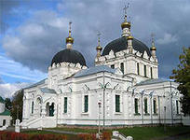
memory
In place-names: Gagarin and Gagarin district (Smolensk region)
Gagarin called boulevards, streets, avenues, squares,
Smelovka memorial in the village near the landing site of the first cosmonaut of the Earth

Slide 9
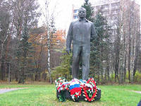
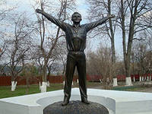
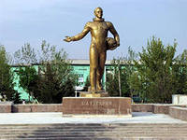
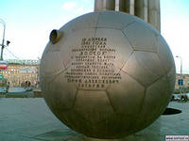
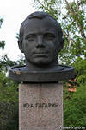
monuments to Gagarin

Slide 10
How are you in 2013? Landed on Mars?

