Slide 1
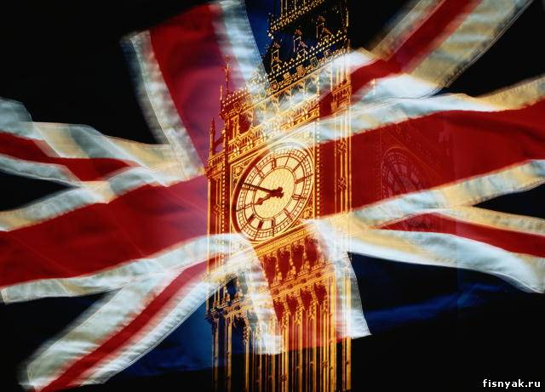
Традиции стран изучаемого языка.
Презентация по английскому языку на тему:
British customs and traditions.
Авторы: Калинина О.Е.
Чернышева Е.С.
МБОУ СОШ №13 г. Балаково 2013 г.

Slide 2
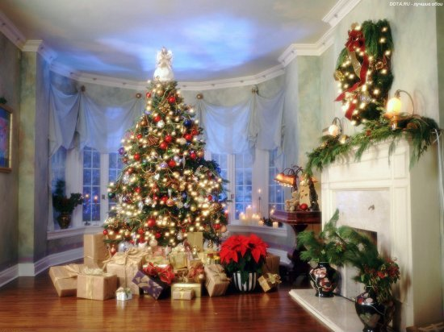
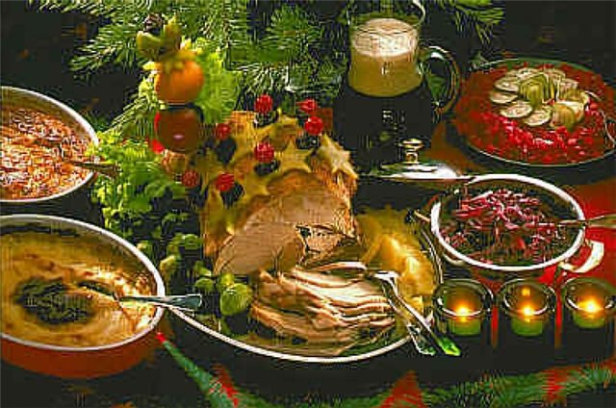
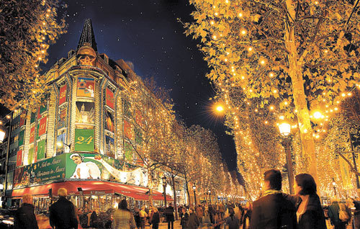
Christmas
Christmas is Christian holiday that celebrates the birth of Jesus Christ. Christmas Day is observed on the 25th of December. For millions of Christians throughout the world it is the happiest and the busiest time of the year. Children write letters to Santa Claus and tell him what presents they would like to get. People send Christmas cards to relatives and friends. On Christmas Eve or Christmas morning, families open their presents. A traditional Christmas dinner consists of stuffed turkey, mashed potatoes, cranberry sauce and a variety of other dishes.

Slide 3
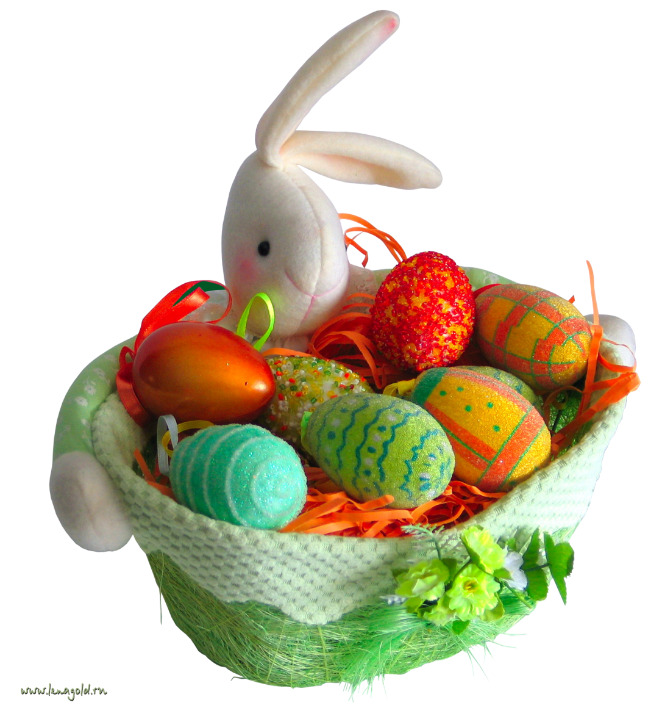
The Easter
Easter is one of the most important holidays in Christianity. It’s a time for giving and receiving presents, mostly Easter eggs. We can say that the egg is the most popular emblem of Easter, but spring-time flowers are also used to stress the nature’s awakening. Nowadays there are a lot of chocolate Easter eggs, having some small gifts inside. Egg-rolling is a traditional Easter pastime. You roll the eggs down a clope until they are cracked and broken, after they are eaten up.

Slide 4
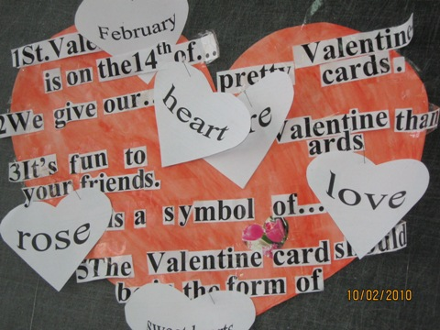
ST. VALENTINE’S DAY
It’s the day when boys and girls, sweethearts and lovers, husbands and wives, friends and neighbours, and even the office staff will exchange greetings of affections, undying love or satirical comment. People send to each other greeting cards, chocolate and flowers. There is a version of the First Valentine. It was a bishop, a Christian martyr who before he was put to death by the Romans sent a note of friendship to his jailer’s blind daughter. Valentine cards are usually decorated with symbols of love and friendship. This day has become traditional for many couples to become engaged.

Slide 5
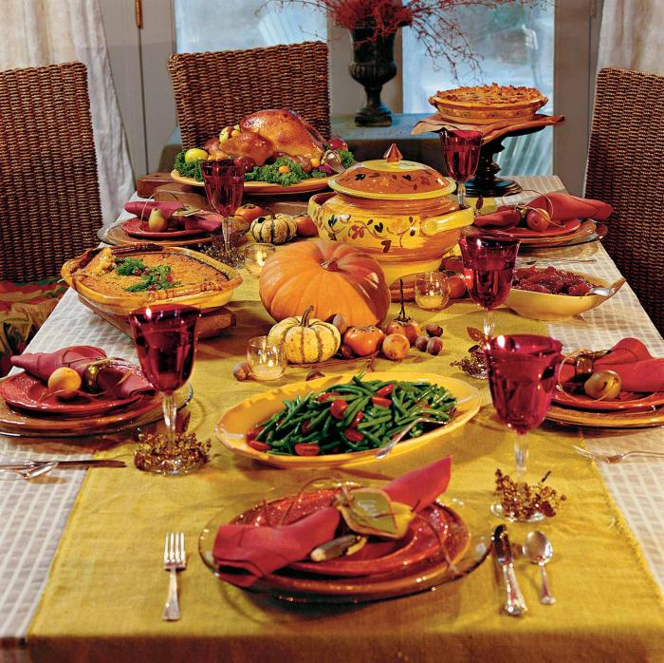
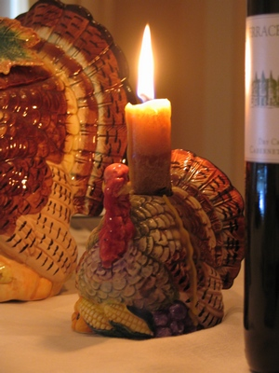
Thanksgiving Day
Almost in every culture in the world there is a celebration of thanks for rich harvest. The American Thanksgiving began as a feast of thanksgiving almost four hundred years ago. After the United States gained independence, Congress recommended one yearly day of thanksgiving for the whole country. Later, George Washington suggested the date November 26 as Thanksgiving Day. Then Abraham Lincoln suggested the last Thursday in November to be the day of thanksgiving. On Thanksgiving Day, family members gather at the house of an older relative, even if they live far away. All give thanks for everything good they have.

Slide 6
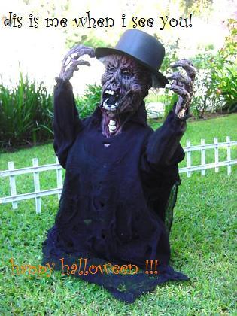
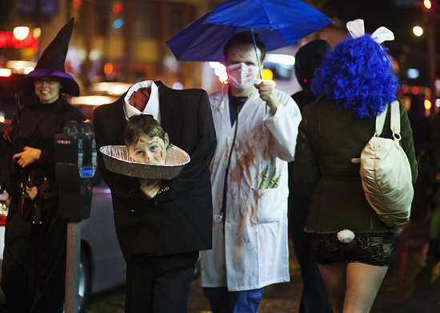
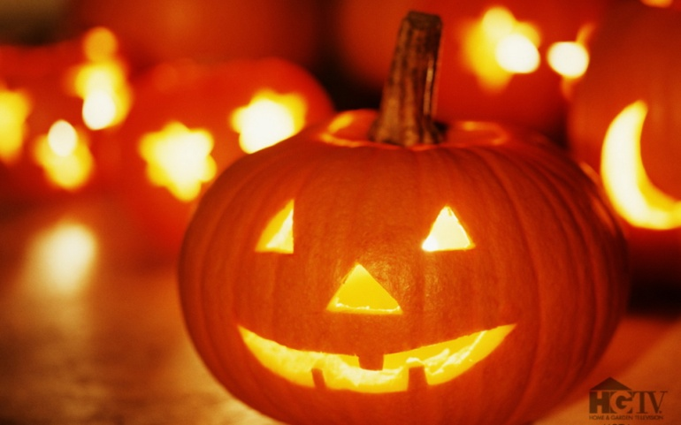
Halloween
October 31st is Hallowe'en, and you can expect to meet witches and ghosts that night. A long time ago people were afraid and stayed at home on Hallowe'en. But now in Britain its a time for fun. There are always a lot of parties on October 31st. At these parties people wear masks and they dress as ghosts and witches, or as Dracula or Frankenstein's monster. And some people make special Hallowe'en lamps from a large fruit the pumpkin. First they take out the middle of the pumpkin. Then they cut holes for the eyes, nose and mouth. Finally they put a candle inside the pumpkin.

Slide 7
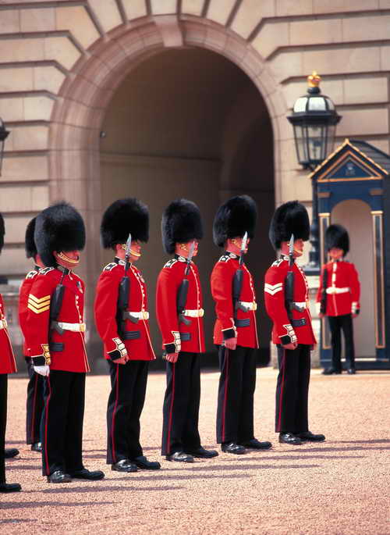
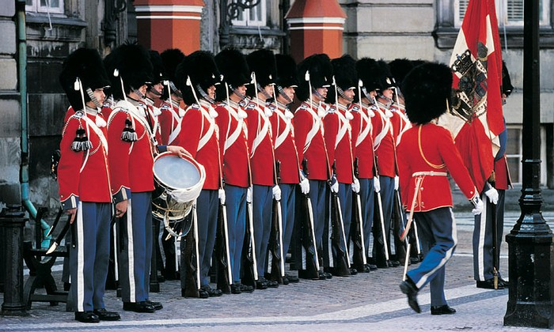
Changing of the Guard The ceremony of the Changing of the Guard that takes place daily at eleven o'clock in the morning. Every day a large crowd of people gather to see this famous and traditional ceremony. The troops who take part are selected from the five regiments of Foot Guards. Their numbers depend on whether the Queen is in residence or not. The men of the duty guard march from either Wellington or Chelsea Barracks to Buckingham Palace with a band.

Slide 8
Countries and sities
Canada
Japan
India
Australia
Spain
Egypt
France
Vietnam
China
Norway
Kenya
Tokio
Madrid
Peking
Canberra
Ottawa
Delhi
Hanoi
Cairo
Paris
Oslo
Nairobi
back

Slide 9
Riddles
The little old woman who has 12 children: Some short, some long, some cold, some hot. What is it?
2. What has teeth, but cannot bite?

Slide 10
Riddles
1. What has a face, but no head, and hands, but no fingers?
2. It hears everything and says nothing.

Slide 11
Proverbs
keeps the doctor
away
So many men
2.Like father
3. A cat in gloves
4. An apple a day
5. A good beginning .
6. Better an egg today
b. makes a good ending.
c. so many minds.
d. than a hen tomorrow
e. catches no mice
f. like sons.

Slide 12
Make words
Christmas Day

Slide 13
Make sentenses
tree, Santa Claus, winter, common, present, poems,
socks, fireplace, cards, games, snow, sweets, decorate, favourite, songs, church, holly, snowman, deer, turkey, bells, pudding, special.

Slide 14
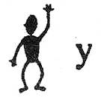
Rebus

Slide 15
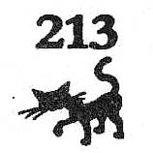
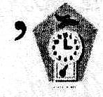
Rebus

