Slide 1
Student's life in USA

Slide 2
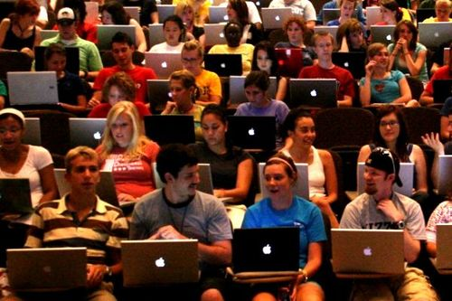
In America it is possible not to choose a speciality at a receipt stage in university. There the person enlisted in high school, throughout two years has possibility to reflect on whom to study.

Slide 3
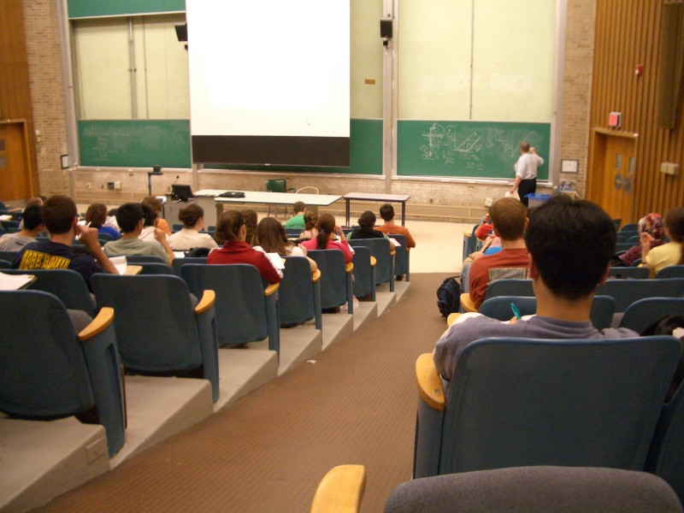
The university appoints obligatory courses and facultative – and within first two weeks allows to replace one course with another if, for example, you don't like the professor or the course has appeared for you uninteresting.

Slide 4
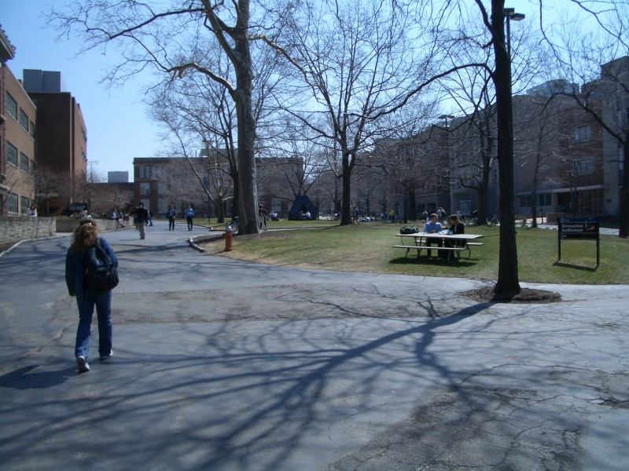
At each student the own schedule of study. Therefore at huge university the student, in general, is lonely. Such concept as ' the group ', there doesn't exist. With one people you sit at a seminar, is perfect with others listen to lecture.

Slide 5
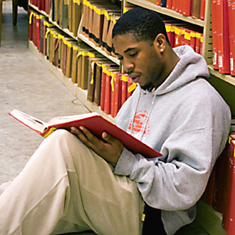
The American students approach to got knowledge as to base bases of the future trade. Unlike our, Russian, students the American don't perceive student's years as the carelessness period when it is possible to oversleep, shirk etc.

Slide 6
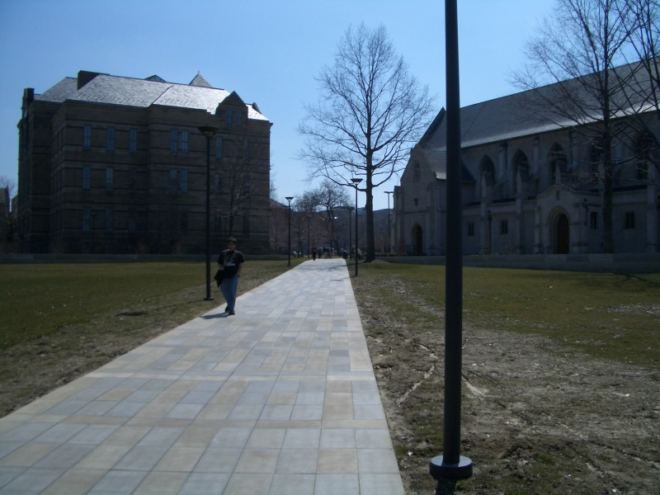
Students should pay the formation since free training in the USA isn't present.

Slide 7
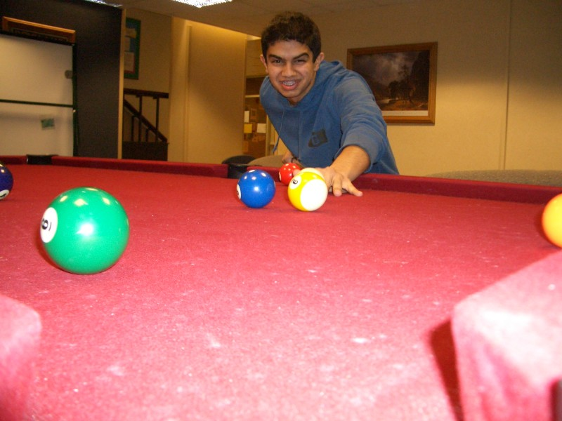
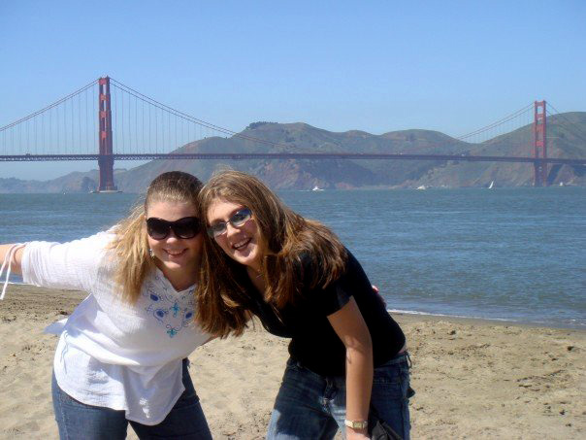
The American students almost also as well as Russian have a rest and have a good time. They visit bowling, billiards, go on discos, to cinema, travel.

Slide 8
The American student conducts much more various way of life, than it is represented at first sight. Besides a student's school desk, libraries, offsets and parties after them, pupils of colleges and higher educational institutions have found to themselves employment much more interesting.

Slide 9
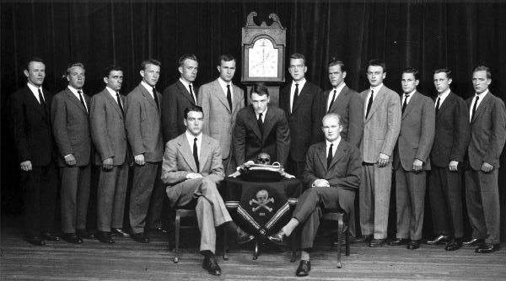
Students of many HIGH SCHOOLS and colleges are united in «фратрии». Фратрии (from Greek "brotherhood") Each of them has the motto, an emblem and "cabinet" with accurate distribution of powers. Brotherhoods live under own laws and piously observe all ordered rituals (dedication and so forth). Officially proclaimed purposes of their activity - the organization of student's leisure. Including sports, carrying out of charitable actions, all-round aid to "brothers" and etc.

Slide 10
Bright student's life, certainly, is very attractive and takes a special place in the American culture, but besides fun, it has one more important line: an American education, actually, qualitative and effective.

Slide 11
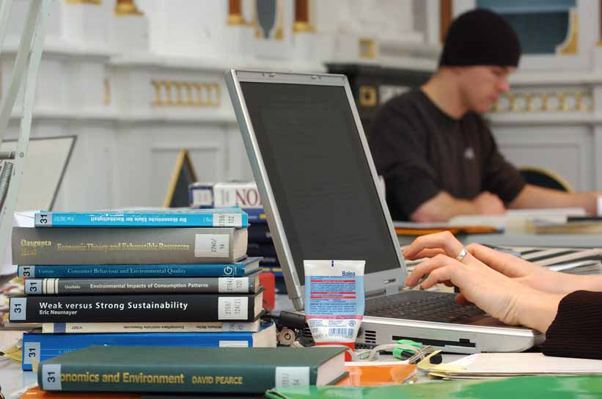
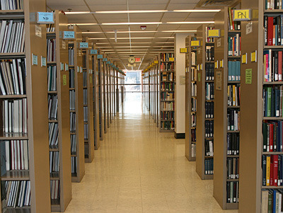
On a campus all conditions for productive educational process: in hostels on each floor – the computer class, also computer classes is on a campus and they work 24/7, in each computer class – on the printer filled with a paper for your unlimited using. Wi-fi in any point of a campus at your order, besides some cases are opened 24/7 that you could come and learn during any time convenient for you. Well and certainly, library catalogs are accessible in electronic form that you could is direct from the room to look, whether there is available this or that book.

Slide 12
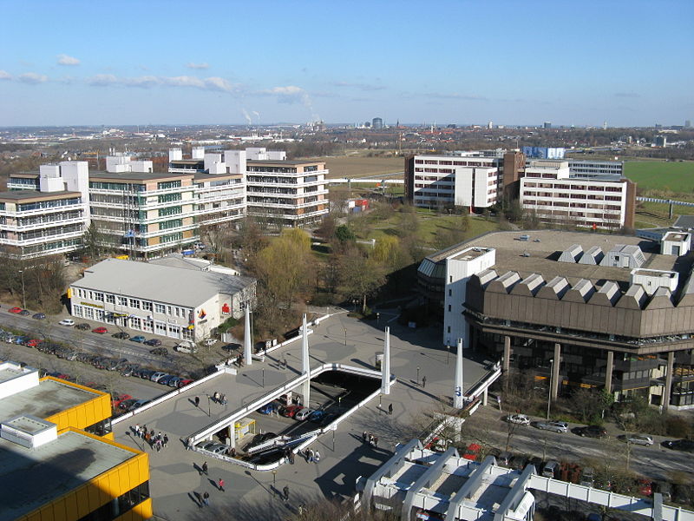
Campus— the campus including, as a rule, educational premises, scientific research institutes, premises for students, libraries, audiences, dining rooms and etc.

Slide 13
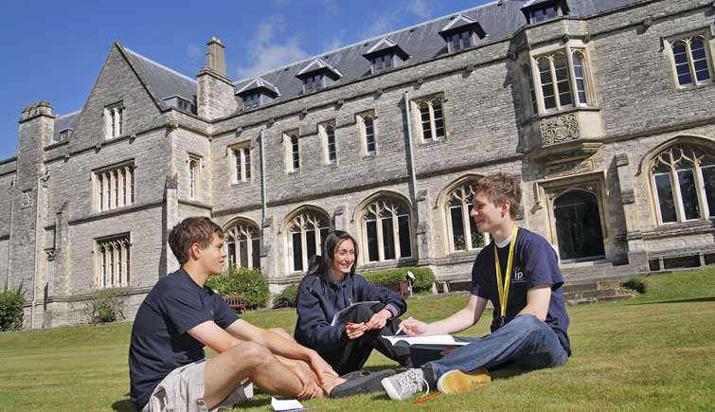
“study groups”. It is the typical form of preparation for seminars and control: students собираються groups on 3-5 persons also try to understand a material by discussion in group. As shows experiment, such groups promote the best mastering of a material, development of communicative abilities, a sense of responsibility and collective rapprochement. To that in the majority of tasks for seminars – group so to "hammer" it will not turn out, differently you will bring not only, but also group.

Slide 14
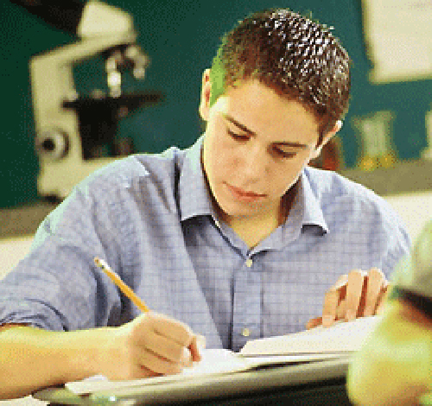
Any oral examination – all in writing! It is not necessary to wait hours for the turn at a door!

