Slide 1
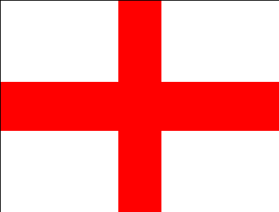
THE UNITED KINGDOM OF GREAT BRITAIN AND NORTHERN IRELAND
Prezentacii.com
Автор проекта: Леонтьева Татьяна Филипповна, учитель английского языка МОУ СОШ с УИОП г.Кирс

Slide 2
Краткая аннотация проекта
Данный урок может быть проведен как урок систематизации знаний в системе уроков по теме: «Великобритания» по учебникам Кузовлева В.П. и Верещагиной И. Н..Тема презентации способствует формированию социальной и коммуникативной компетентностей.

Slide 3
Основополагающий вопрос
The UK is an English speaking country with its traditions, isn’t it?

Slide 4
Подтемы проекта:
A. Parts of the United Kingdom
B. Symbols and flags of the countries
C. Sights of London

Slide 5
Проблемные вопросы:
A. Why can we say that Great Britain is a part of the Kingdom?
B. Is it possible to speak about countries without their symbols?
C. Sights of London are connected with the past, aren’t they?

Slide 6
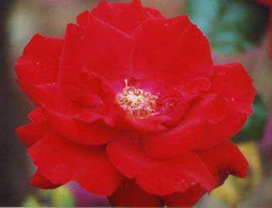
England
Every country has its own symbol. Red rose is the emblem of England. The flag of England is the red cross of St.George.

Slide 7
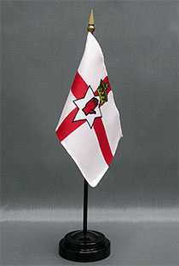
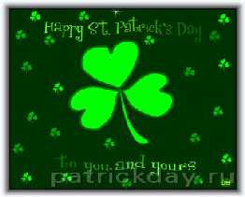
Northern Ireland
Northern Ireland has its own symbol- a shamrock.The flag is the red cross of St.Patrick.

Slide 8
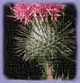
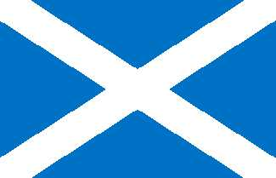
Scotland
The national symbol of Scotland is the thistle and a white flag of St. Andrew.

Slide 9
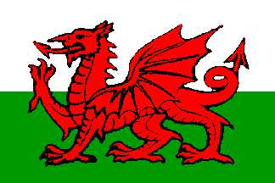
Wales
Wales has a daffodil, as a symbol.There are many of them in the Wales valleys.

Slide 10
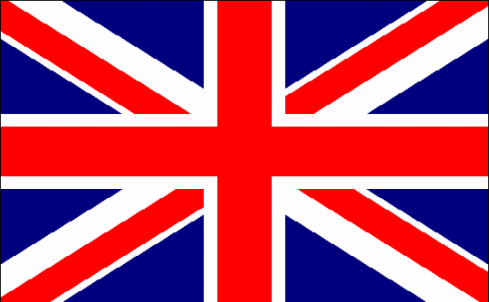
‘Union Jack’
The flag of the United Kingdom is known as the Union Jack.It is made up of three crosses.

Slide 11
Историческое прошлое Лондона
Авторы проекта:
Веретенникова Марина,
Горшкова Тамара,
ученицы 7 «А» класса МОУ СОШ с УИОП г.Кирс

Slide 12
Историческое прошлое Лондона
Авторы проекта:
Веретенникова Марина,
Горшкова Тамара,
ученицы 7 «А» класса МОУ СОШ с УИОП г.Кирс

Slide 13
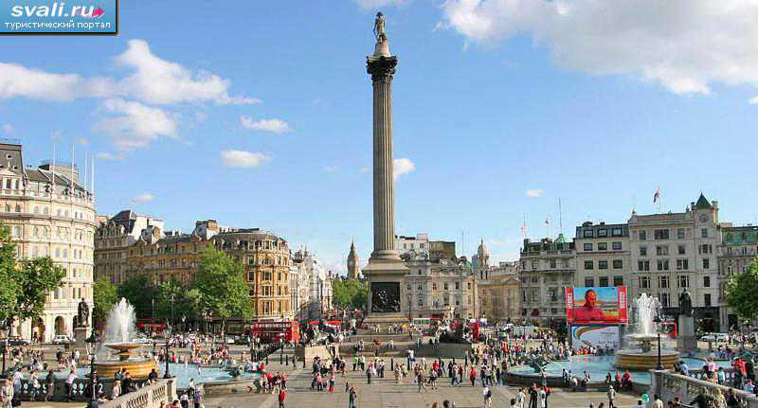
1. It is the largest sguare. You can see a tall column. People go there to see the New Year in.

Slide 14
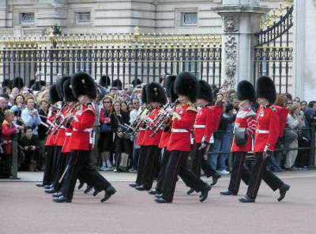
It is the residence of the British Queen. There are many guards near it. They are dressed in red clothes and black caps.

Slide 15
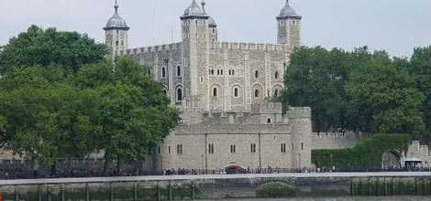
It is one of the oldest buildings. It was a prison, a fortress in the past. Black ravens live there now.

Slide 16
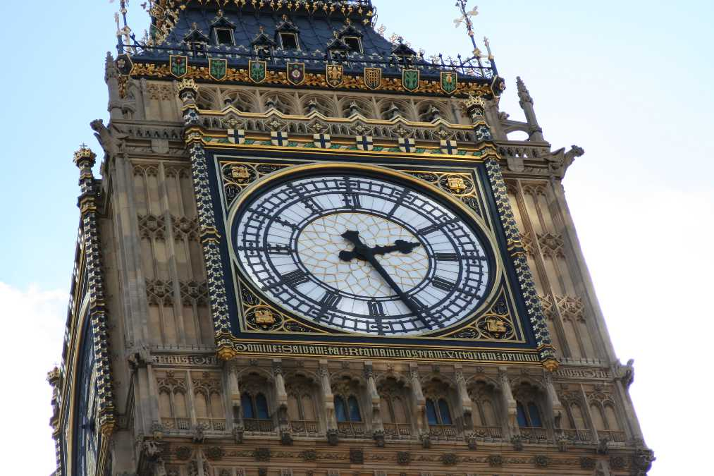
It is the largest clock. It strikes every hour. Many tourists want to see it.

Slide 17
This building is situated on the bank of the river Thames. It consists of two Houses.The flag can be seen over it.

Slide 18
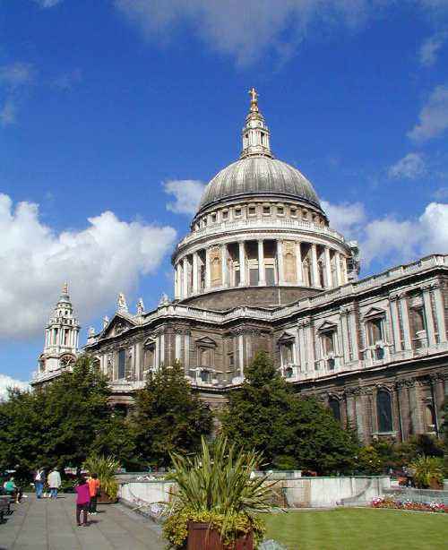
It is one of the oldest churches. It is crowned with a huge dome. Sir Christopher Wren built it 35 years.

Slide 19
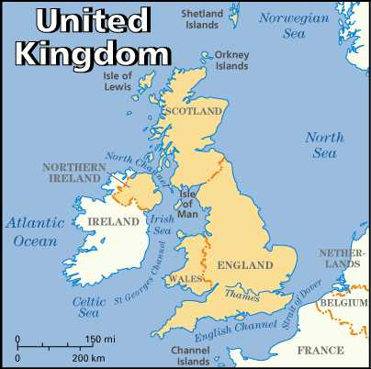
Test
1. Great Britain is separated from the continent by…
a. the Pacific Ocean
b. the Irish Sea
c. the Bristol Channel
d. the English Channel
2. Britain’s population is more than…million people
a. 56 b. 5,6 c. 560 d. 7
3. The head of State in Britain is…
a. the Prime Minister
b. the President
c. the Queen
d. the Speaker
4. The ‘Union Jack’ is…
a. the flag of the UK
b. the flag of Scotland
c. the flag of Wales
d. the flag of England
5. The symbol of England is….
a. daffodil b. shamrock
c. red rose d. thistle
6. The capital of the UK is….
a. Belfast b. Dublin
c. Edinburgh d. London
7. How many countries are there in the UK?
a. 2 b. 3 c. 1 d. 4

Slide 20
QUESTIONS
1. Where does the Queen work?
2. Who does the power in the country belong to?
3. Is Westminster Abbey an attractive place for tourists?
4. What did the Tower of London use to be in the past?
5. Where can you see Big Ben?
6. What is Trafalgar Square famous for?

Slide 21
Состав УМП
Визитка
Презентация учащихся
Дидактические материалы
Тесты
Вопросник

Slide 22
Спасибо за внимание !

