Slide 1
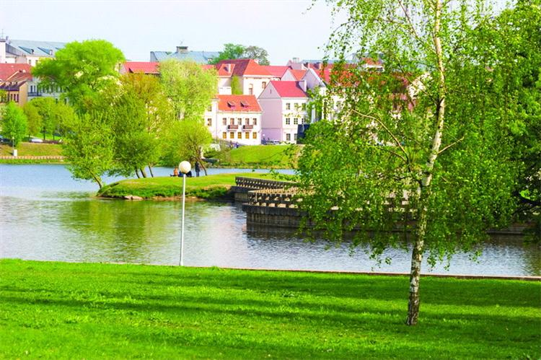
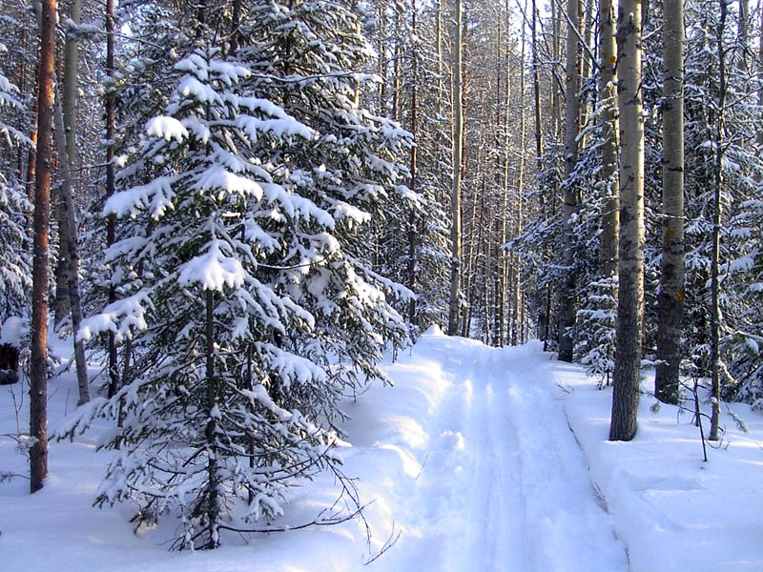
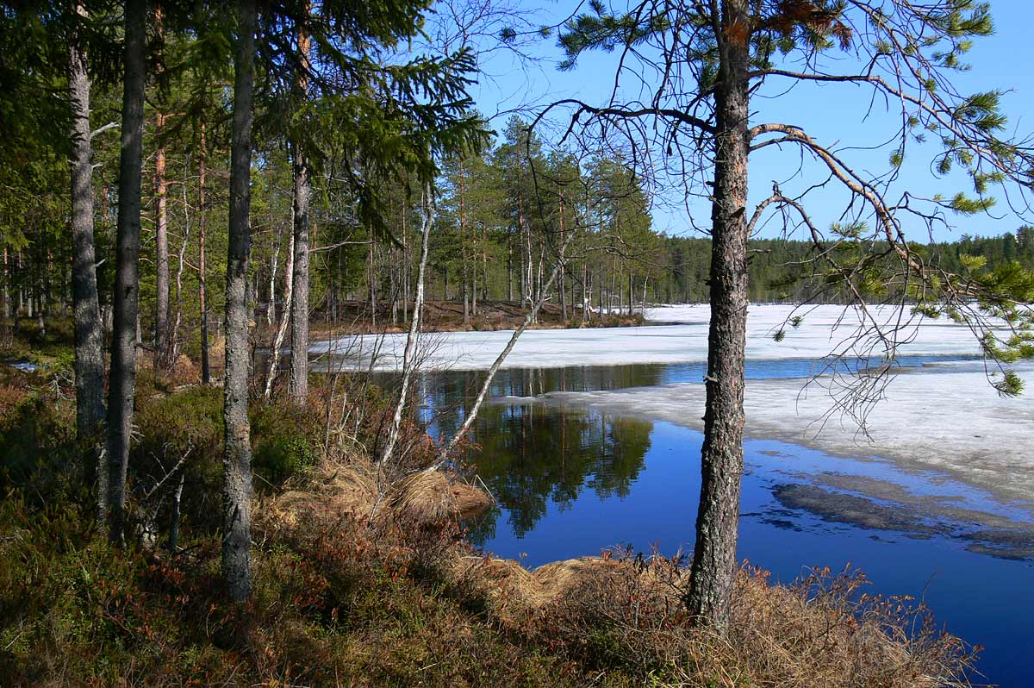
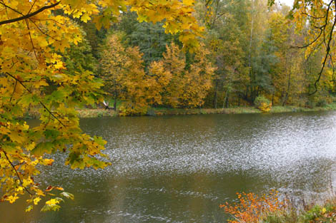
Weather and climate of Belarus

Slide 2
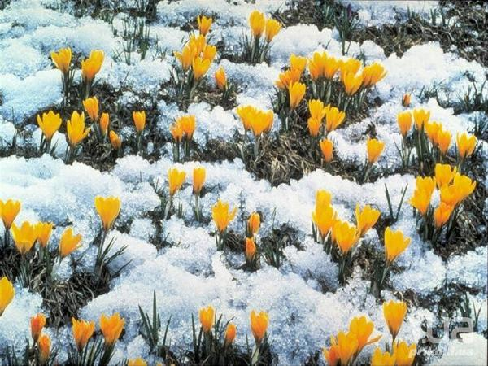
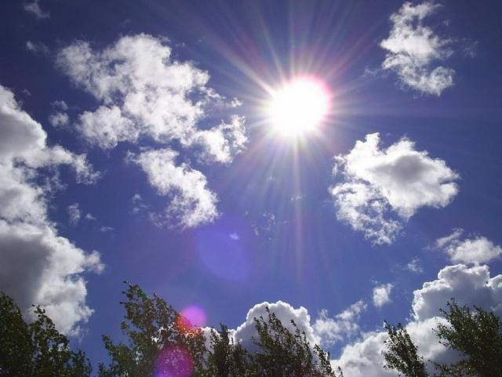
What is the climate of the weather?
Weather - is the state of the atmosphere in this location at a certain time or for a limited period of time (day, month, year).
Climate - is the long-term patterns of weather, typical for the given area due to its geographical position.

Slide 3
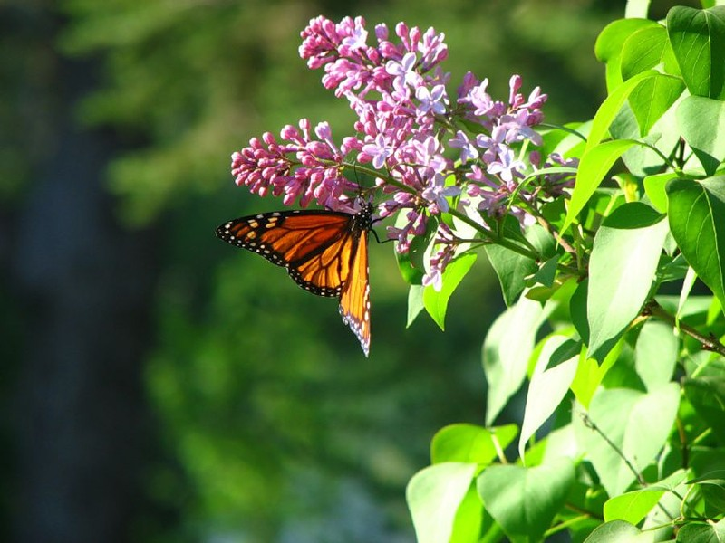
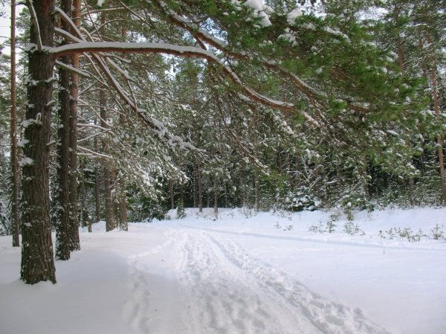
The Climate Of Belarus
The Climate of Belarus is moderately continental. Is formed under the influence of air masses of the Atlantic ocean, is characterized by rainy ,cool summers , mild winter with frequent thaws, unstable weather in autumn and winter.

Slide 4
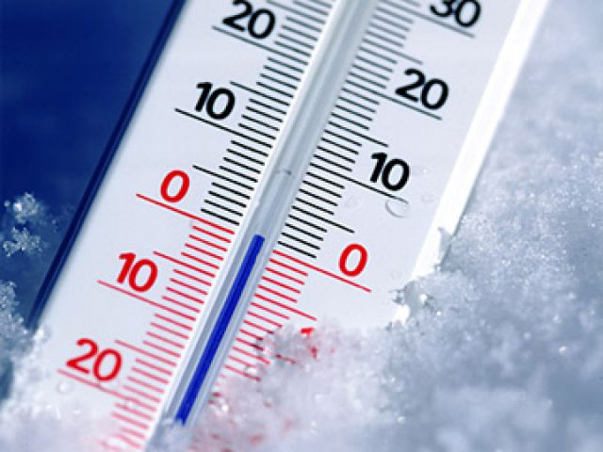
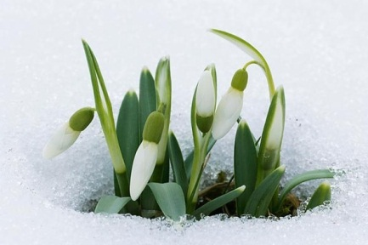
The temperature of the air in Belarus
The average temperature varies depending on regions of Belarus. In July the average temperature is from +17 C in the north to +18,5 C in the south.
The average temperature in January ranges from-cent-4,5 per cent C in the south-west up to -8 C in the north-east.
In some regions of Belarus temperature below zero is stored more than one-third of the year.

Slide 5
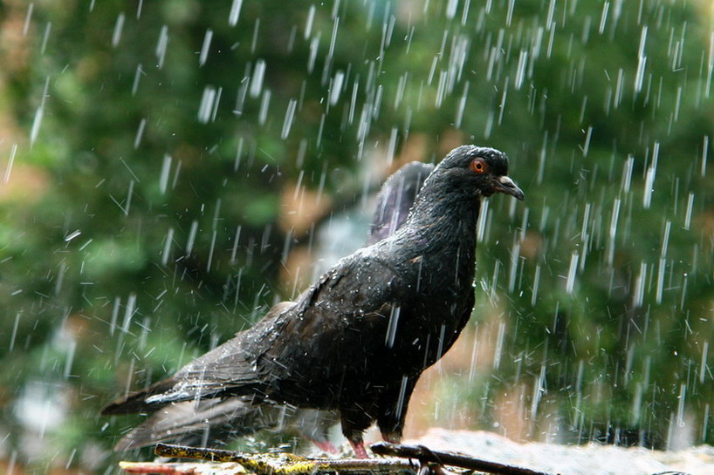
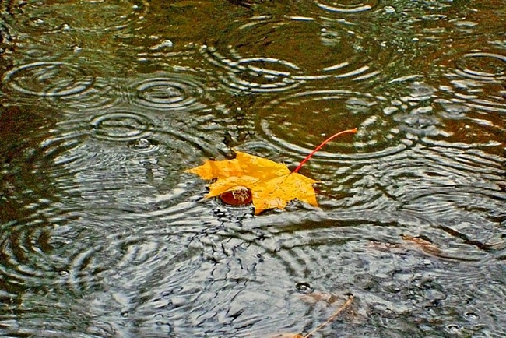
Rainfall in Belarus
On the territory of Belarus at an average annual rainfall is 600 to 700 mm of precipitation.
70% of precipitation in the form of rain falls in April-October.
The number of snow days in Belarus, from 75 in the south-west up to 125 in the north-east. Maximum height of snow cover, respectively, from 15 to 30 cm.

Slide 6
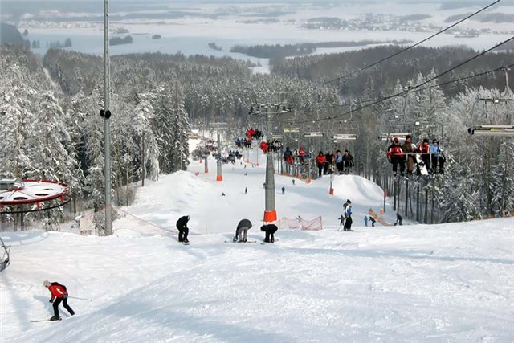
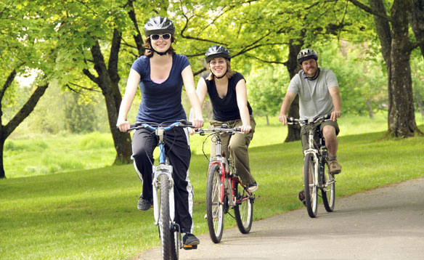
Best time to travel to Belarus
For summer recreation favorable time period with daily average temperature above 15 C increase in the direction from the north-east to south-west - with 70-89 days in Poozerie up to 90-95 days in Central Belarus and 96-114 days in Polesie.
For the winter holidays favorable period with temperatures ranging from -5 to -15 degrees C ranges from 30 days in the south-west of up to 60 days in the north-east, and in the cold of winter it can grow up to 130 days.

Slide 7
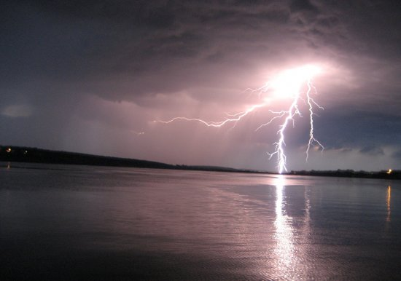
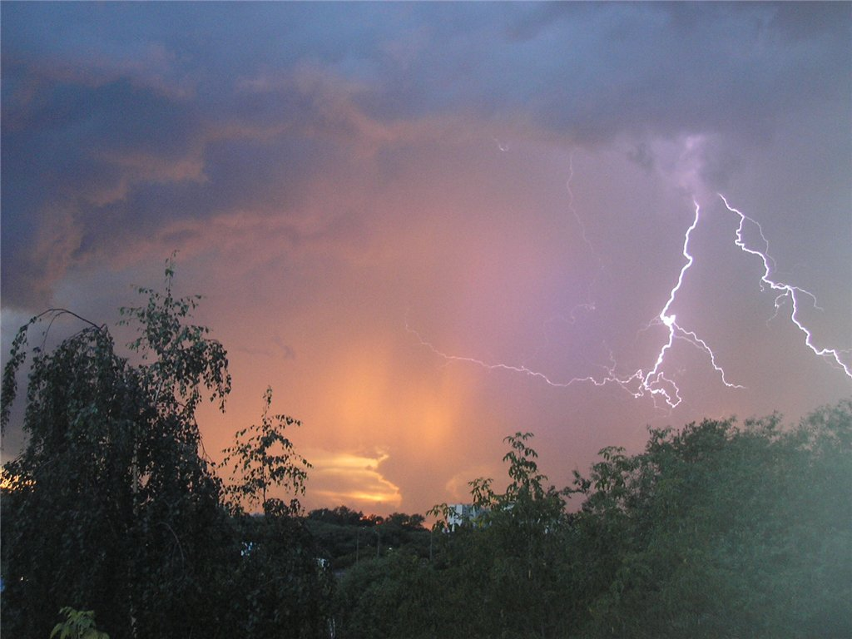
Omens about the weather
When the day was hot, stuffy and are increasing rapidly
cumulus clouds, it portends a thunderstorm.

Slide 8
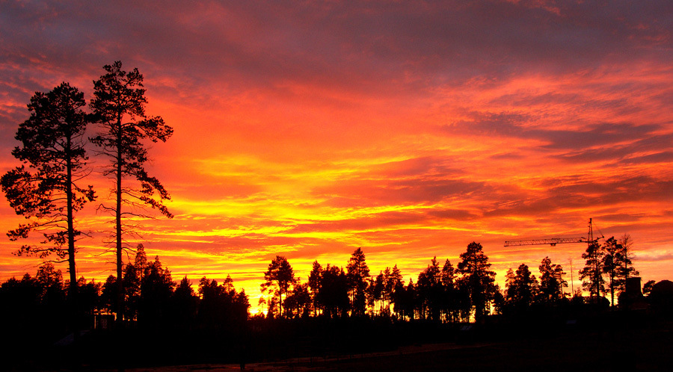
Omens about the weather
When the evening becomes bright red or
purple color - it is to a deterioration in the weather.

Slide 9
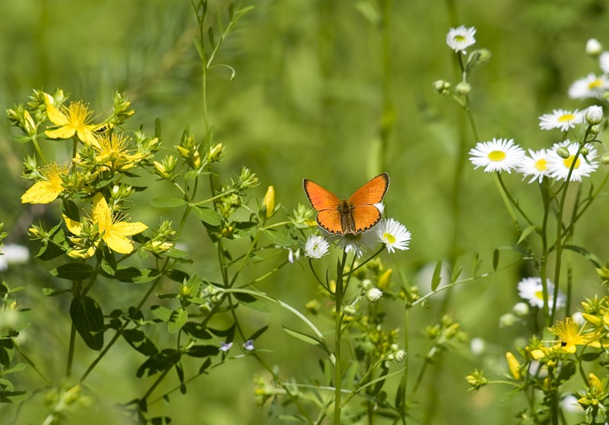
Omens about the weather
If the smoke from the chimneys and from the fire rises straight up it portends good weather.

Slide 10
The End.
Thank you for your attention!

