Slide 1
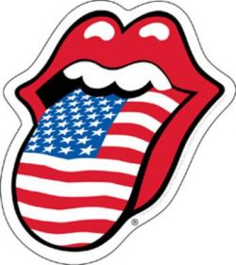
Rock & Roll
Rock and roll is a genre of popular music that originated and evolved in the United States during the late 1940s and early 1950s.

Slide 2
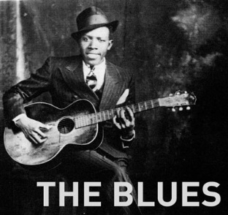
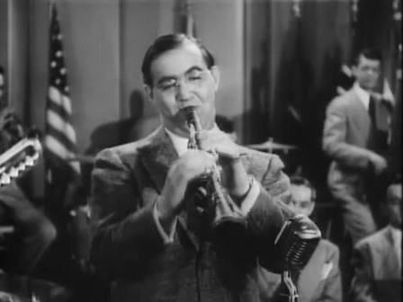
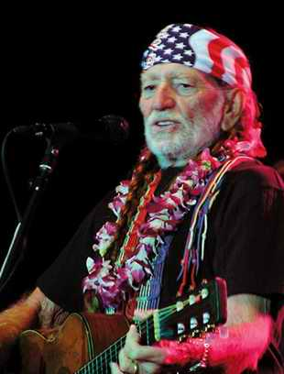
Stylistic origins
Blues
Gospel
Folk
Country
Electric blues
Jump blues
Chicago blues
Swing
Boogie-woogie
Rhythm and blues

Slide 3
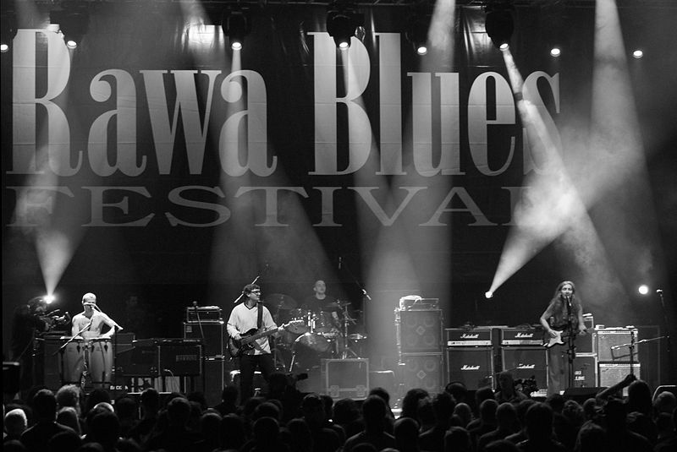
Blues
Blues is the name given to both a musical form and a music genre that originated in African-American communities of primarily the "Deep South" of the United States at the end of the 19th century from spirituals, work songs, field hollers, shouts and chants, and rhymed simple narrative ballads.

Slide 4
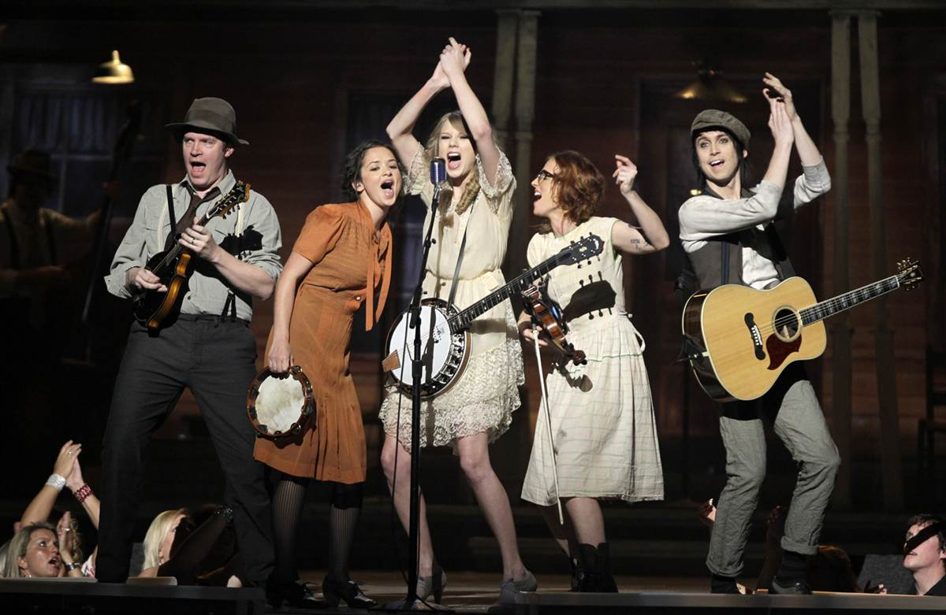
Country
Country music is a popular American musical style that began in the rural Southern United States in the 1920s. It takes its roots from Western cowboy and southeastern American folk music.

Slide 5
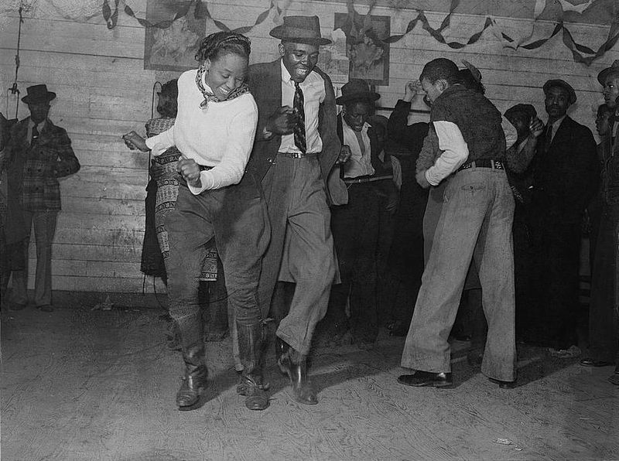
Swing
"Swing dance" is most commonly known as a group of dances that developed with the swing style of jazz music in the 1920s-1950s, although the earliest of these dances predate "swing era" music.

Slide 6
The history of Rock & Roll
For questions 1-11, read the text below and decide which answer A,B,C or D fits best each space. There is an example at the beginning.
Rock ’n’ roll started in the USA (0)_C_ the great black rhythm ’n’ blues players: Muddy Waters; John Lee Hooker and Chuck Berry. Fifty years ago black white music were two completely separate things .Chuck Berry was the fist black musician (1)__ cross the barrier and sell records to (2)__ black and white young people .His songs were about the lives of teenagers .Jerry Lee Lewis, Elvis Presley and Buddy Holly mixed black music with white ‘country’ music to create rock ‘n’ roll .This was all happening in the US .But people in Britain were listening to this music(3)__. The black rhythm ‘n’ blues singers and the best rock ‘n’ roll stars (4)__ Buddy Holly were (5)__ popular in Britain than in the States. Then, in the 1960s the British invaded America, (6)__ the Americans some years before did. The Beatles , The Rolling Stones, The Kinks, The Who. There were concerts with tens of thousands of fans. The name of the music – rock ‘n’ roll changer to ‘rock’. In the 1960s the style of the musicians changer a lot. The clothes of the musicians became crazy and (7)__ their hair. The guitar became (8)__ important as the voice . Jimi Hendrix and Eric Clapton were guitarists (9)__than singers. In the 1970s rock went in two different directions.(10)__ Elton John and Rod Stewart , The Sex Pistols, The Stranglers , and a few other bands started to play loud, violent music called ‘punk’ . Punk was also important (11)__ a fashion in clothes.

Slide 7
0 A. at | B. on | C. with | D. from
1 A . who | B. that | C. to | D. -
2 A. like | B. As | C. - | D. both
3 A. too | B. either | C. so | D. -
4 A. as | B. Like | C. so | D. and
5 A. so | B. As | C. more | D. Much
6 A. as | B. like | C. So | D. Also
7 A. so did | B. So was | C. Both was | D. As did
8 A. so | B. As | C. Too | D. More
9 A. best | B. Also | C. More | D. Much
10 A. not as | B. As not | C. Unlike | D. More than
11 A. like | B. - | C. than | D. as
Your score | 11-10 | 9-8 | 7-6 | 5
Your mark | 5 | 4 | 3 | 2

