Slide 1
Учитель английского языка
ГБОУ СОШ № 546 г Санкт-Петербурга
Листова Елена Геннадьевна
Notes:
Good day everybody. Today we`ll speak about the UK, so I want to tell you about Tower of London.

Slide 2
Цели презентации
Познакомить учащихся с одной из главных достопримечательностей Лондона.
Развивать воображение и языковую догадку у детей.
Учить рассказывать о достопримечательности по плану-презентации.
Notes:
Эта презентация может быть показана в 6-9 классах общеобразовательных школ, в контексте изучения темы «Лондон». Рассказывать может как учитель, так и подготовленный ученик из класса или старшеклассник.

Slide 3
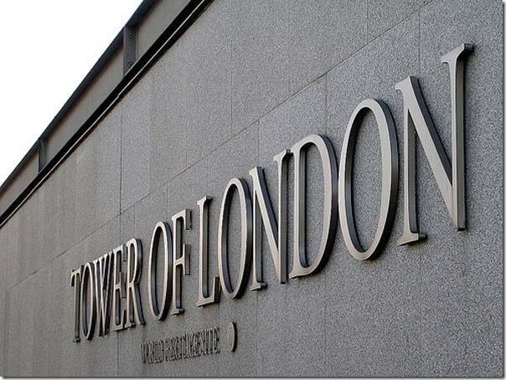
Tower of London - symbol of Great Britain
Notes:
The Tower of London — one of the symbols of Great Britain. It takes a special place in the history of the English nation and is one of the most visited places in the world. The Towe Crows, yeomen guards, royal jewelry and stories about a gloomy fortress prison — here are the first associations with the name the Tower of London.

Slide 4
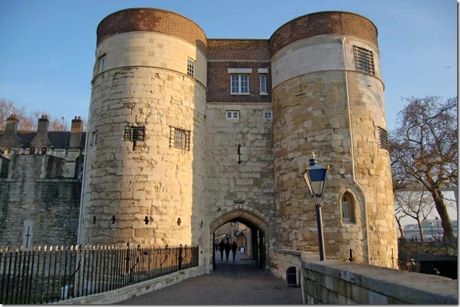
Fortress round the city
Was built from 1066 to 1377
Notes:
In 1066 the duke of Normand Villiam began a gain of England. By the end of the Anglo-Saxon period London becomes the predominating city in Engiand. Safety of the city was Villiam's main goal during his crowning. He gives the order to build a fortress round the city. So in 1100 the construction of the White Tower comes to an end. The Tower is protected by huge walls from the northern, western and southern parts. In 1377 all constructions in the Tower ended.

Slide 5
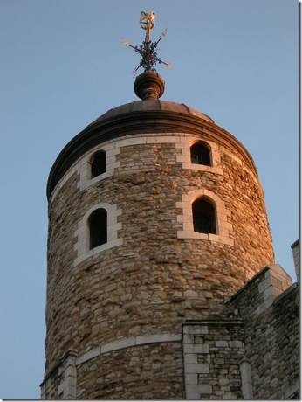
Tower as a prison
Henry VI, and also 12-year-old Edward V and his younger brother were killed.
Henry VI, and also 12-year-old Edward V and his younger brother were killed.
Henry VI, and also 12-year-old Edward V and his younger brother were killed.
The first prisoner was confined to the Tower in 1100.
Henry VI, and also 12-year-old Edward V and his younger brother were killed.
Notes:
The first prisoner was confined to the Tower in 1100. At that time the Tower - prison intended for the richand a high rank people. Among the most high-ranking prisoners were kings of Scotland and France and members of their families, and also representatives of the aristocracy and the priests. Tower walls also remember many executions and murders: In the Tower Henry VI, and also 12-year-old Edward V and his younger brother were killed.

Slide 6
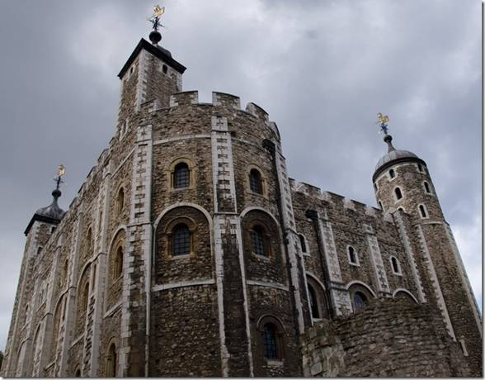
Reputation of an ominous place
A lot of the persons of a royal sort were forwarded in the Tower and then were executed.
Notes:
The Tower got reputation of an ominous place of tortures at the time of the Reformation. Henry VIIIth wanted to have the son and started to pursuit all who refused to recognize him the head of Church of England. Henry accused Anna Boleyn, his second wife, in treachery and an adultery. As a result Anna, her brother and four other persons were decapitated in the Tower. The same was with Catherin Howard, Henry's fifth wife. A lot of the persons of a royal sort were forwarded in the Tower and then were executed.

Slide 7
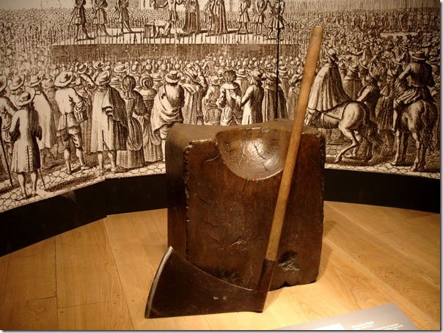
Tower Hill
1500 people`s bodies were buried in chapel cellars.
Notes:
Only five women and two men were decapitated in the fortress territory that rescued them from a shame of a public execution. Three from these women were queens — Anna Boleyn, Catherin Howard and Jane Grey. The most part of other executions — generally beheading — occurred on the Tower hill. The cut head put on a stake and exposed on a public inspection on London Bridge as the prevention for the others. The decapitated body was taken away in the Tower and buried in chapel cellars.

Slide 8
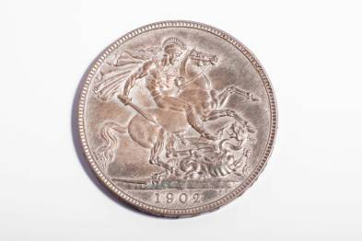
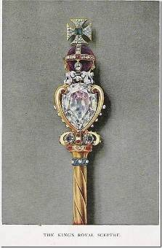
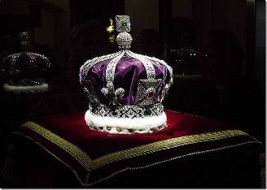
The main office of a royal mint
The weapon and military equipment of the king and royal army was produced and stored in the Tower.
Notes:
More than 500 years in the Tower there was the main office of a royal mint. Henry VIIIth ordered the mintage from the silver of destroyed monasteries. Important states and legal records were stored in the Tower, and the weapon and military equipment of the king and royal army was produced and stored.

Slide 9
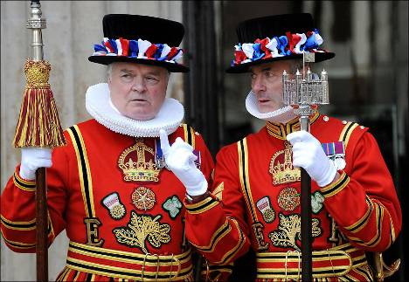
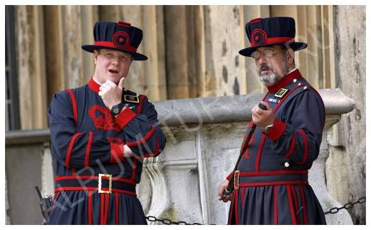
Palace guards
Notes:
Palace guards protect the Tower up to this days. In occasions they dress magnificent suits of times of Tyudor. In usual days they are dressed in dark blue uniforms of the Victorian era. English guards quite often call bifiters. museum.

Slide 10
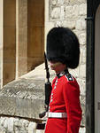
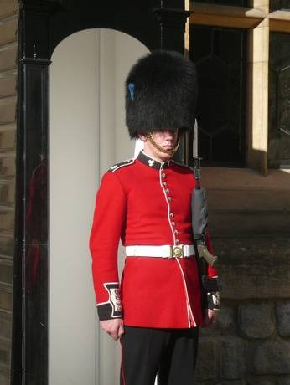
Palace guards
Notes:
This nickname, appeared at the time of hunger when Londoners underate, and the palace guards regularly received a ration of beef meat. The English crown provided to itself reliable protection. Today the Tower of London is a museum.

Slide 11
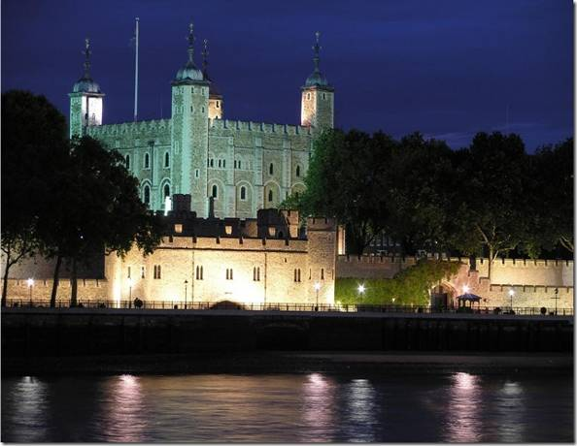
Tower at night
Notes:
At night Tower is as beautiful as during day. Many big lamps lights all Tower wall and the Tower.

Slide 12
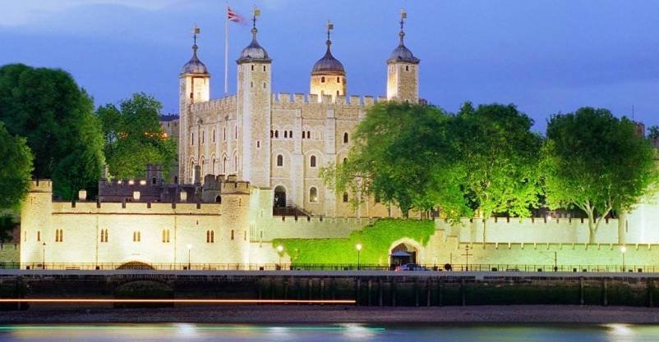
Museum
Notes:
Today Tower of London is a museum. But the history of the UK remember it as a king residence and a prison. If you visit the Tower of London you`ll enjoy it!

Slide 13
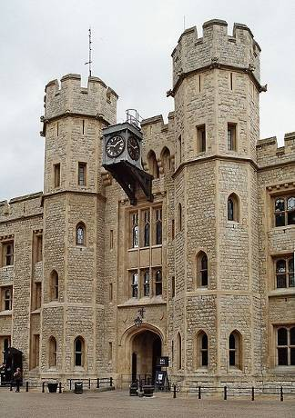
Thanks for your attention
Notes:
I think that you like this presentation. Thanks for your attention. Now try to tell us some facts from the life of the Tower of London.

Slide 14
Список источников
Статья «Лондонский Тауэр» с иллюстрациями
http://lifeglobe.net/blogs/details?id=659
Статья «Лондонский Тауэр»
http://en.wikipedia.org/wiki/Tower_of_London

Slide 15
Список источников
http://lifeglobe.net/x/entry/659/1_1.jpg
http://lifeglobe.net/x/entry/659/1240508099_vorota_3.jpg
http://lifeglobe.net/x/entry/659/1240506880_belajabashnja_3.jpg
http://lifeglobe.net/x/entry/659/2728751_3.jpg
http://lifeglobe.net/x/entry/659/1240507251_plakha_3.jpg
http://lifeglobe.net/x/entry/659/1240506497_dragocennosti_02_3.jpg
http://static.infoturism.ro/poze-oferte/circuit/poze/792679.jpg
http://www.town-explorer.ru/wp-content/uploads/2011/10/721.jpg
http://im6-tub-ru.yandex.net/i?id=211602156-18-72&n=21
http://gfreemom.com/wp-content/uploads/2010/10/DSC_1954-685x1024.jpg
http://lifeglobe.net/x/entry/659/1245223898_london_touwer_31_3.jpg
http://im0-tub-ru.yandex.net/i?id=179311108-59-72&n=21
http://s018.radikal.ru/i514/1201/b2/e7e96b1a3597.jpg

