Slide 1
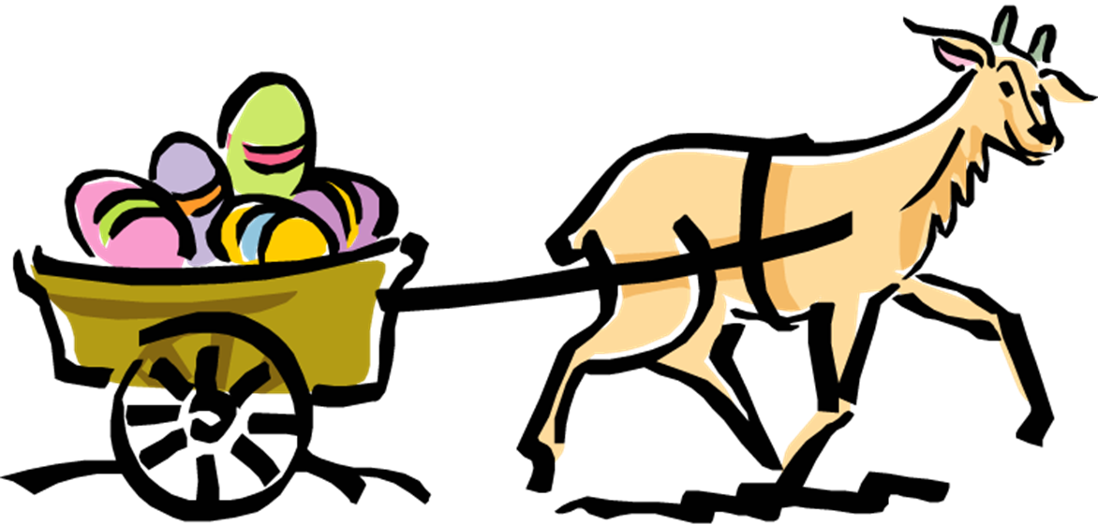
Easter
In England and Russia

Slide 2
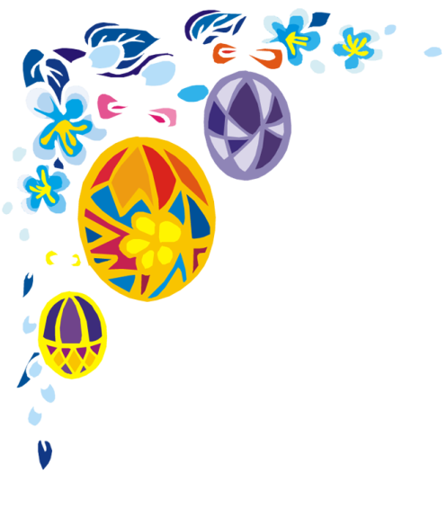
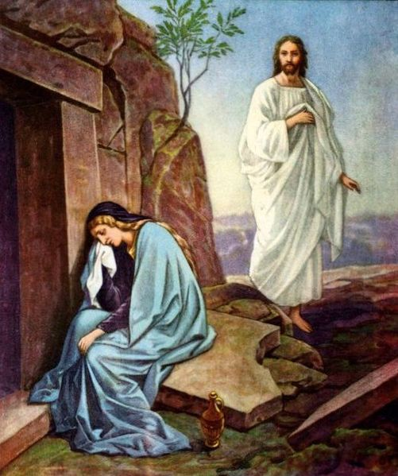
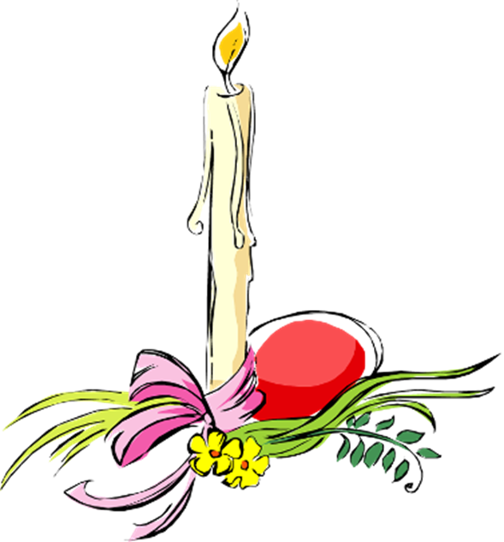
Easter is a holiday in late March or early April, the first Sunday after the first full moon after 21 March. Easter is a moveable feast, meaning it is not fixed in relation to the civil calendar.
According to the Canonical gospels, Jesus
rose from the dead on the third day
after his crucifixion.

Slide 3
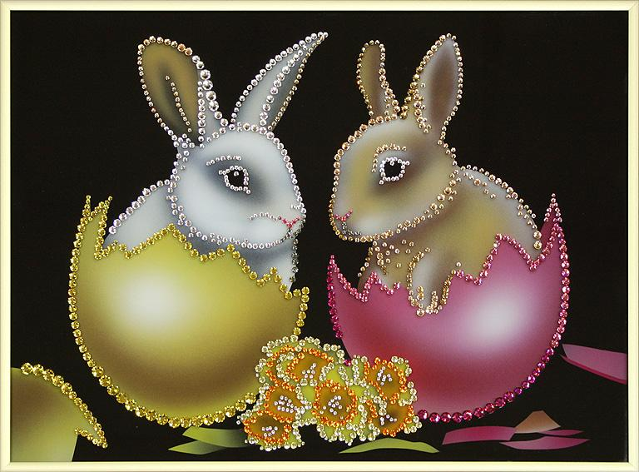
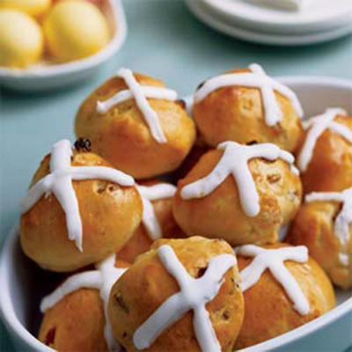
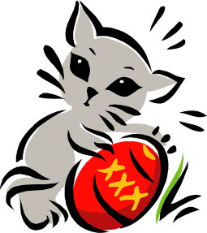
The last Friday before Easter is called
Passionate Friday in Russia and Good Friday in England, commemorating the crucifixion and death of Jesus.
In Russia people cooks kulich and make them consecrated.
In England people treat hot cross buns to each other.

Slide 4
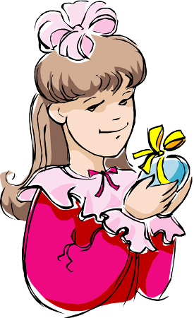
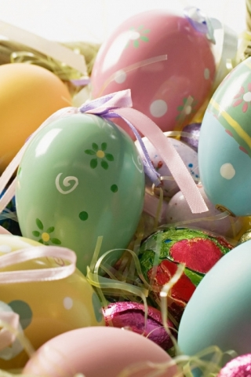
Symbols of Easter:
Easter greeting
Religious service
- Eggs
Easter food
Spring Flowers
Easter Bunny (only in England)

Slide 5
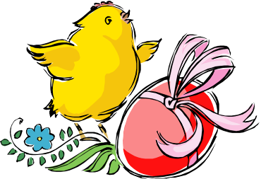
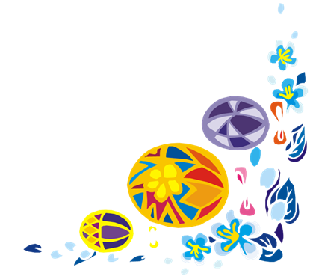
Easter greeting
On the Sunday people usually greet each other with world:
“Jesus rose from the dead! - Has truly revived.” And people should kiss each other three times.

Slide 6
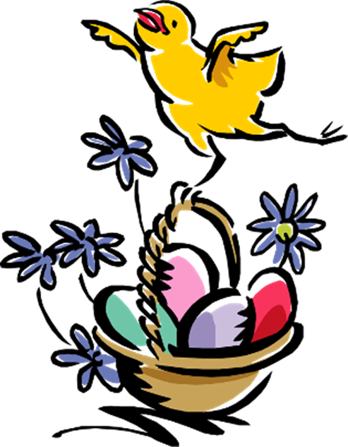
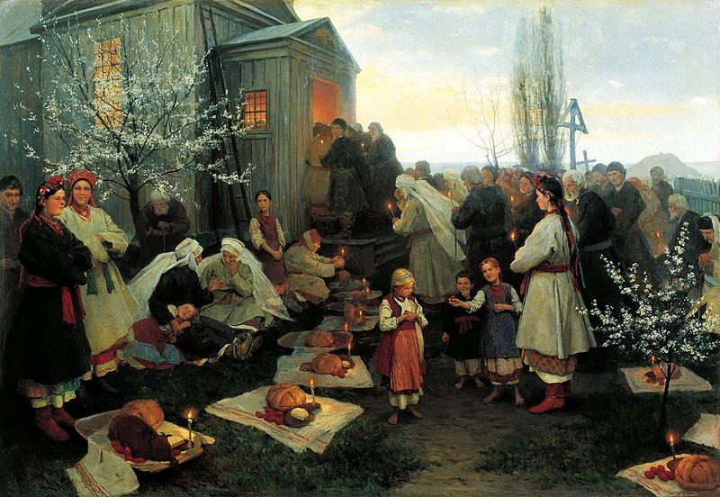
Religious service
There is a special religious service in the churches in Russia and England. English people bring Easter basket to consecrate food from it.
In England religious service is at sunrise.
In Russia religious service is at midnight.

Slide 7
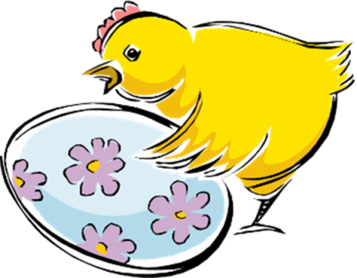
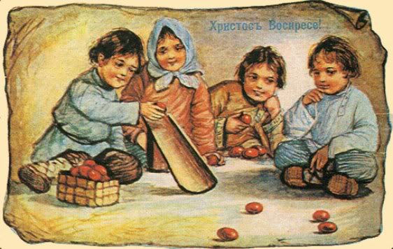
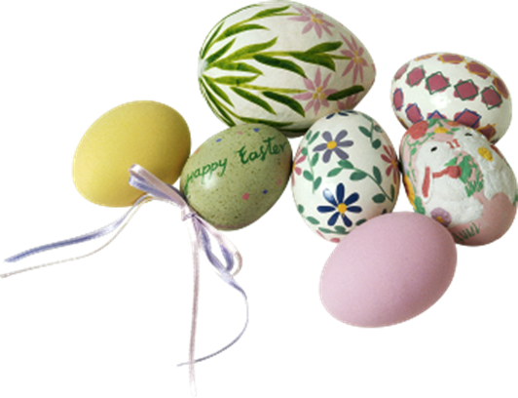
Eggs
On the Easter people traditionally give to each other presents-Easter eggs. Easter egg is the most popular emblem of Easter. In Russia people colour eggs in red. Nowadays in England Easter eggs are usually made of chocolate. Easter egg is the symbol of new life.
Egg-rolling is a traditional Easter pastime which still flourishes in Britain. Unfortunately, Russian children have forgotten this tradition.

Slide 8
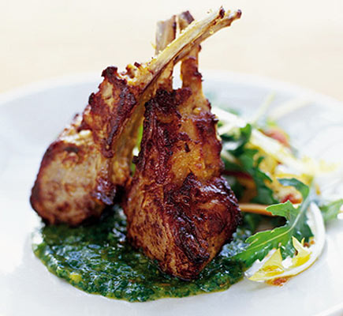
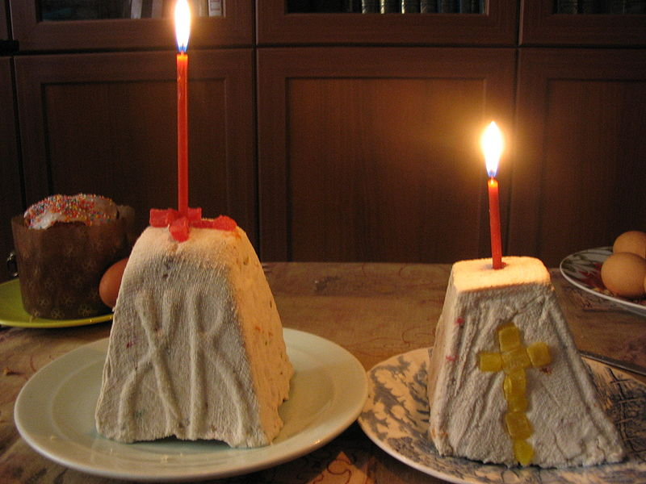
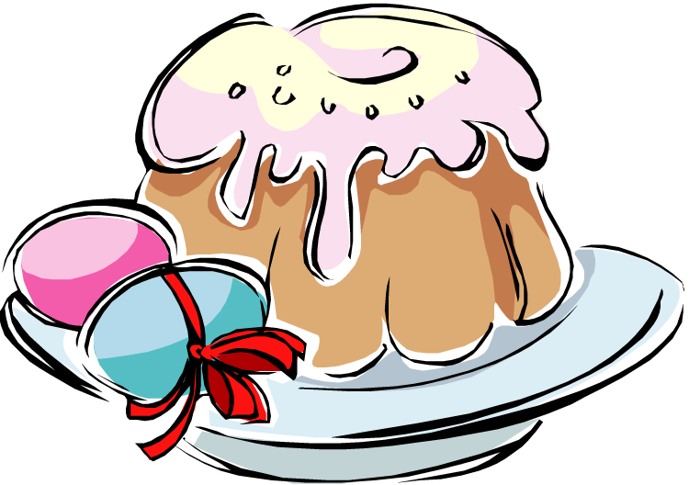
Easter food
In England: The traditional Easter entertainments are meat medovo-garlick quenelles, spring salad. The main Easter dish is a The baked stuffed lamb.
In Russia: The traditional Easter entertainments are kulich, pasha. People start to cook food on a Maundy Thursday.

Slide 9
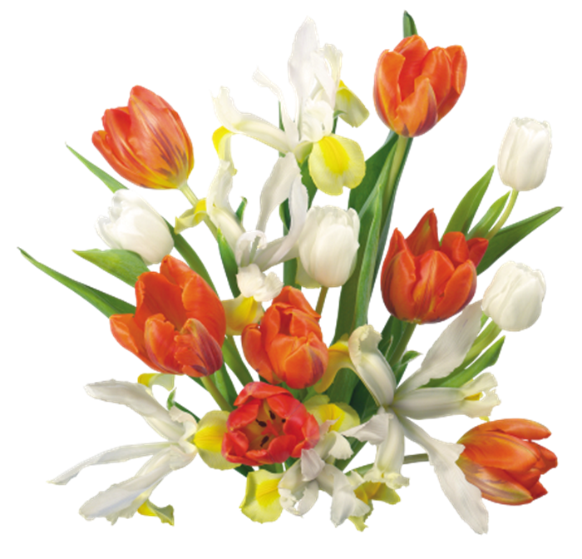
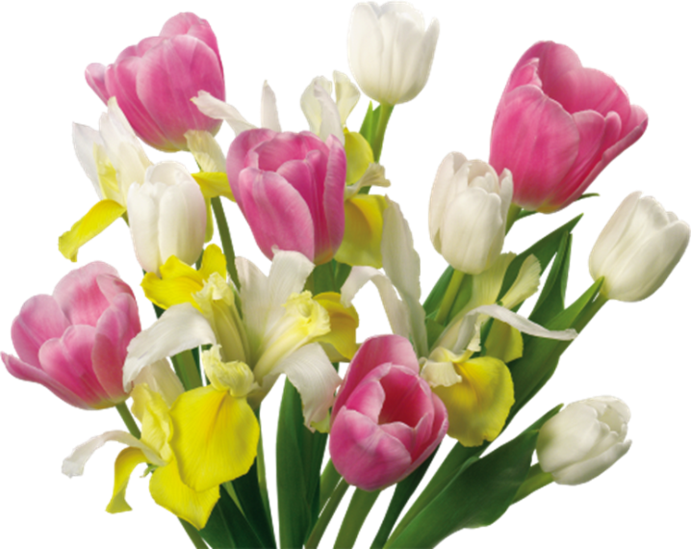
Spring Flowers
Easter it the time of the waiting of spring.
Tulips, narcissuses decorate Russian houses.
In England people decorate churches and their houses with flowers. The main flowers is the snow-white lily. It is the symbol of the hope and motherhood.

Slide 10
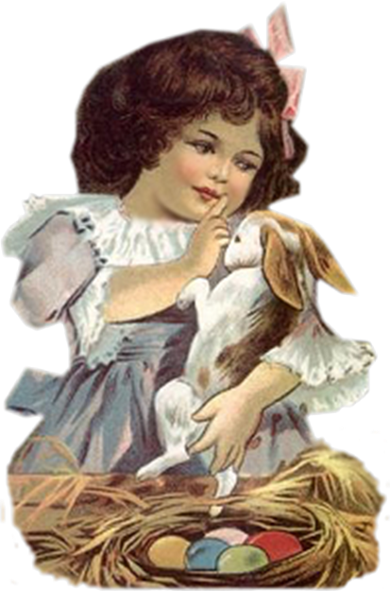
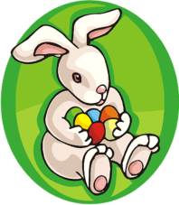
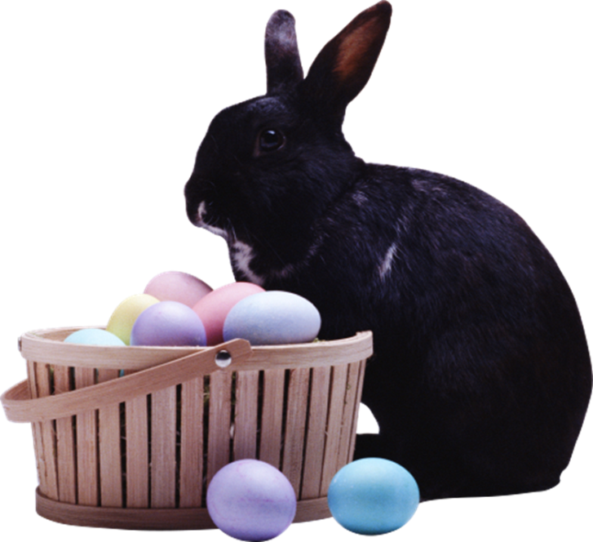
Easter Bunny
The Easter bunny is an imaginary rabbit. Parents tell their children, that he gives them presents. Children look forward to Easter Sunny because Easter Bunny brings them an Easter basket with chocolate eggs and other sweet things. When children wake up, they run about trying to find the eggs.
The Bunny is symbol of fertility and prosperity.

Slide 11
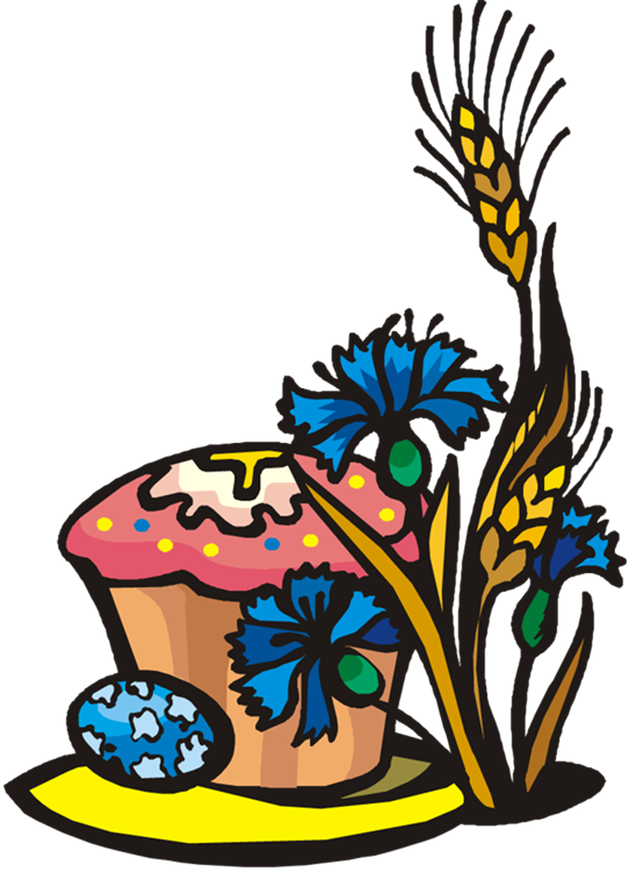
The end

