Slide 1
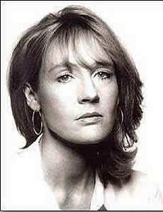
Joanne Rowling

Slide 2
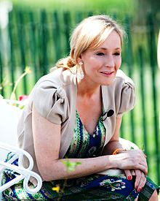
Joanne Rowling
She was born at the 31th of July 1965 in England
Occupation: Novelist
Education: Bachelor of Arts
Alma mater: University of Exeter
Genres: Fantasy
Notable work: Harry Potter series
Children: 2 daughters, 1 son

Slide 3
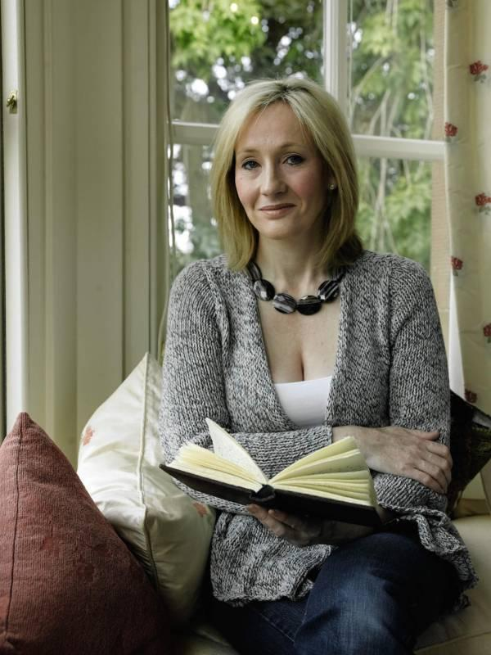
Joanne Rowling was born in Yate, near Bristol, a few miles south of a town called Dursley.

Slide 4
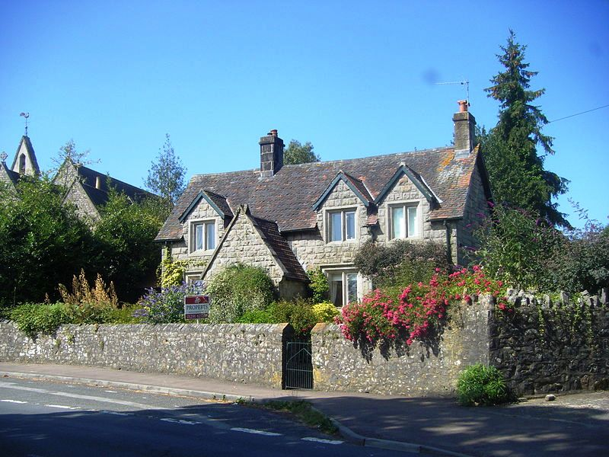
Church Cottage, Tutshill
It is Rowling's childhood home

Slide 5
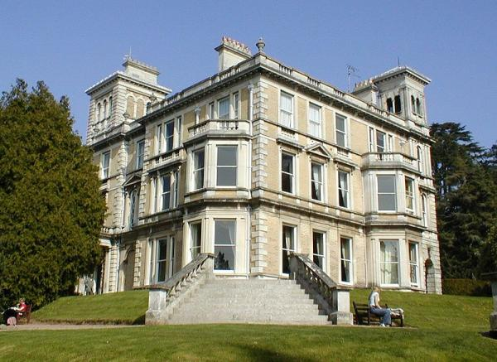
Graduated from Exeter University.

Slide 6
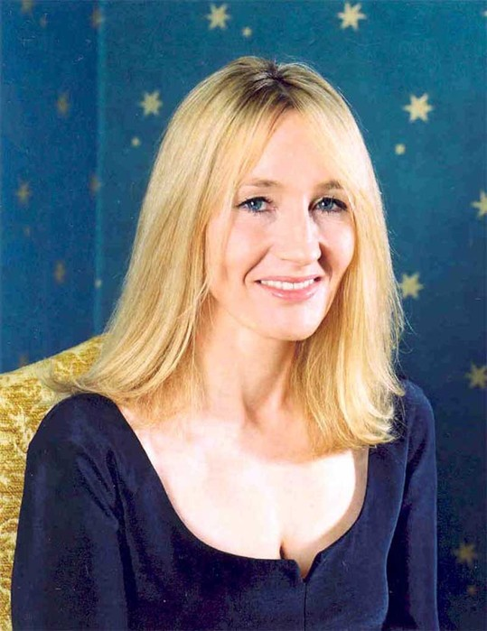
She is a former English teacher.

Slide 7
In 1988, Rowling wrote a short-essay about her time studying Classics entitled "What was the Name of that Nymph Again? or Greek and Roman Studies Recalled", it was published by the University of Exeter's journal Pegasus

Slide 8
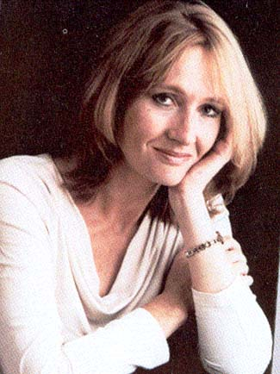
She writes all of her books in longhand, rather than with a computer.

Slide 9
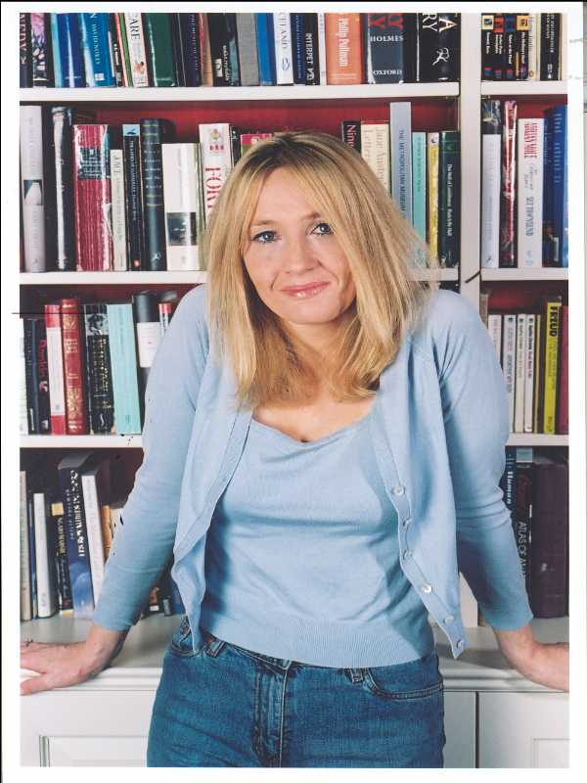
«J.K.R.»
When the first "Harry Potter" novel was published, the publisher asked her to use initials rather than her first name, because boys would be biased against a book written by a woman. Since she only had one given name, they then asked her to make up another initial; she took "K." from her favorite grandmother, Kathleen.

Slide 10
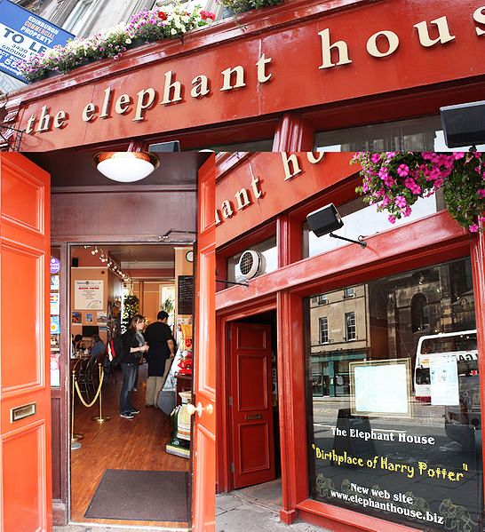
The elephant house
"The Elephant House" – one of the cafés in Edinburgh in which Rowling wrote the first Harry Potter novel

Slide 11
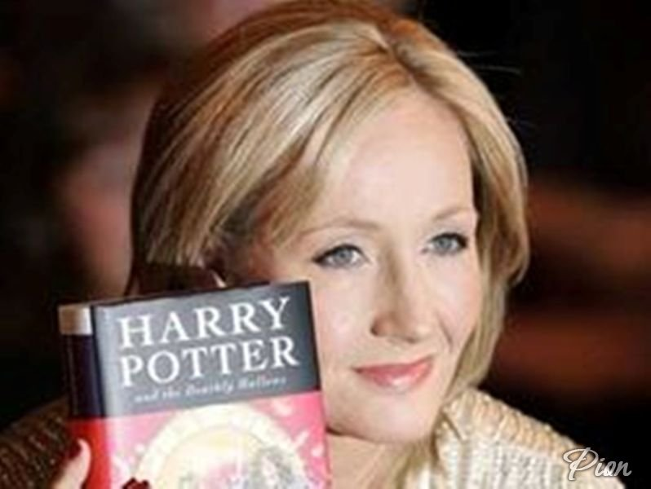
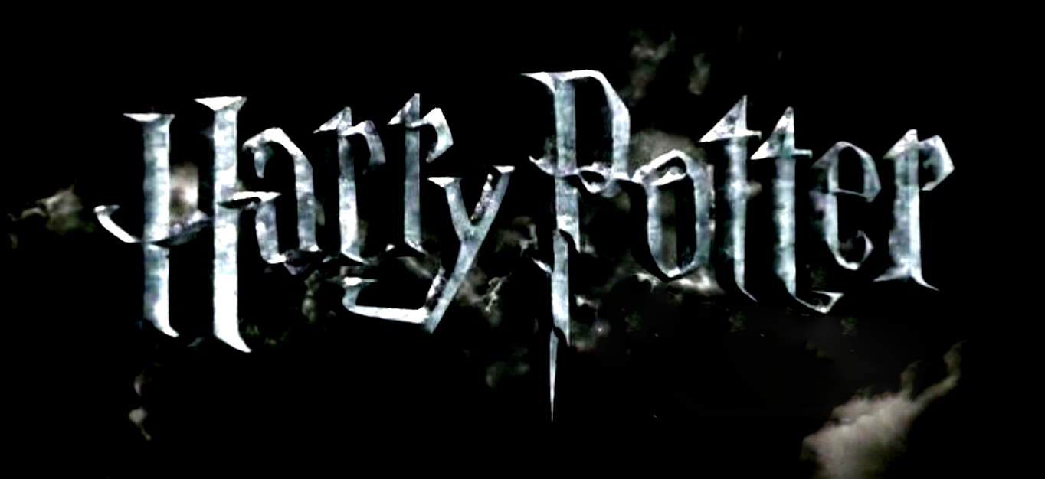
In 1995, Rowling finished her manuscript for Harry Potter and the Philosopher's Stone on an old manual typewriter

Slide 12
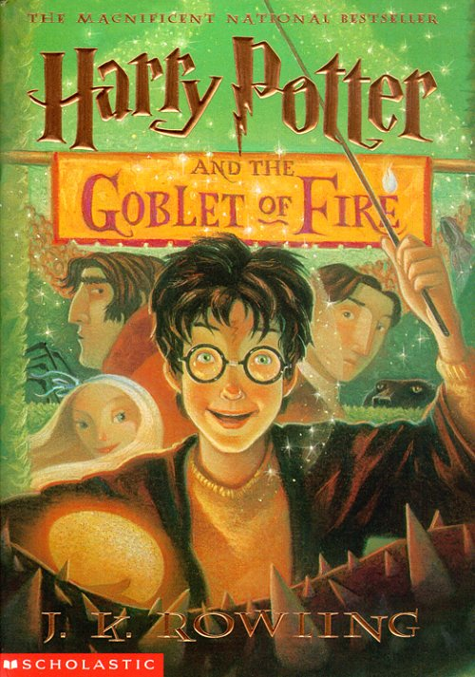
Her book, "Harry Potter and the Goblet of Fire", was the top-selling book of 2000, with 7 million hardcovers sold.

Slide 13
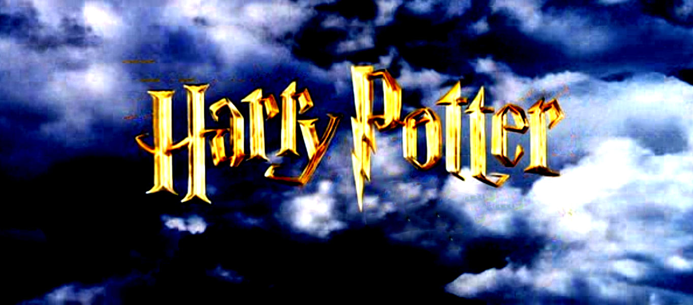
Harry Potter is now a global brand worth an estimated £7 billion ($15 billion)

Slide 14
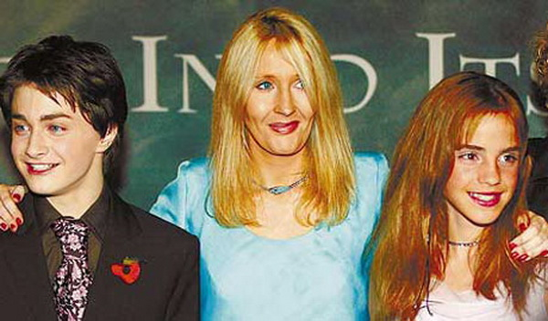
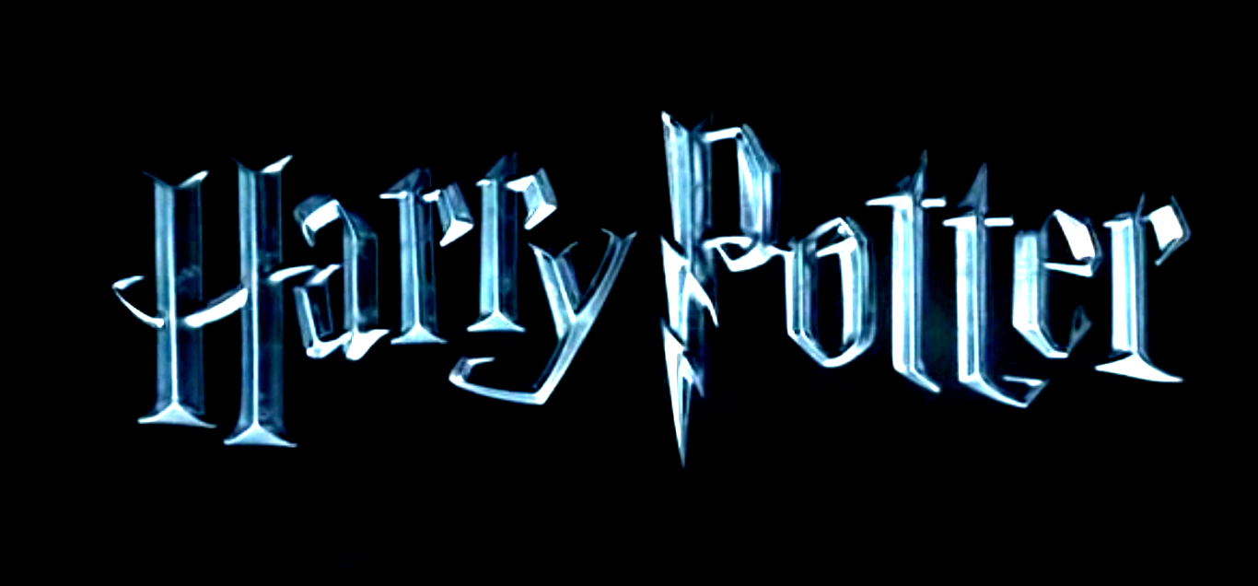
In October 1998, Warner Bros. purchased the film rights to the first two novels for a seven-figure sum

Slide 15
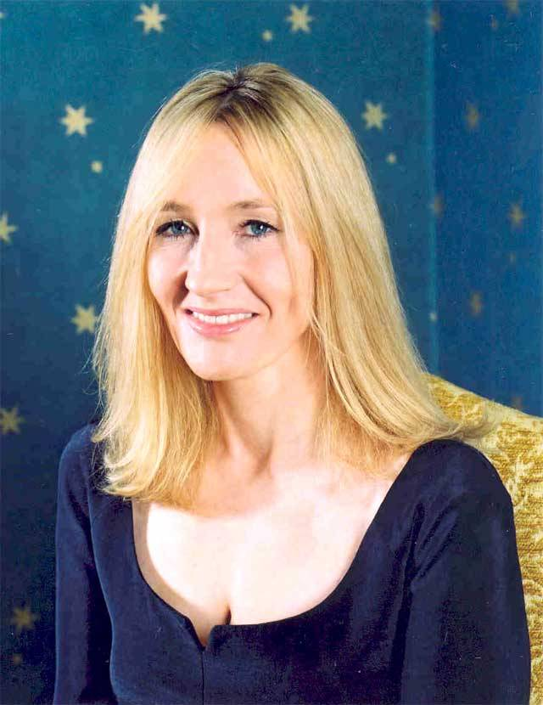
Rowling had gained some creative control on the films, reviewing all the scripts as well as acting as a producer on the final two-part installment, Deathly Hallows

Slide 16
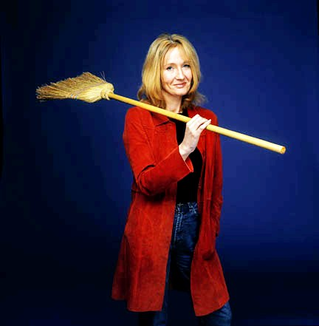
Forbes has named Rowling as the first person to become a U.S.-dollar billionaire by writing books, the second-richest female entertainer and the 1,062nd richest person in the world

Slide 17
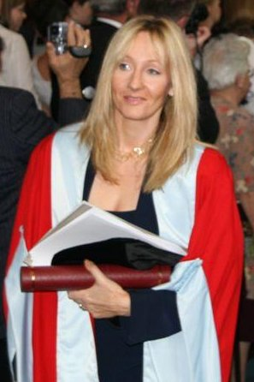
She was awarded the O.B.E. (Officer of the Order of the British Empire) in the 2000 Queen Elizabeth II's Birthday Honors List for her services to literature and received it from one of her fans, Prince Charles, the Prince of Wales.

Slide 18
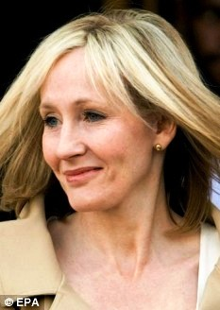
Rowling, once a single parent herself, is now president of the charity Gingerbread (originally One Parent Families)

Slide 19
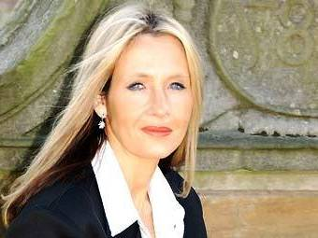
In 2006, Rowling contributed a substantial sum toward the creation of a new Centre for Regenerative Medicine at Edinburgh University

Slide 20
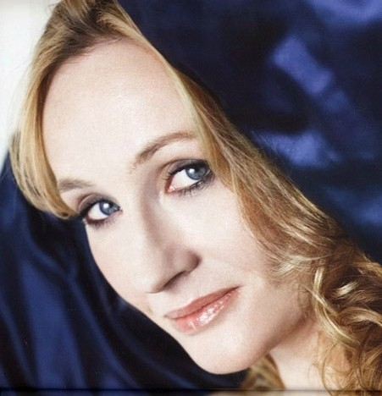
In September 2008, on the eve of the Labour Party Conference, Rowling announced that she had donated £1 million to the Labour Party

Slide 21
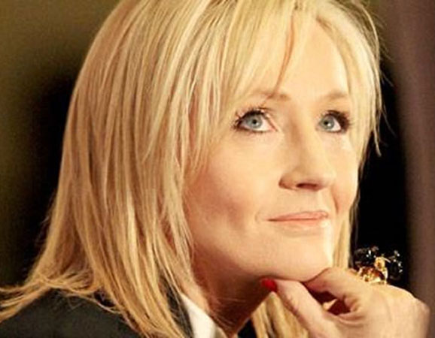
She believes that poor and vulnerable families will fare much better under the Labour Party than they would under a Cameron-led Conservative Party

Slide 22
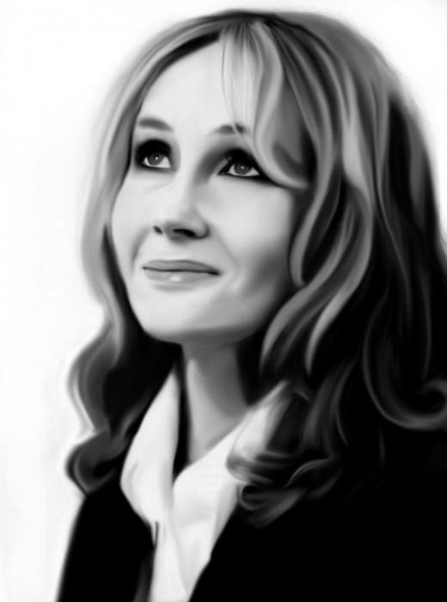
As a resident of Scotland, Rowling is eligible to vote in the 2014 referendum on Scottish independence, and intends to vote in favour of the union

Slide 23
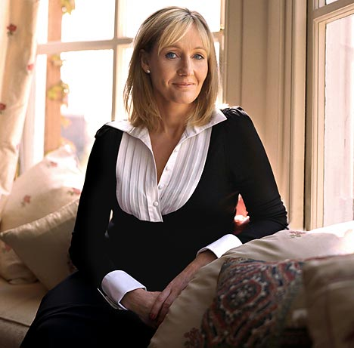
Over the years, some religious people have decried Rowling's books for supposedly promoting witchcraft; however, Rowling identifies as a Christian

Slide 24
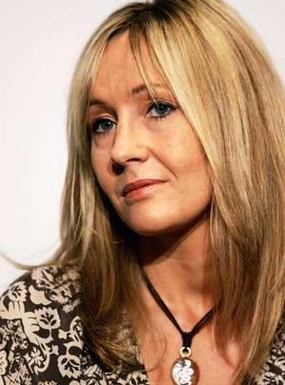
Rowling has received honorary degrees from St Andrews University, the University of Edinburgh, Napier University, the University of Exeter, the University of Aberdeen and Harvard University, for whom she spoke at the 2008 commencement ceremony. In 2009 Rowling was awarded the Légion d'honneur by French President Nicolas Sarkozy

Slide 25
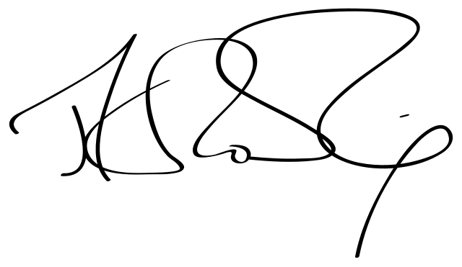
J. K. Rowling’s signature

Slide 26
Tiganova Nadezhda-Anastasiya, Ternovetskaya Anna School №10 Petropavlovsk-Kamchatsky

