Slide 1
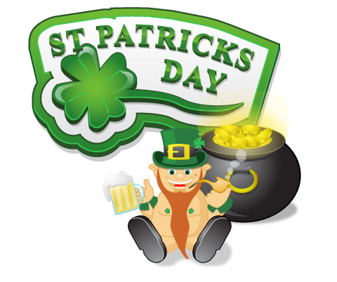
Everyone wants to be Irish on St. Patrick’s Day
Овсянникова Ирина Владимировна, учитель английского языка, МОУ «СОШ №83», г. Северска, Томской области

Slide 2
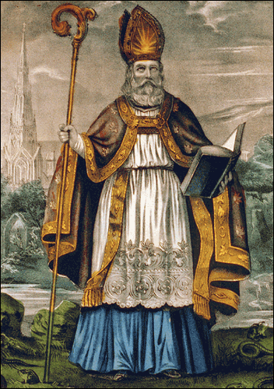
Saint Patrick's Day is a religious holiday celebrated internationally on 17 March. It commemorates Saint Patrick (c. AD 387–461), the most commonly recognised of the patron saints of Ireland.

Slide 3
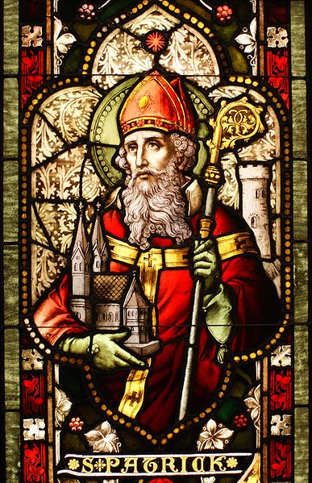
Sacred Patrick, under the legend, has relieved Ireland of paganism and has made Christian, and also has expelled from island of snakes. For Irish it is a holiday of pleasure, fun and coming spring.

Slide 4
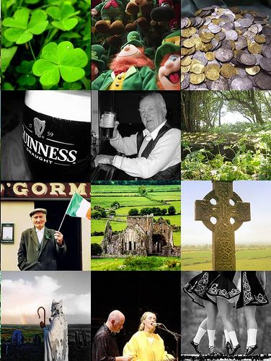
Saint Patrick's Day was made an official feast day in the early 17th century, and has gradually become a secular celebration of Irish culture in general.

Slide 5
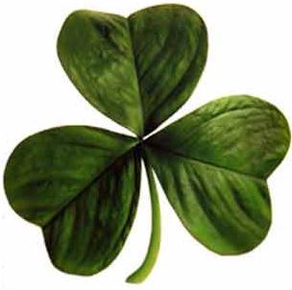
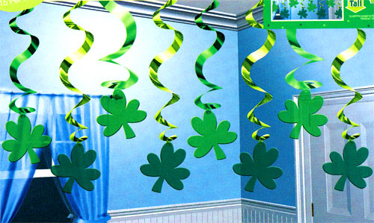
Saint Patrick's day associated with green colour. Green ribbons and shamrocks were worn in celebration of St Patrick's Day as early as the 17th century. The phrase "the wearing of the green", meaning to wear a shamrock on one's clothing.

Slide 6
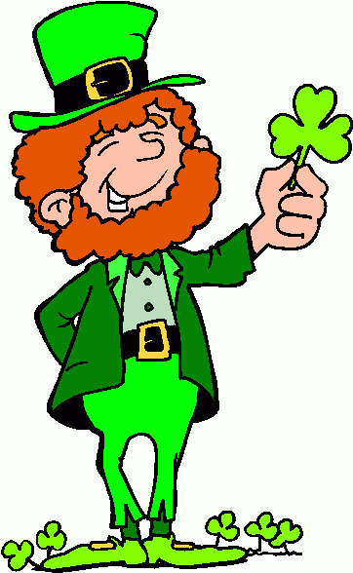
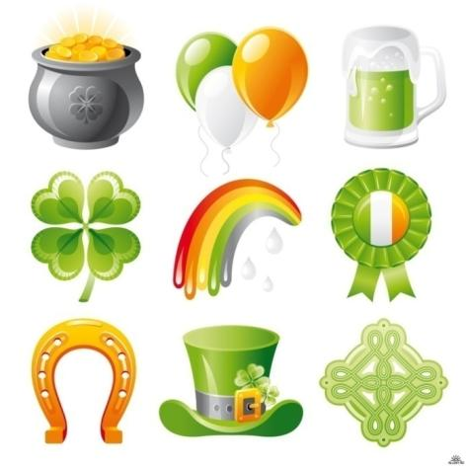
So the symbols of this day are the Shamrock, Snake and Leprechaun.

Slide 7
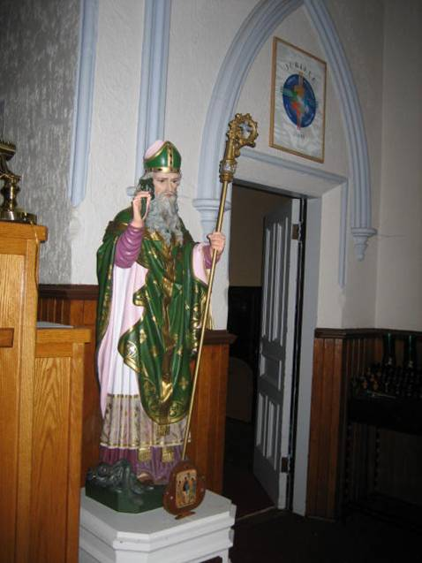
Traditionally Irish families wear green and attend church in the morning.

Slide 8
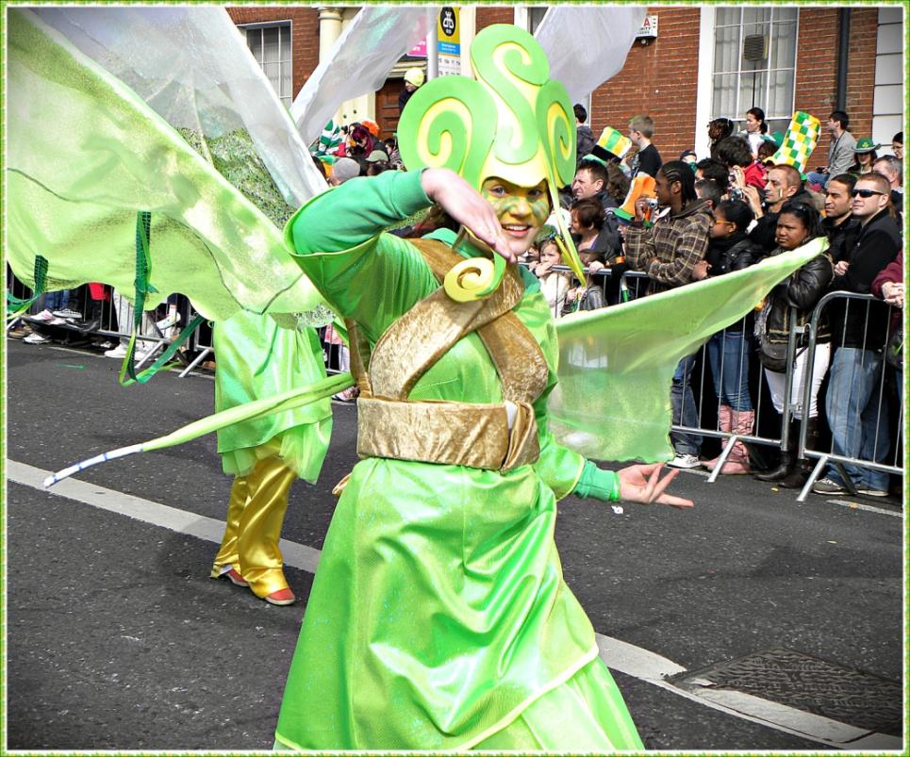
In the afternoon they take part in a festival. The first Saint Patrick's Festival was held on 17 March 1996.

Slide 9
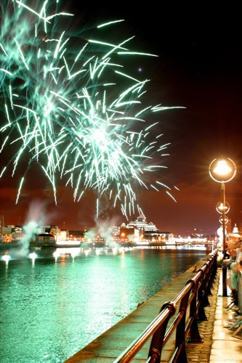
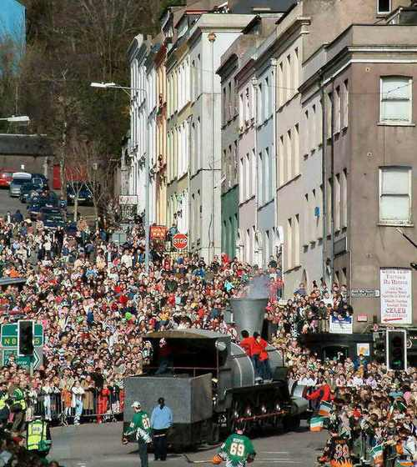
Overall 2009's five day festival saw close to 1 million visitors, who took part in festivities that included concerts, outdoor theatre performances, and fireworks.

Slide 10
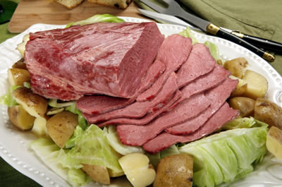
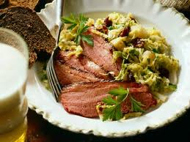
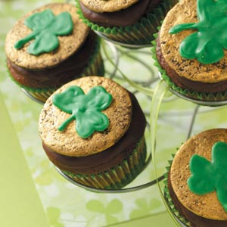
Traditional meal is Irish bacon and cabbage.

Slide 11
It is also widely celebrated by the Irish diaspora, especially in places such as Great Britain, Canada, the United States, Argentina, Australia, and New Zealand, among others.

Slide 12
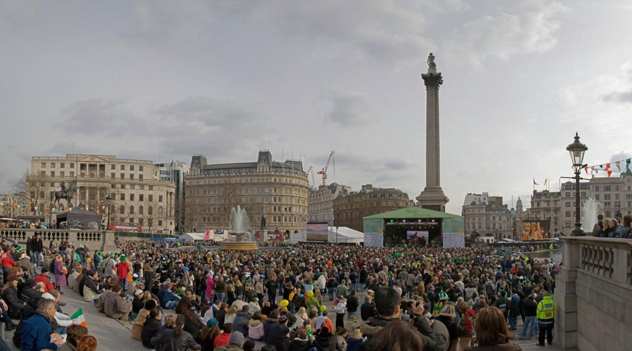
Great Britain
In Great Britain, Queen Mother used to present bowls of shamrock flown over from Ireland to members of the Irish Guards. The Irish Guards still wear shamrock on this day, flown in from Ireland.

Slide 13
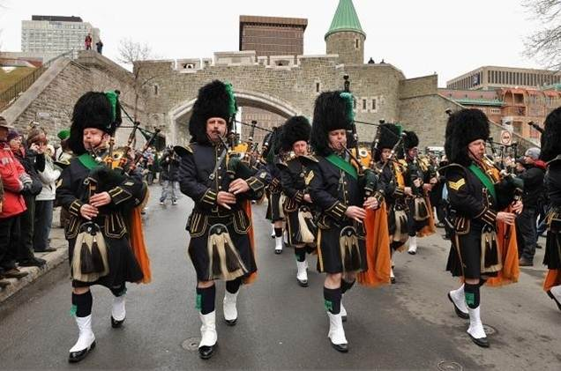
Canada
The longest-running Saint Patrick's Day parade in North America occurs each year in Montreal, the flag of which has a shamrock in one of its corners. The parades have been held in continuity since 1824.

Slide 14
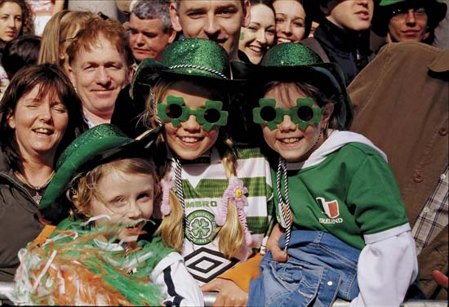
Argentina
In Argentina all-night long parties are celebrated in designated streets. People dance and drink only beer throughout the night, until seven or eight in the morning. Many people wear something green.

Slide 15
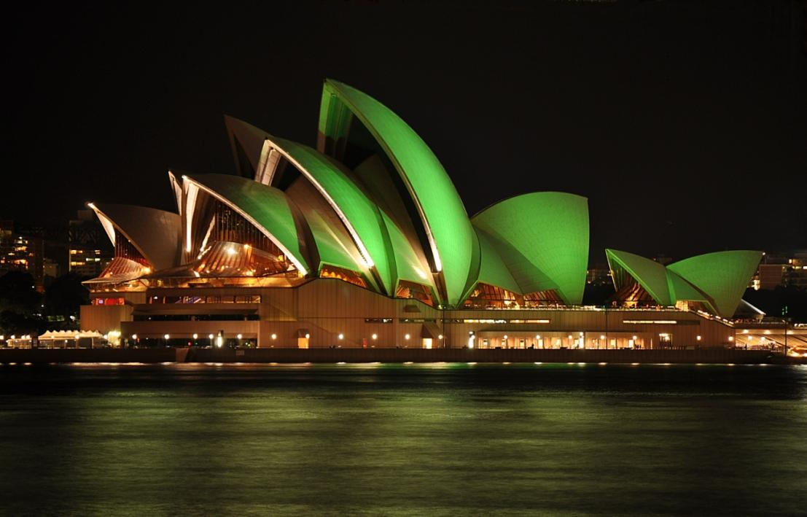
New Zealand and Australia
Saint Patrick's Day is widely celebrated in these countries - green items of clothing are traditionally worn and the streets are often filled with revellers drinking and making merry from early afternoon until late at night.

Slide 16
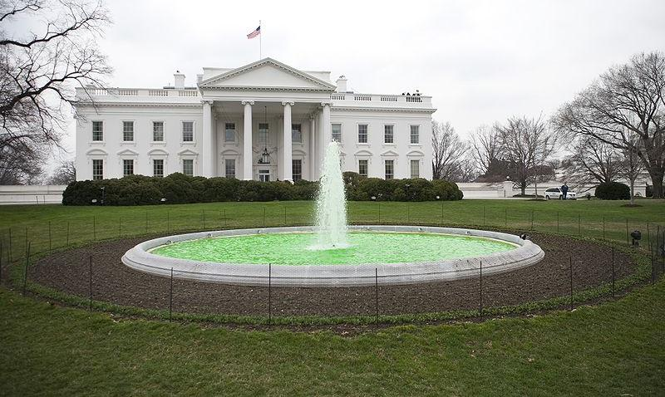
The United States
In every year March has been proclaimed Irish-American Heritage Month by the US Congress or President due to the date of St. Patrick's Day.

Slide 17
Saint Patrick's Day is widely celebrated in America by Irish and non-Irish alike. For most Irish-Americans, this holiday is both religious and festive.

Slide 18
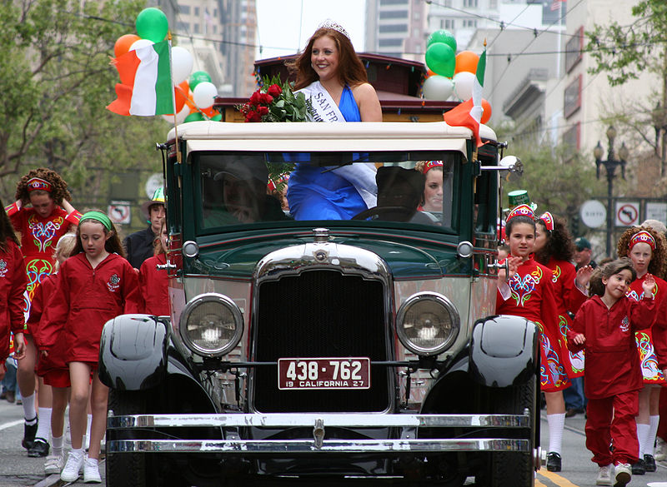
St. Patrick's Day church services are followed by parades and parties, Irish music, songs, and dances.

Slide 19
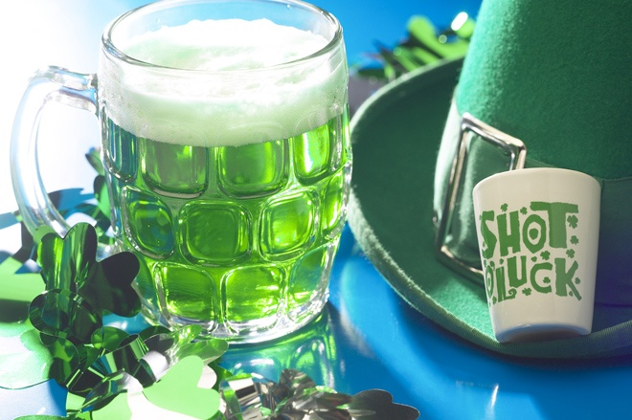
It is one of the leading days for consumption of alcohol in the United States, as individuals are allowed to break their Lenten sacrifices for the day in order to celebrate Saint Patrick's Day.

Slide 20
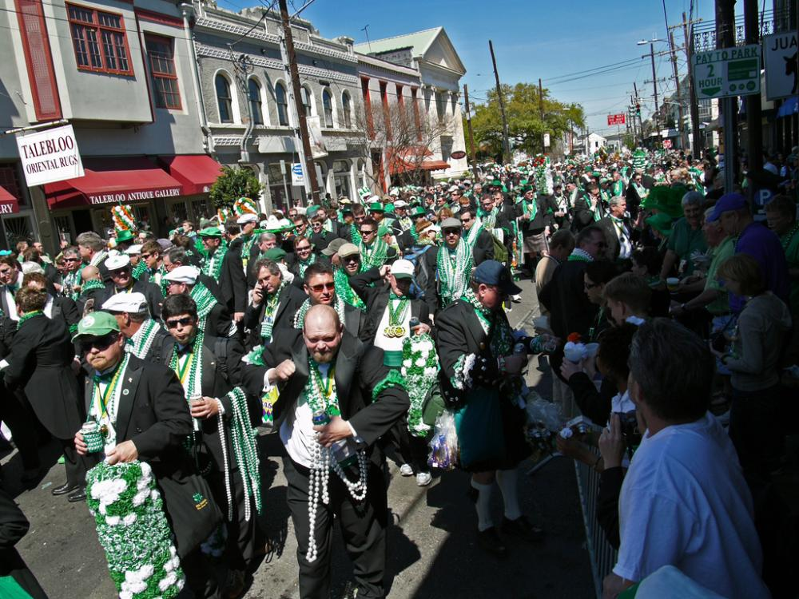
Many people choose to wear green coloured clothing and items. Traditionally, those who are caught not wearing green are pinched affectionately.

Slide 22
Resources
http://www.slideshare.net/indezine_powerpoint/st-patricks-day-256214
http://en.wikipedia.org/wiki/Apple_Day
Image resources
http://upload.wikimedia.org/wikipedia/commons/8/86/Saint_Patrick_%28window%29.jpg
http://www.catholiclibrary.ie/images/small_patrick.jpg
http://upload.wikimedia.org/wikipedia/commons/0/0c/Irish_clover.jpg
http://upload.wikimedia.org/wikipedia/commons/6/69/Quebecstpatrickparade.jpg
http://upload.wikimedia.org/wikipedia/commons/c/c7/Happy_Saint_Patrick%27s_Day_2010%2C_Dublin%2C_Ireland%2C_the_green_luck%2C_the_green_love%2C.jpg
http://upload.wikimedia.org/wikipedia/commons/d/d6/St_Patrick%27s_Day_-_Trafalgar_Square_March_2006.jpg
http://upload.wikimedia.org/wikipedia/commons/4/49/Sydney_Opera_House_St_Patricks_2010a.jpg
http://upload.wikimedia.org/wikipedia/commons/e/e3/Green_Fountain_at_White_House_on_St_Patricks_Day%2C_2009.jpg
http://upload.wikimedia.org/wikipedia/commons/2/20/PostcardStPatricksDaySouvinir1912.jpg
http://upload.wikimedia.org/wikipedia/commons/d/dd/Chicago_River_dyed_green%2C_buildings_more_prominent.jpg
http://upload.wikimedia.org/wikipedia/commons/b/b3/St_Pattys_New_Orleans_-_sea_of_green_03.jpg
http://holidaypromos.files.wordpress.com/2008/03/stpatrickb.jpg?w=500

Slide 23
http://www.tahminkazan.com/?fdf=st-patty's-pictures-U1MNxxQkD/I/IE9WLSFfMXOxyNYIEOYNqdt7lWwf9azkjHJWq5m2jwj_87a4_RBxfhZesJYiiIrqOpkTgoIO9HD3JvXC0VGslccXX0HxtPRy1aTamNamS62ndFrQZg==geg.jpg
http://www.thegardenhelper.com/pixpg/graphics/shamrock.JPG
http://howsweetthesound.typepad.com/.a/6a00e550d89fd9883401310fac8b5d970c-600wi
http://blog.vegas.com/wp-content/uploads/2011/02/st_patricks_day.jpg
http://party-supplies-mall.com/st-patricks-day/st-patricks-day-7.jpg
http://www.360blog.org/wp-content/uploads/2009/03/staptricks2.jpg
http://www.polosaty.ru/upload/20101230/im1268948297025940689.jpg
http://www.stpatrickschurchrestorationfund.com/wp-content/uploads/2010/03/Statue-of-St.-Patrick.jpg
http://29.media.tumblr.com/tumblr_kzffio4BAe1qbqy70o1_400.jpg
http://upload.wikimedia.org/wikipedia/commons/f/f1/Ireland-St_Patrick.jpg
http://0.tqn.com/d/paganwiccan/1/0/o/2/-/-/StPattySnakes.JPG
http://www.wrcoc.org/uploads/posts/2010-03/1268611593_1268602016_st.-patrick.jpg
http://www.disputeresolutioncounsel.com/wp-content/uploads/2011/03/CornedBeefCabbage.jpg
http://hostedmedia.reimanpub.com/TOH/Images/Photos/37/exps45618_FF1450927D02_26_5b.jpg
http://www.reluctantgourmet.com/images/corned_beef_cabbage_recipe.jpg
http://www.alighthouse.com/lepclovertop.jpg

